Slide 1



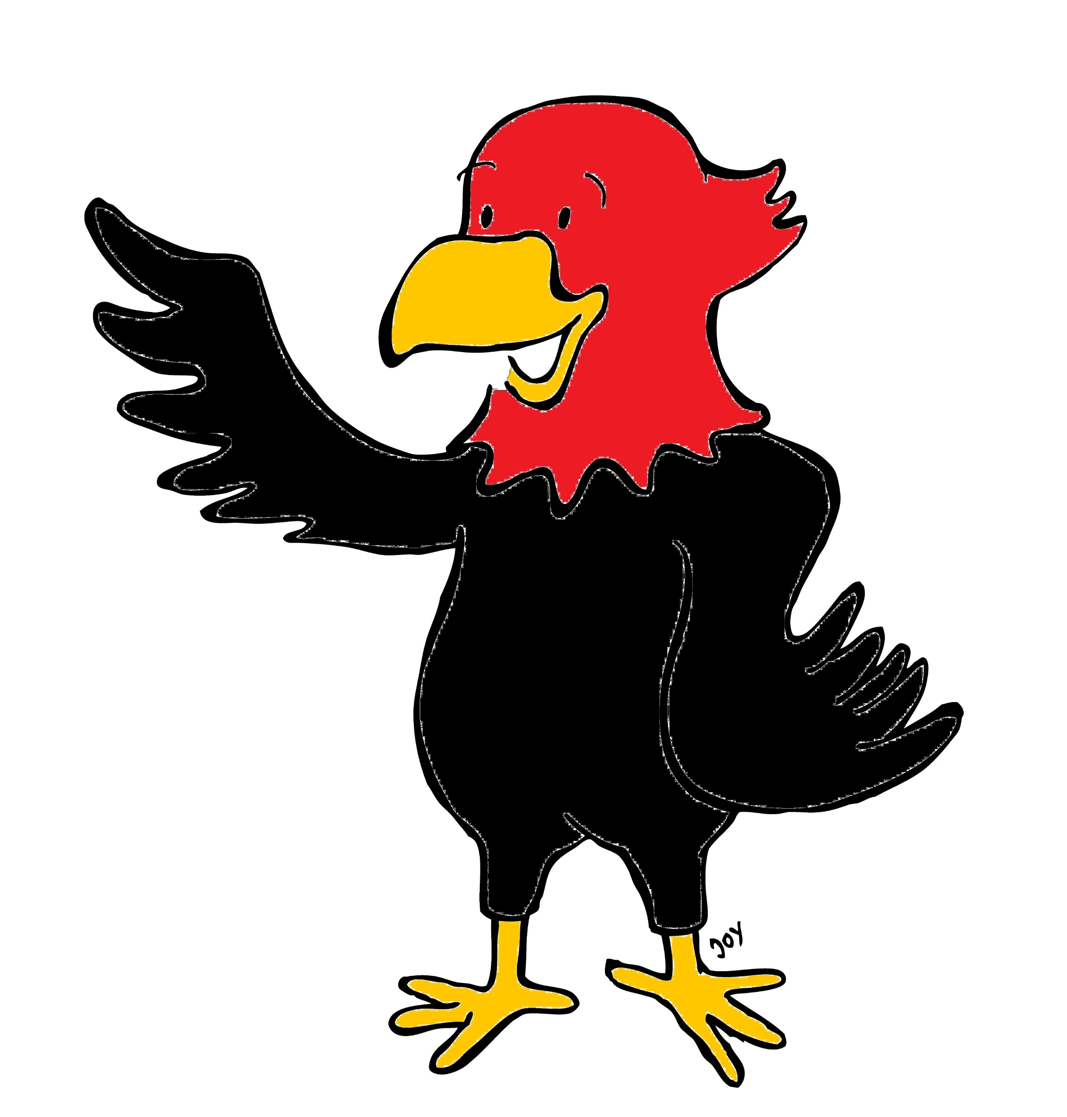


GET Buddied Up
German with Ali, the Eagle
get-across-borders@uni-mainz.de
© 2020 - GET Across Borders

Slide 2
Deutsch lernen mit Ali, unserem Adler
Sigrid Rieuwerts get-across-borders@uni-mainz.de

Slide 3
Willkommen!
Today we are going to learn how to…
…ask for the number of something.
…give the number.
Heute lernen wir…
…nach der Anzahl von etwas zu fragen.
…die Anzahl anzugeben.
© GET Across Borders

Slide 4

Die Zahlen – The numbers
0 null zero
eins one
zwei two
drei three
vier four
fünf five
sechs six
sieben seven
acht eight
neun nine
zehn ten
© GET Across Borders

Slide 5
Achtung: Schwierig!
When counting, you put the number in front of the word, like in English.
zwei Hunde
vier Katzen
BUT:
If you have only one, it is “eine” for nouns that go with the article “die”, for all others it’s “ein”.
die Katze – eine Katze
der Hund – ein Hund
das Haus – ein Haus
© GET Across Borders
Notes:
Note to teacher: If you think, this might be too complex for the students, you can leave this slide out.

Slide 6

Wie viele Schiffe? = How many ships?
©Pixabay
© GET Across Borders

Slide 7
Fünf Schiffe!
©Pixabay
© GET Across Borders

Slide 8

Wie viele Frösche? = How many frogs?
©Pixabay
© GET Across Borders

Slide 9
Drei Frösche!
©Pixabay
© GET Across Borders

Slide 10

Wie viele Wale? = How many whales?
©Pixabay
© GET Across Borders

Slide 11
Zwei Wale!
©Pixabay
© GET Across Borders

Slide 12
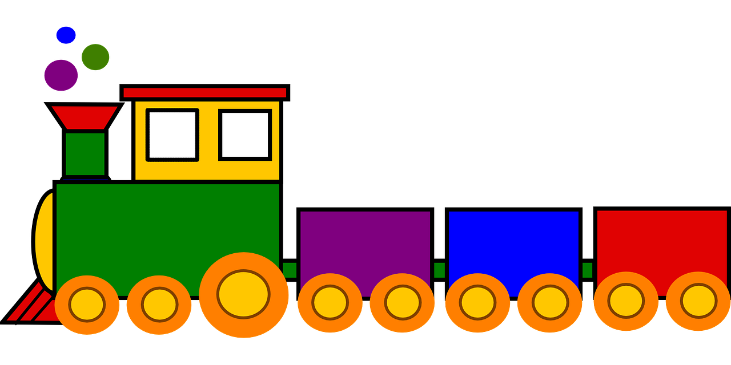
Wie viele Züge? = How many trains?
©Pixabay
© GET Across Borders

Slide 13
Sechs Züge!
©Pixabay
© GET Across Borders

Slide 14

Wie viele Schmetterlinge?
How many butterflies?
©Pixabay
© GET Across Borders

Slide 15
Vier Schmetterlinge!
©Pixabay
© GET Across Borders

Slide 16
Wie viele Adler? = How many eagles?
(der Adler)
© GET Across Borders

Slide 17
Ein Adler!
© GET Across Borders

Slide 18
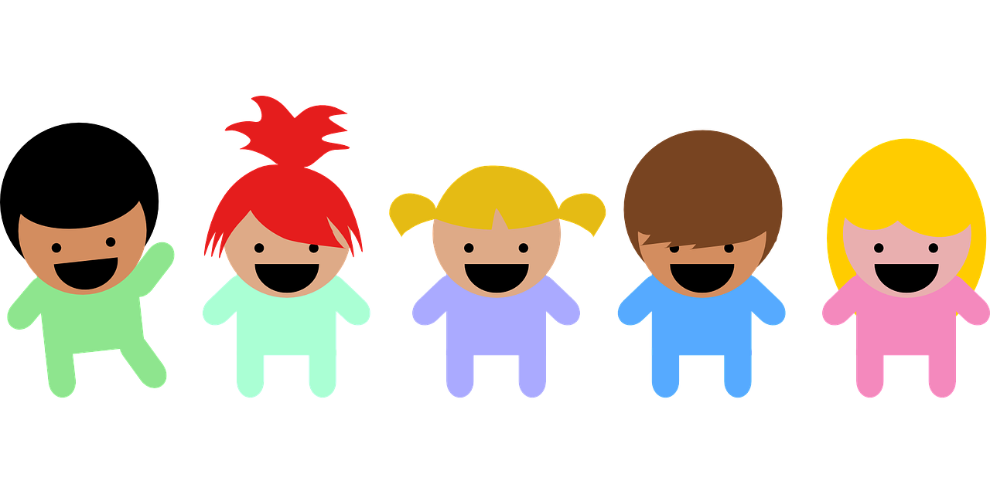
Wie viele Kinder? = How many children?
©Pixabay
© GET Across Borders

Slide 19
Fünf Kinder!
©Pixabay
© GET Across Borders

Slide 20
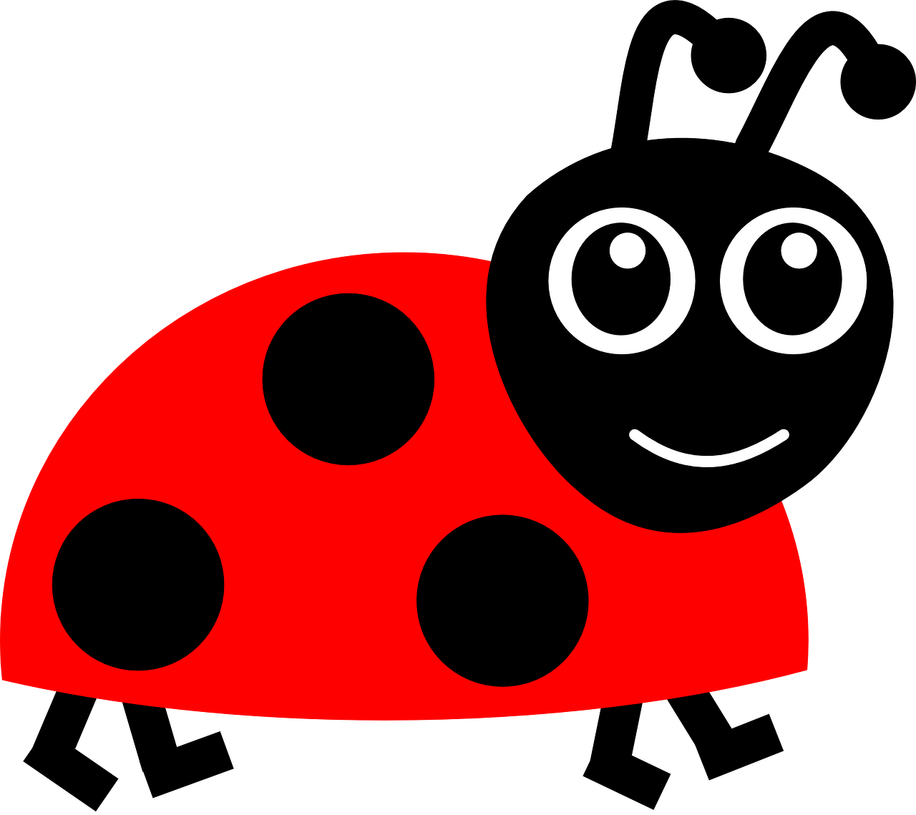
Wie viele Käfer? = How many beetles?
©Pixabay
© GET Across Borders

Slide 21
Sieben Käfer!
©Pixabay
© GET Across Borders

Slide 22

Wie viele Ballons? = How many balloons?
©Pixabay
© GET Across Borders

Slide 23
Acht Ballons!
©Pixabay
© GET Across Borders

Slide 24
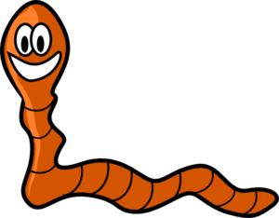
Wie viele Würmer? = How many worms?
©Pixabay
© GET Across Borders

Slide 25
Zehn Würmer!
©Pixabay
© GET Across Borders

Slide 26
Sources
Slide 8&9: https://pixabay.com/de/vectors/frog-amphibien-tier-gr%C3%BCn-gl%C3%BCcklich-152631/
Slide 10&11: https://pixabay.com/de/vectors/wal-meer-wasser-fisch-schwimmen-4788690/
Slide 12&13: https://pixabay.com/de/vectors/zug-spielzeug-bunte-lokomotive-308471/
Slide 14&15: https://pixabay.com/de/vectors/schmetterlinge-roter-schmetterling-1948441/
Slide 18&19: https://pixabay.com/de/vectors/kleinkinder-babys-kinder-303904/
Slide 20&21: https://pixabay.com/de/vectors/marienk%C3%A4fer-insekt-gl%C3%BCck-rot-297875/
© GET Across Borders

Slide 27
Sources
Slide 22&23: https://pixabay.com/de/vectors/luftballons-feier-rot-orange-146682/
Slide 24&25: https://pixabay.com/de/vectors/regenwurm-wurm-niedlich-gl%C3%BCcklich-151033/
© GET Across Borders

Slide 28
Thank you for learning German with us! ☺
DISCLAIMER: Please note that any resources uploaded to this website are purely for educational purposes only. If any of the items, photos or texts uploaded are in infringement of copyright then please do not hesitate to contact us and we will have them removed.
© 2020 – GET Across Borders and © Leap4Joy

