Slide 1



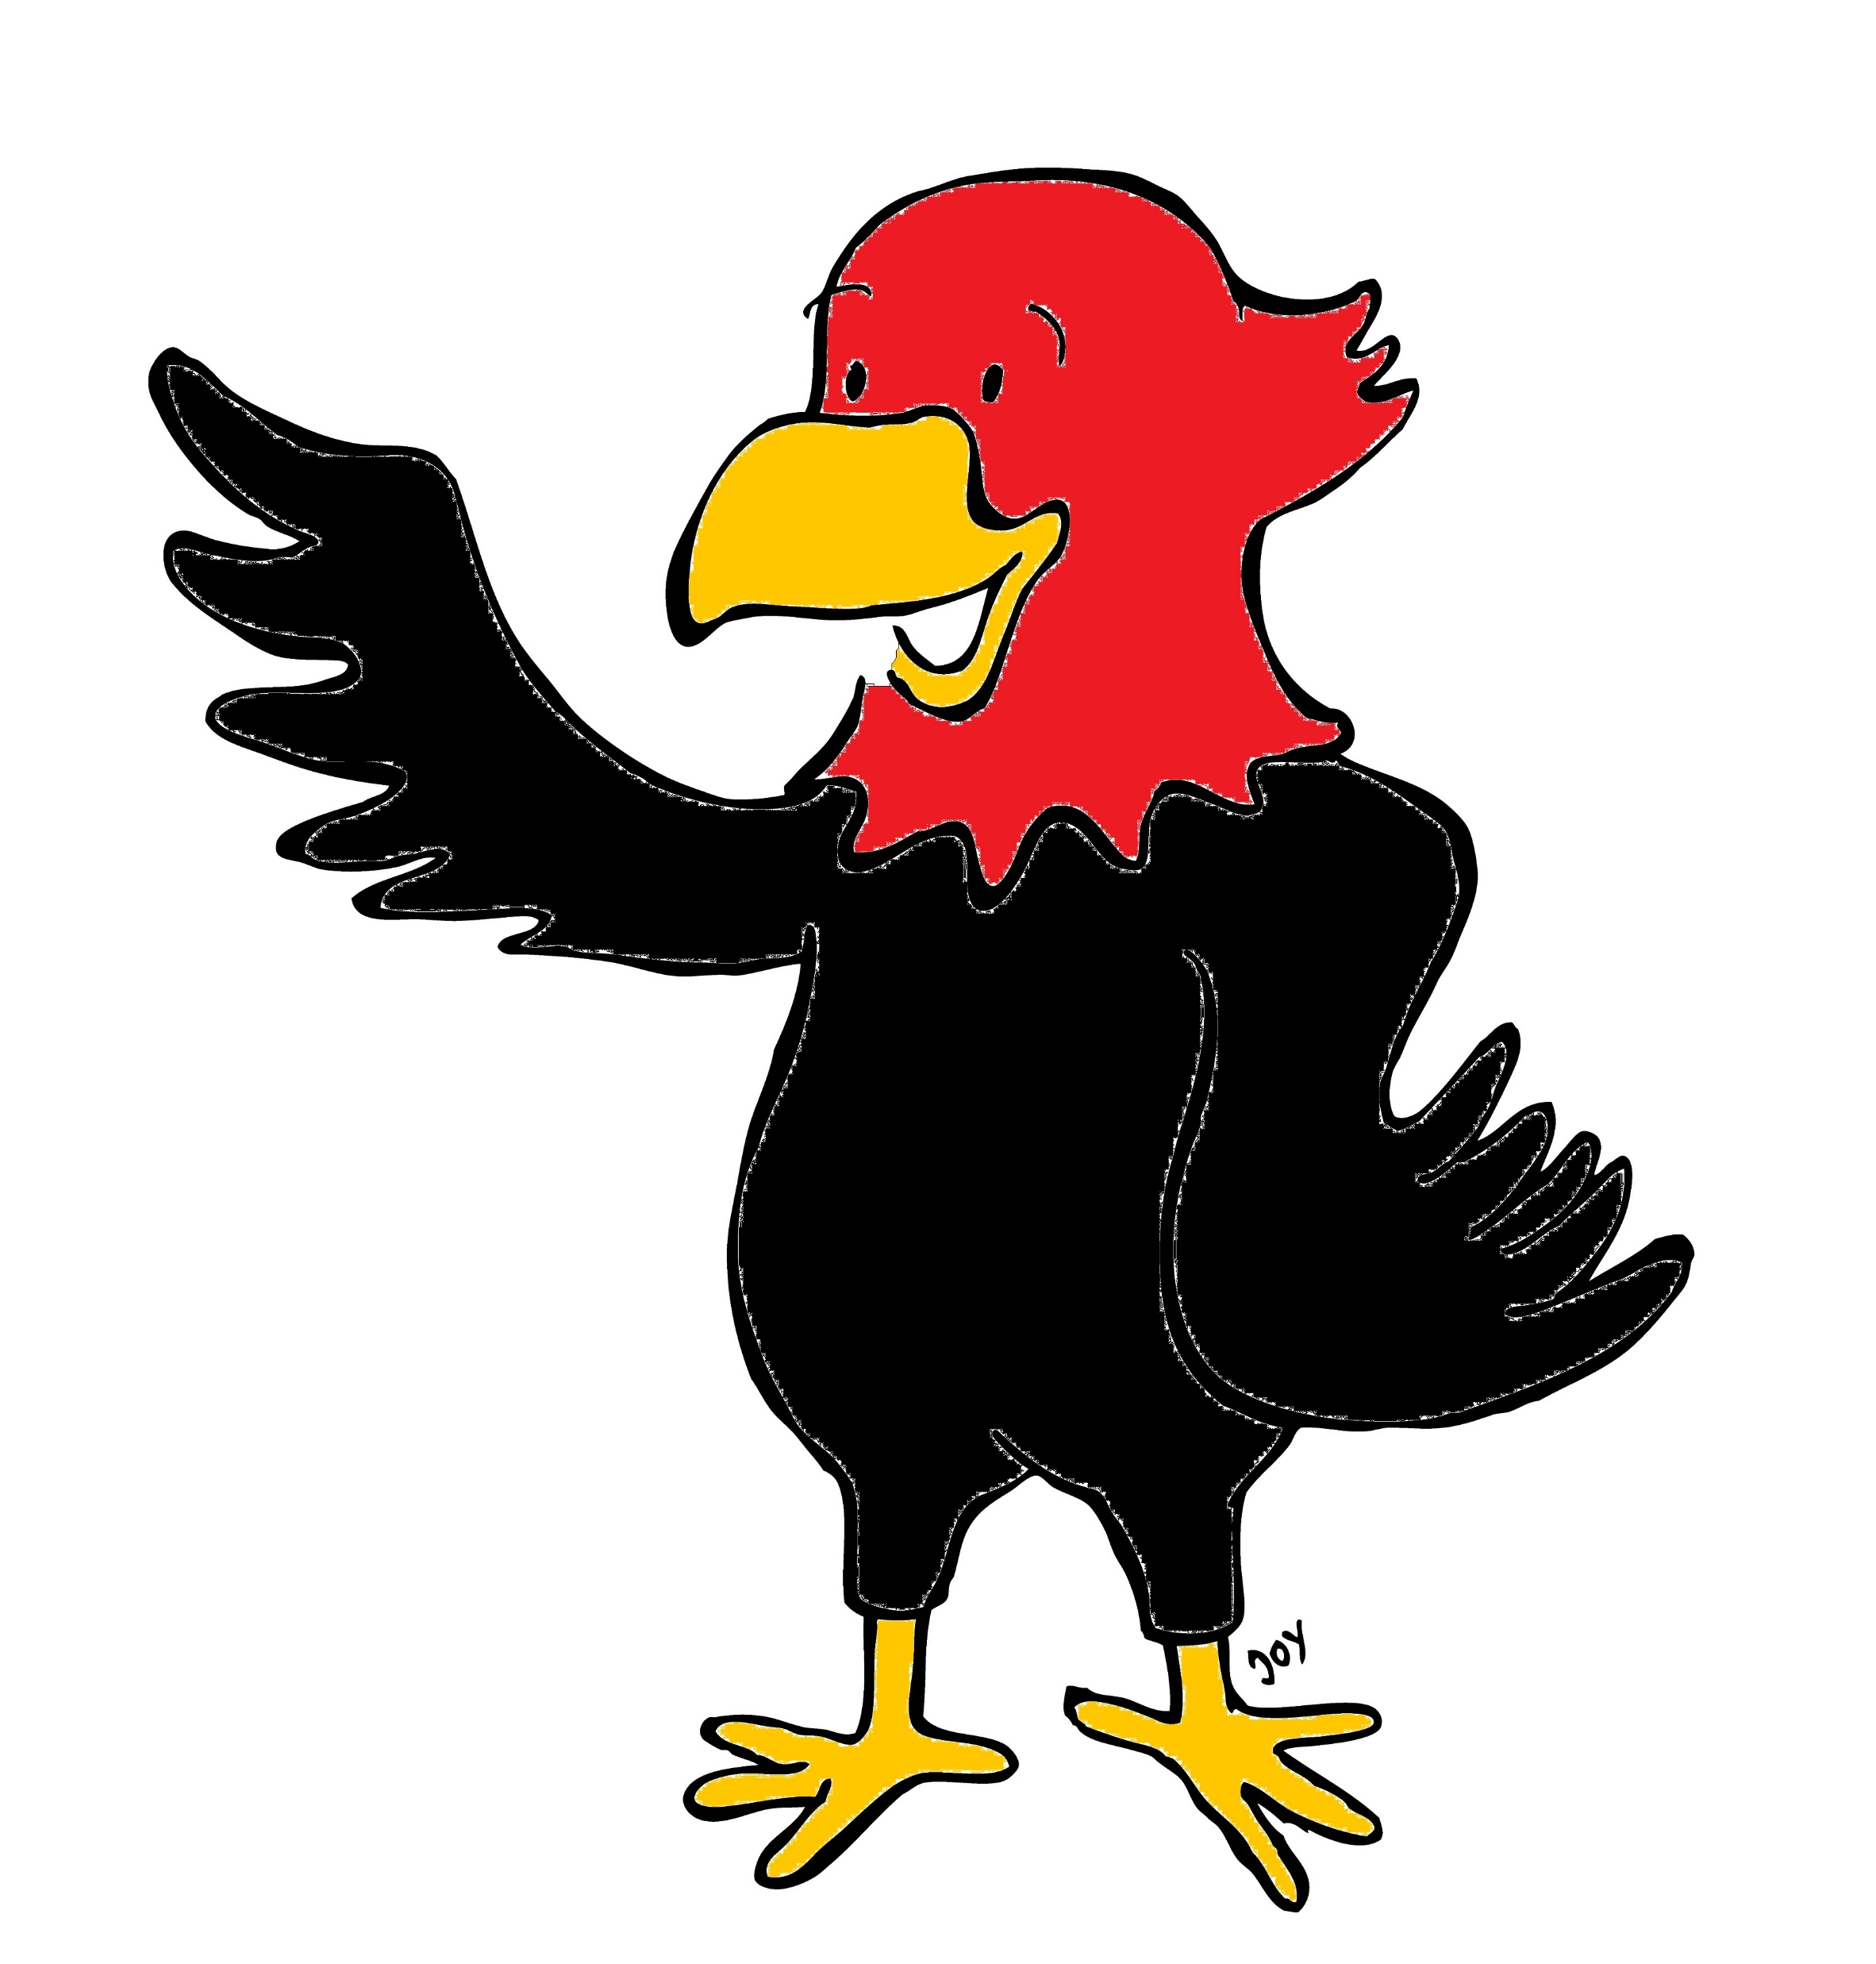

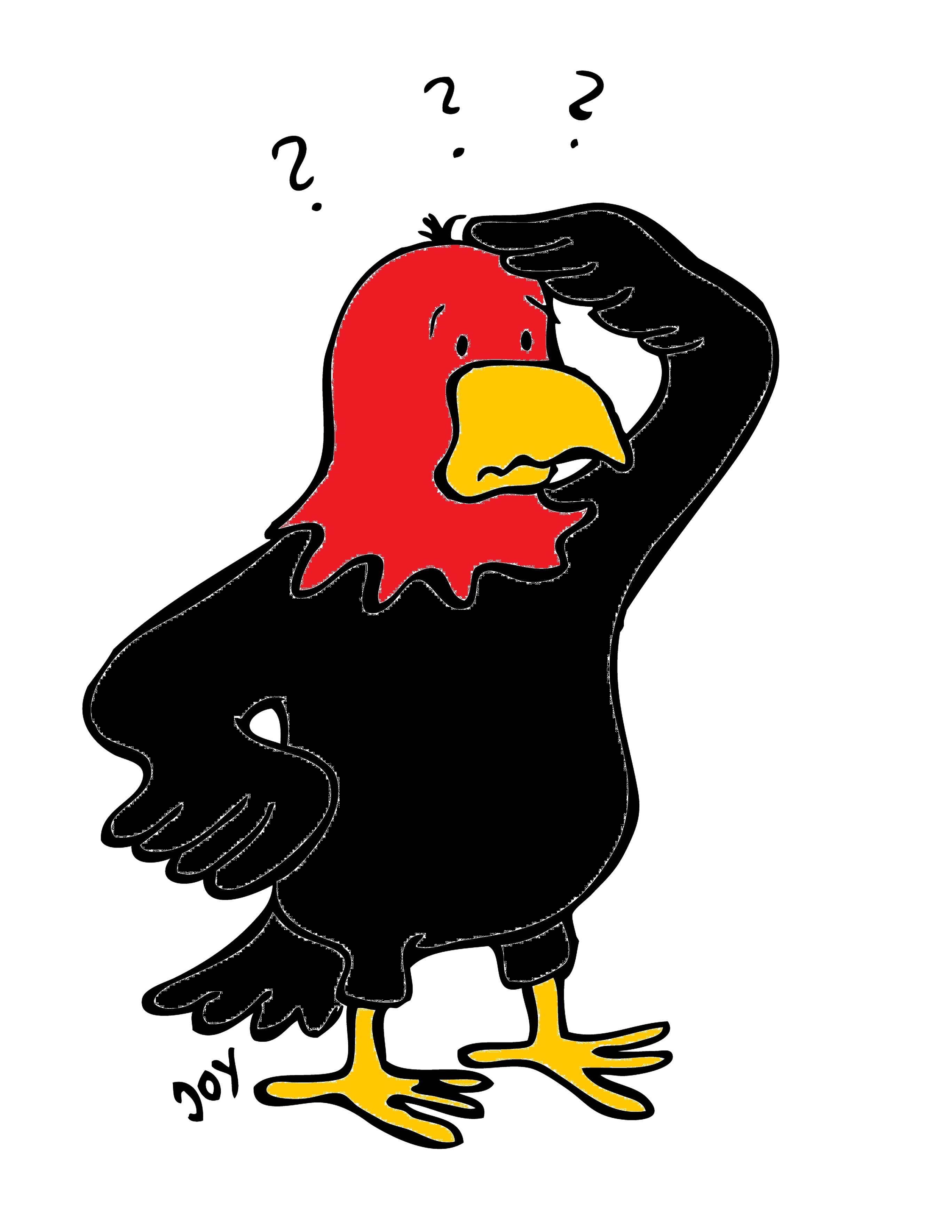
GET Buddied Up
German with Ali, the Eagle
get-across-borders@uni-mainz.de
© 2020 - GET Across Borders

Slide 2
Deutsch lernen mit Ali, unserem Adler
Sigrid Rieuwerts get-across-borders@uni-mainz.de

Slide 3
Welcome!
Heute lernen wir…
…von 0 bis 10 zu zählen.
Today we are going to learn how to…
…count from 0 to 10.
© GET Across Borders

Slide 4

The numbers:
Listen and repeat!
0 null zero
eins one
zwei two
drei three
vier four
fünf five
sechs six
sieben seven
acht eight
neun nine
zehn ten
© GET Across Borders

Slide 5
Exercise
Zählt gemeinsam von 0-10.
Und jetzt: Stellt euch vor, ihr seid der Countdown einer Rakete!
Zählt gemeinsam von 10-0.
Count from 0-10 together.
And now: Imagine, you are the countdown of a rocket!
Count from 10-0 together.
© GET Across Borders
Notes:
Note to teacher: The counting may restart from the beginning every time when there are too many mistakes with one number.

Slide 6
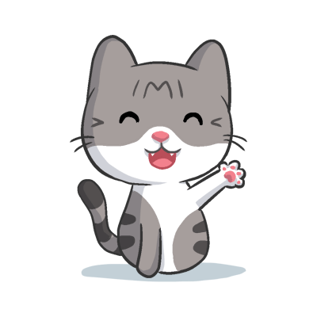
Exercise
Welche Zahl passt?
Beispiel:
Zwei!
What number fits?
©Microsoft Archive
© GET Across Borders

Slide 7
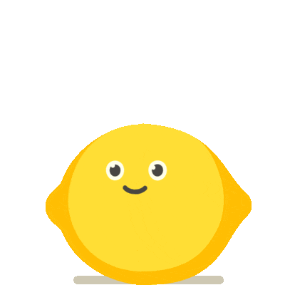
Exercise
Welche Zahl passt?
Fünf!
What number fits?
©Microsoft Archive
© GET Across Borders

Slide 8

Exercise
Welche Zahl passt?
Eins!
What number fits?
©Microsoft Archive
© GET Across Borders

Slide 9

Exercise
Welche Zahl passt?
Sechs!
What number fits?
©Microsoft Archive
© GET Across Borders

Slide 10
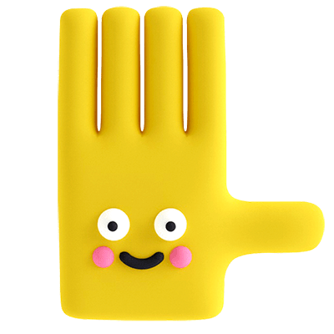
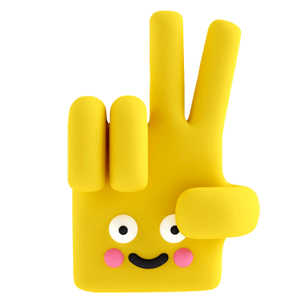
Exercise
Welche Zahl passt?
Sieben!
What number fits?
©Microsoft Archive
© GET Across Borders

Slide 11
Class Challenge!
Try to count to ten together!
Lay your head on the table and start at 1. Only one may speak at a time and only say one number!
If two people talk at the same time, or a number is doubled or left out, start at 1 again.
© GET Across Borders
Notes:
Note for teacher: The plan is that the students go through the numbers from 1-10 and at the same time have a team-building activity. The game is as follows: All students have to be silent and there should be no direct co-ordination like talking or pointing, they should not try to establish an order. Then, they may start counting. Every student may only say one number per turn, so if child 1 says „Eins“, another child has to say „Zwei“ and so on. If two students say a number at the same time, the game has to start again. If a number is doubled or left out, start again as well. This will them repeat the numbers and at the same time is a team building challenge.

Slide 12
Exercise
Kannst du die Telefonnummern auf Deutsch sagen?
555-489703
555-690237
Can you say the phone numbers in German?
© GET Across Borders
Notes:
Students may use their vocabulary sheet, given they have one, if they struggle too much with this task.

Slide 13
Difficult exercise
Kannst du die Telefonnummer als Zahlen aufschreiben?
555-74289
Can you write down the phone number?
© GET Across Borders

Slide 14
Sources
Images on slides 6-10 are taken from the Microsoft PowerPoint archive
© GET Across Borders

Slide 15
Thank you for learning German with us! ☺
DISCLAIMER: Please note that any resources uploaded to this website are purely for educational purposes only. If any of the items, photos or texts uploaded are in infringement of copyright then please do not hesitate to contact us and we will have them removed.
© 2020 – GET Across Borders and © Leap4Joy

