Slide 1
GET Buddied Up
German with Ali, the Eagle
get-across-borders@uni-mainz.de
© 2020 - GET Across Borders

Slide 2
Deutsch lernen mit Ali, unserem Adler Sigrid Rieuwerts get-across-borders@uni-mainz.de

Slide 3
Willkommen!
What we’re going to learn today…
How to say simple prices in German.
How to ask for prices in German.
© GET Across Borders
3

Slide 4
What do we need to know?
Was müssen wir wissen?
1. Die Zahlen / The numbers (1,2,3…) Revision ☺
2. Der Euro / The Euro = Currency of the European Union (EU)
das Eurosymbol = €
Münzen / coins and Scheine / currency notes
3. Preise sagen / How to say simple prices:
2,50 € = zwei Euro und fünfzig Cent
© GET Across Borders
4

Slide 5
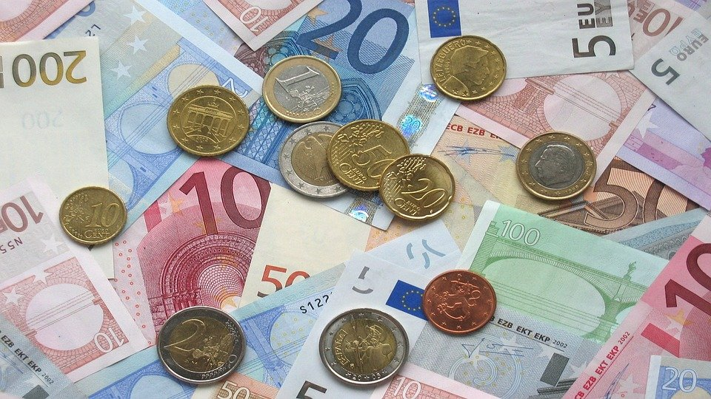
Simple facts about the Euro:
Einfache Fakten über den Euro:
Münzen/Coins:
0,01 Cent
0,02 Cent
0,05 Cent
0,10 Cent
0,20 Cent
0,50 Cent
1,00 Euro
2,00 Euro
Remember:
1 Euro = 100 Cent
1 Euro = 0, 89 Pence
1,12 Euro = 1 Pound
Scheine/Currency notes:
5,00 Euro
10,00 Euro
20,00 Euro
50,00 Euro
100,00 Euro
200,00 Euro
500,00 Euro
© Pixabay
© GET Across Borders
5

Slide 6
Game time!
Match the prices with the correct German phrase.
Work with a partner.
You will get the solution shortly!
© GET Across Borders
6

Slide 7
Matching Exercise
1,50 €
5,00 €
0,50 €
15,50 €
7,20 €
20,20 €
0,30 €
50,05 €
fünfzig Cent
sieben Euro und zwanzig Cent
ein Euro und fünfzig Cent
fünfzig Euro und fünf Cent
dreißig Cent
fünf Euro
zwanzig Euro und zwanzig Cent
fünfzehn Euro und fünfzig Cent
© GET Across Borders
7

Slide 8
Check your answers!
Überprüfe deine Antworten!
1,50 €
5,00 €
0,50 €
15,50 €
7,20 €
20,20 €
0,30 €
50,05 €
fünfzig Cent
sieben Euro und zwanzig Cent
ein Euro und fünfzig Cent
fünfzig Euro und fünf Cent
dreißig Cent
fünf Euro
zwanzig Euro und zwanzig Cent
fünfzehn Euro und fünfzig Cent
© GET Across Borders
8

Slide 9
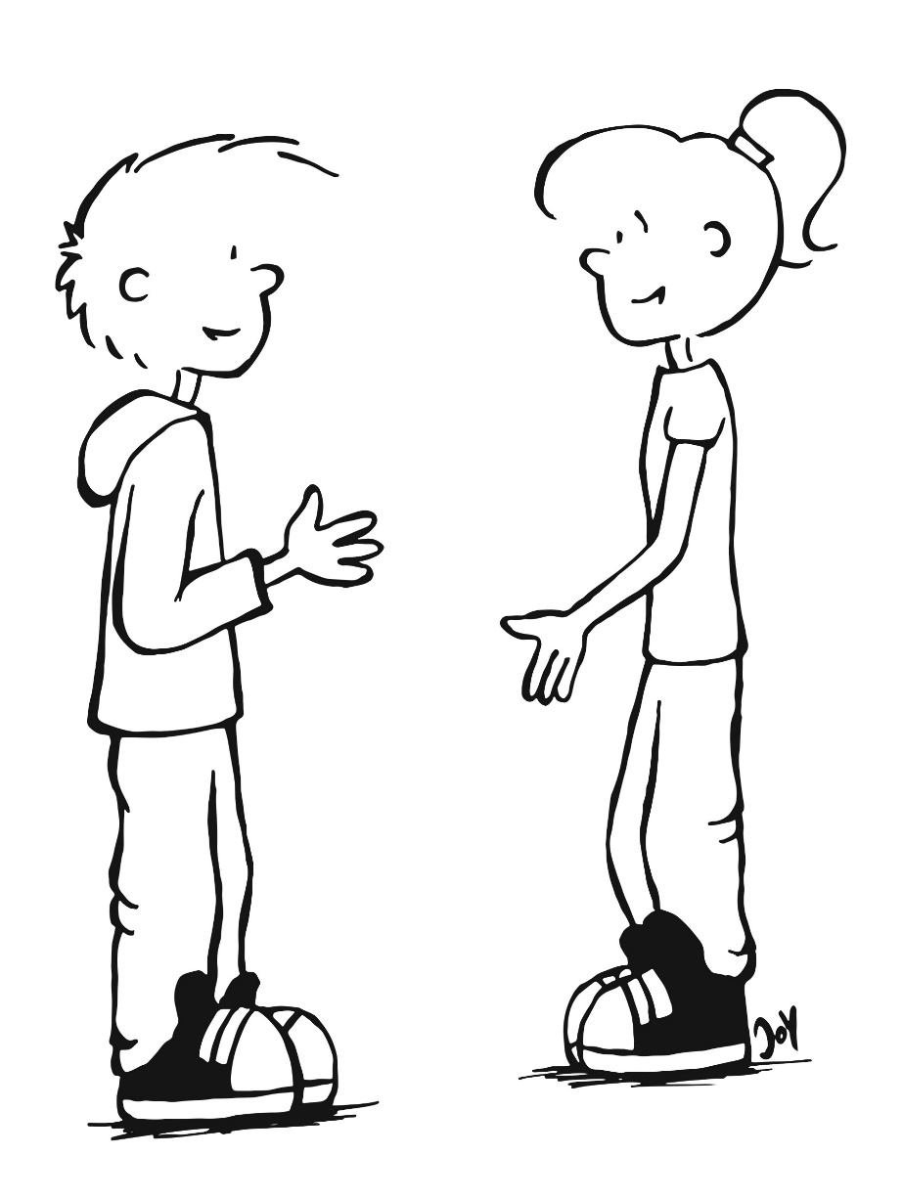
Let’s go to the market!
Lasst uns auf den Markt gehen!
Wie viel
kostet das?
How much is it?
Das macht…
drei Euro.
It costs three euros.
© Pixabay
© Pixabay
© GET Across Borders
9

Slide 10
Game time!
Look at the price and say the correct price (in German.)
Question:
Wie viel kostet das?
How much is it?
You will get the solution shortly!
© GET Across Borders
10

Slide 11
Wie viel kostet das?
2,50 €
Das macht…
© Pixabay
© GET Across Borders
11

Slide 12
Wie viel kostet das?
2,50 €
Das macht…
zwei Euro und fünfzig Cent.
© Pixabay
© GET Across Borders
12

Slide 13
Wie viel kostet das?
3,80 €
Das macht…
© Pixabay
© GET Across Borders
13

Slide 14
Wie viel kostet das?
3,80 €
Das macht…
drei Euro und achtzig Cent.
© Pixabay
© GET Across Borders
14

Slide 15
Wie viel kostet das?
12,90 €
Das macht…
© Pixabay
© GET Across Borders
15

Slide 16
Wie viel kostet das?
12,90 €
Das macht…
zwölf Euro und neunzig Cent.
© Pixabay
© GET Across Borders
16

Slide 17
Gimme 5
Think about what we have learned today.
Can we come up with 5 things that we have learned ?
© GET Across Borders
17

Slide 18
Sources
https://pixabay.com/de/photos/euro-banknoten-m%C3%BCnzen-1166051/
https://pixabay.com/de/vectors/markt-anmelden-beschilderung-575842/
https://pixabay.com/de/vectors/ananas-obst-tropisch-frisch-reif-25251/
https://pixabay.com/de/vectors/bananen-obst-lebensmittel-575412/
https://pixabay.com/de/vectors/%C3%A4pfel-obst-lebensmittel-rote-%C3%A4pfel-575317/
https://pixabay.com/de/vectors/gem%C3%BCse-fr%C3%BCchte-lebensmittel-155616/
© GET Across Borders
18

Slide 19
Thank you for learning German with us! ☺
DISCLAIMER: Please note that any resources uploaded to this website are purely for educational purposes only. If any of the items, photos or texts uploaded are in infringement of copyright then please do not hesitate to contact us and we will have them removed.
© 2020 – GET Across Borders and © Leap4Joy

