Slide 1
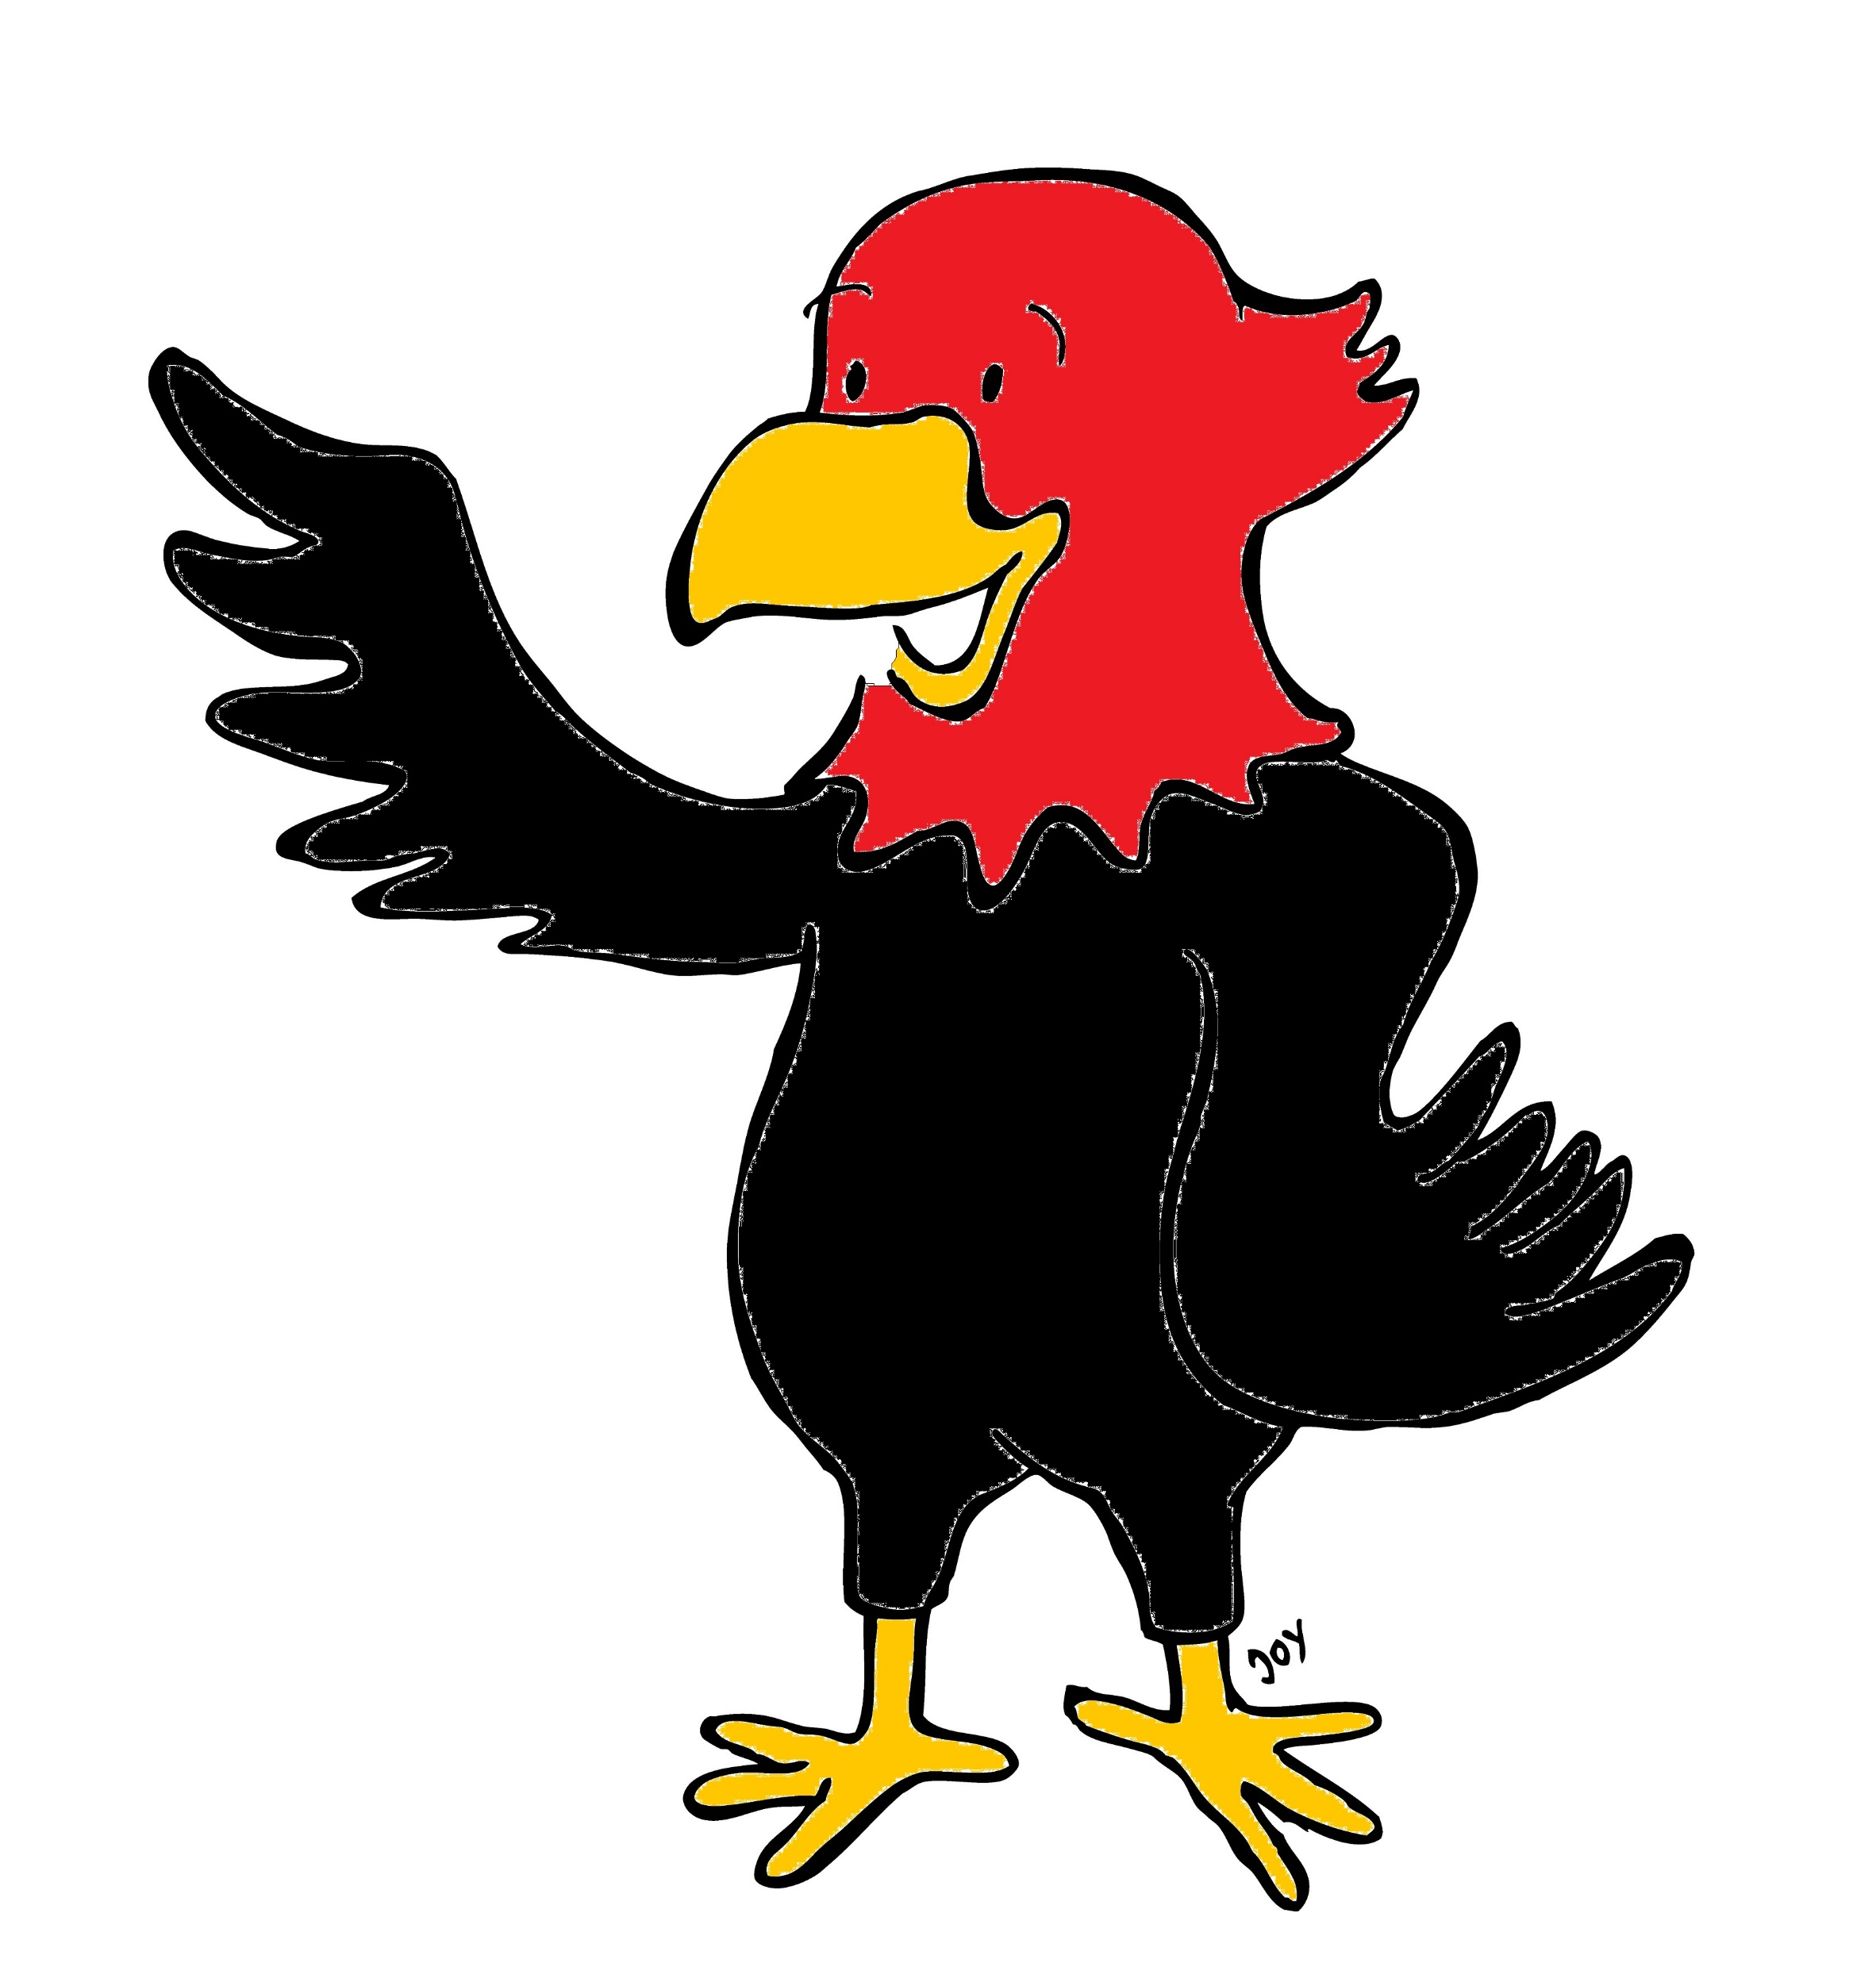
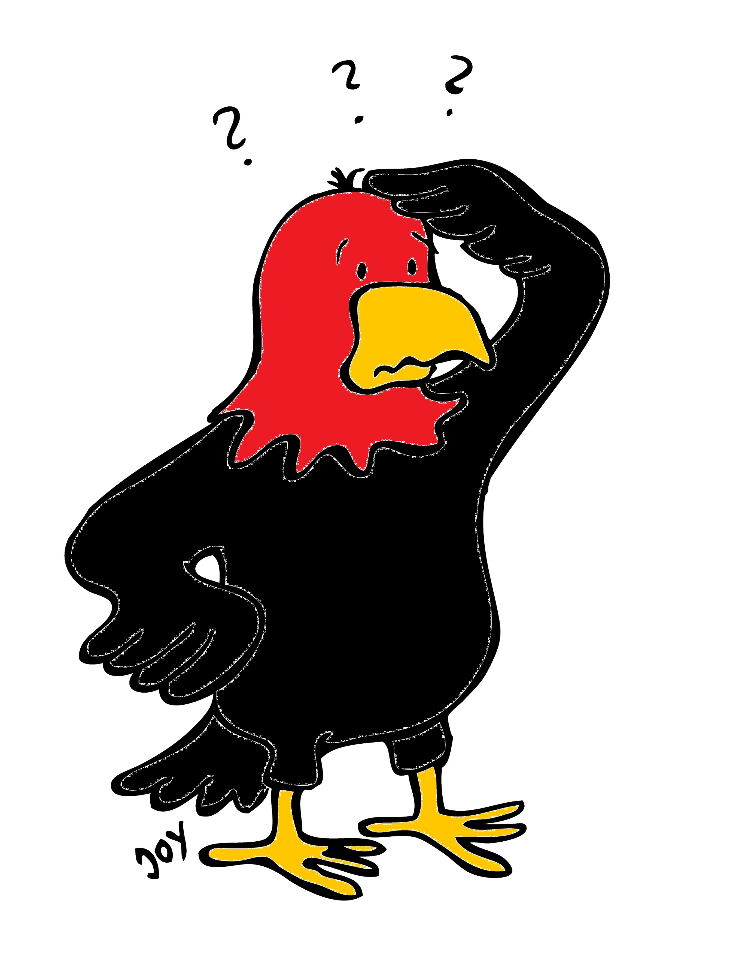
GET Buddied Up
German with Ali, the Eagle
get-across-borders@uni-mainz.de
© 2020 - GET Across Borders

Slide 2
Deutsch lernen mit Ali, unserem Adler Sigrid Rieuwerts get-across-borders@uni-mainz.de

Slide 3
Willkommen!
Today we are going to learn…
what “Karneval” is.
how Germans celebrate it.
how German greet each other on “Karneval”.
German terms for different costumes.
© GET Across Borders
3

Slide 4
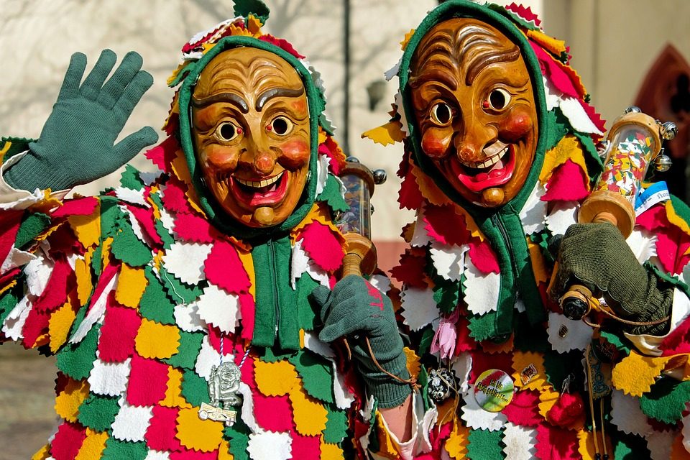
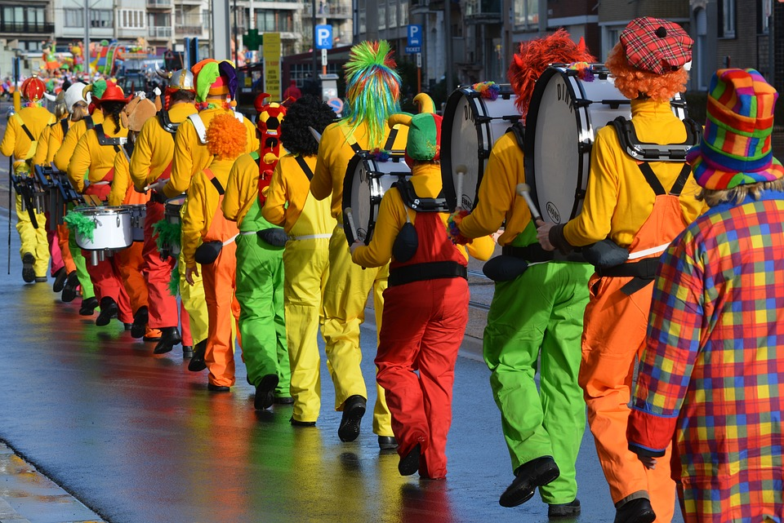
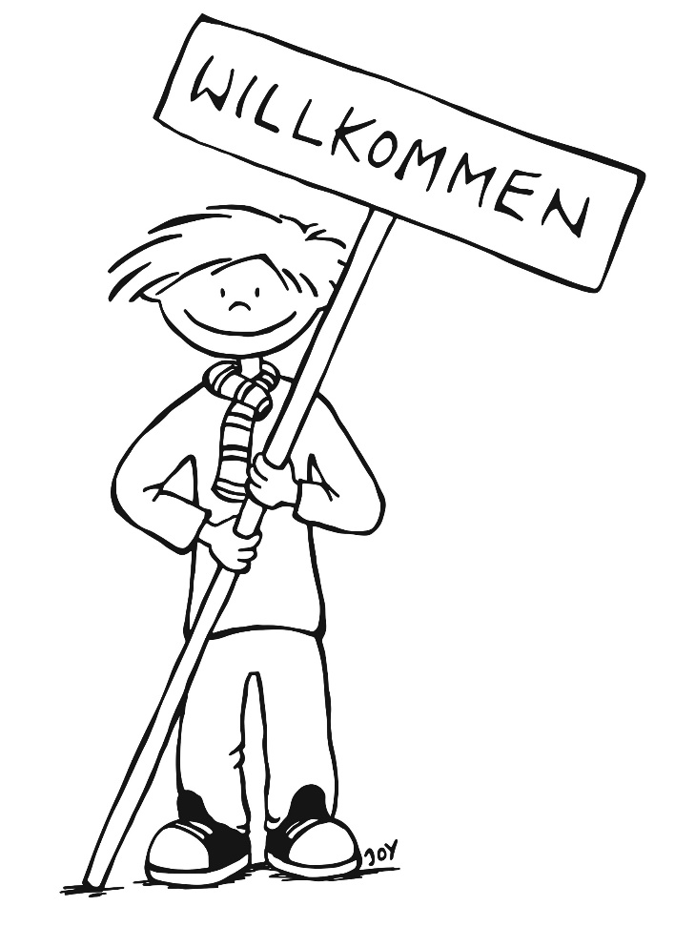
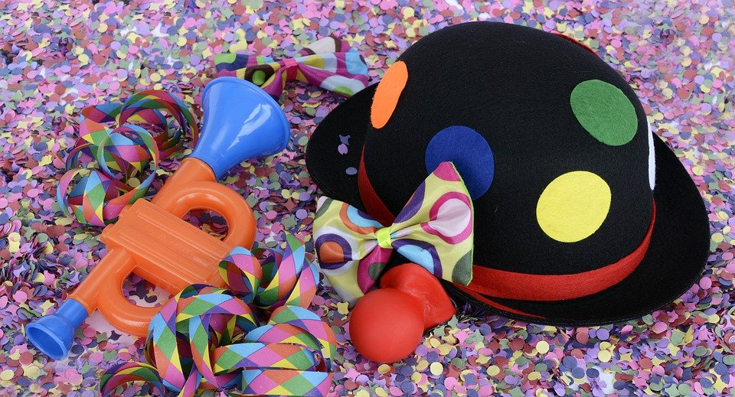
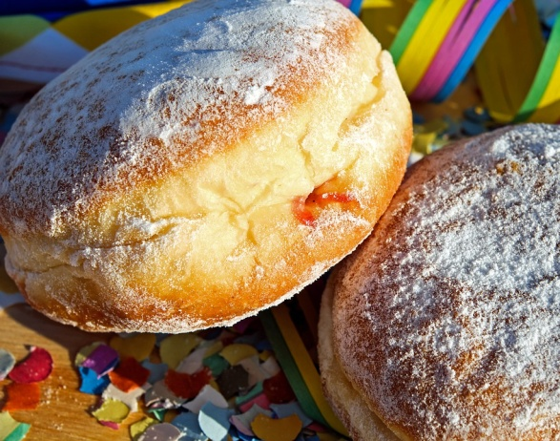
Karneval
© Pixabay
© Pixabay
© Pixabay
© Pixabay
© GET Across Borders
4

Slide 5
What do you think?
What is this German festivity about?
How is it celebrated?
© GET Across Borders
5

Slide 6
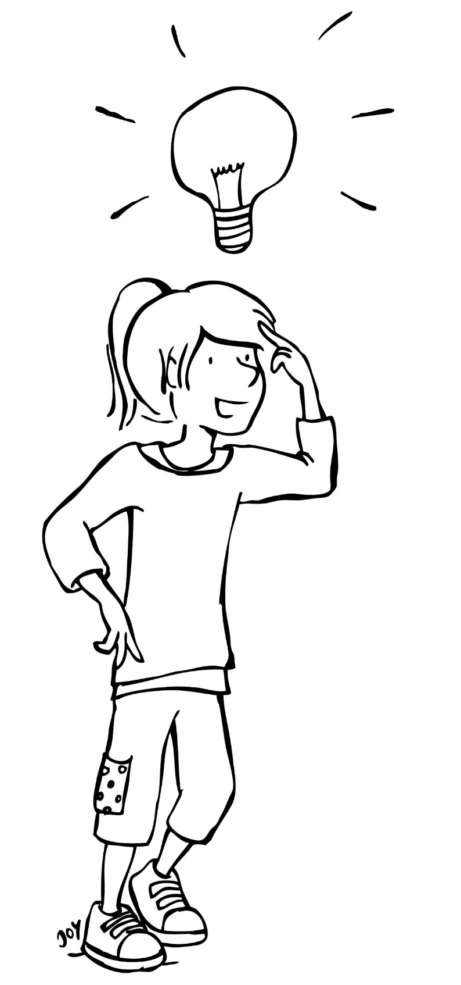
Karneval
Karneval ist ein berühmtes Fest in Deutschland.
Carnival is an important festivity in Germany.
Die Menschen / People:
- verkleiden sich / dress up.
- tragen Kostüme / wear costumes.
- tanzen und singen. / dance and sing.
- lachen und haben Spaß. / laugh and have fun.
© GET Across Borders
6

Slide 7
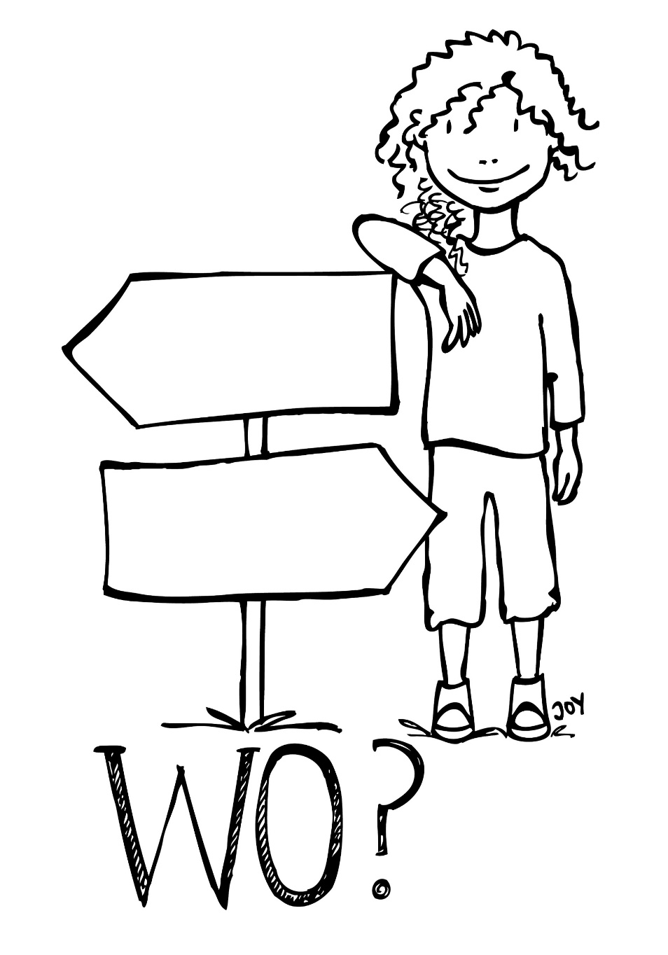
One festivity – many names
Depending on where in Germany you live you will either call it…
… Karneval
… Fasching
… Fastnacht
or
… Fasnet
source: http://archiv.nationalatlas.de/wp-content/art_pdf/Band10_60-61_archiv.pdf
© GET Across Borders
7

Slide 8
Wann? (When?)
In spring, seven weeks before Easter.
After Karneval, the Lent before Easter starts.
Origin of Karneval: have fun and celebrate before Lent.
source: https://www.brauchtum.de/de/fruehjahr/fastnacht-fasching-karneval/unterseiten/naerrisch-im-fasching.html
© GET Across Borders
8

Slide 9
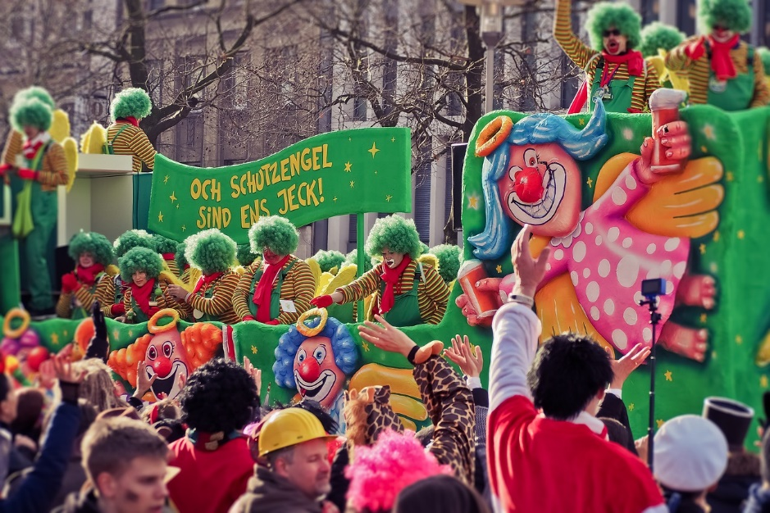
Rosenmontag
Montag
Straßenumzüge (street parades)
© Pixabay
© Pixabay
© GET Across Borders
9

Slide 10
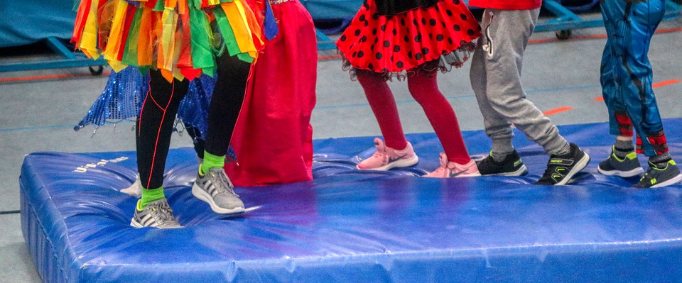
Fastnachtsdienstag
Dienstag
Feiern (celebrations)
© Pixabay
© Pixabay
© GET Across Borders
10

Slide 11
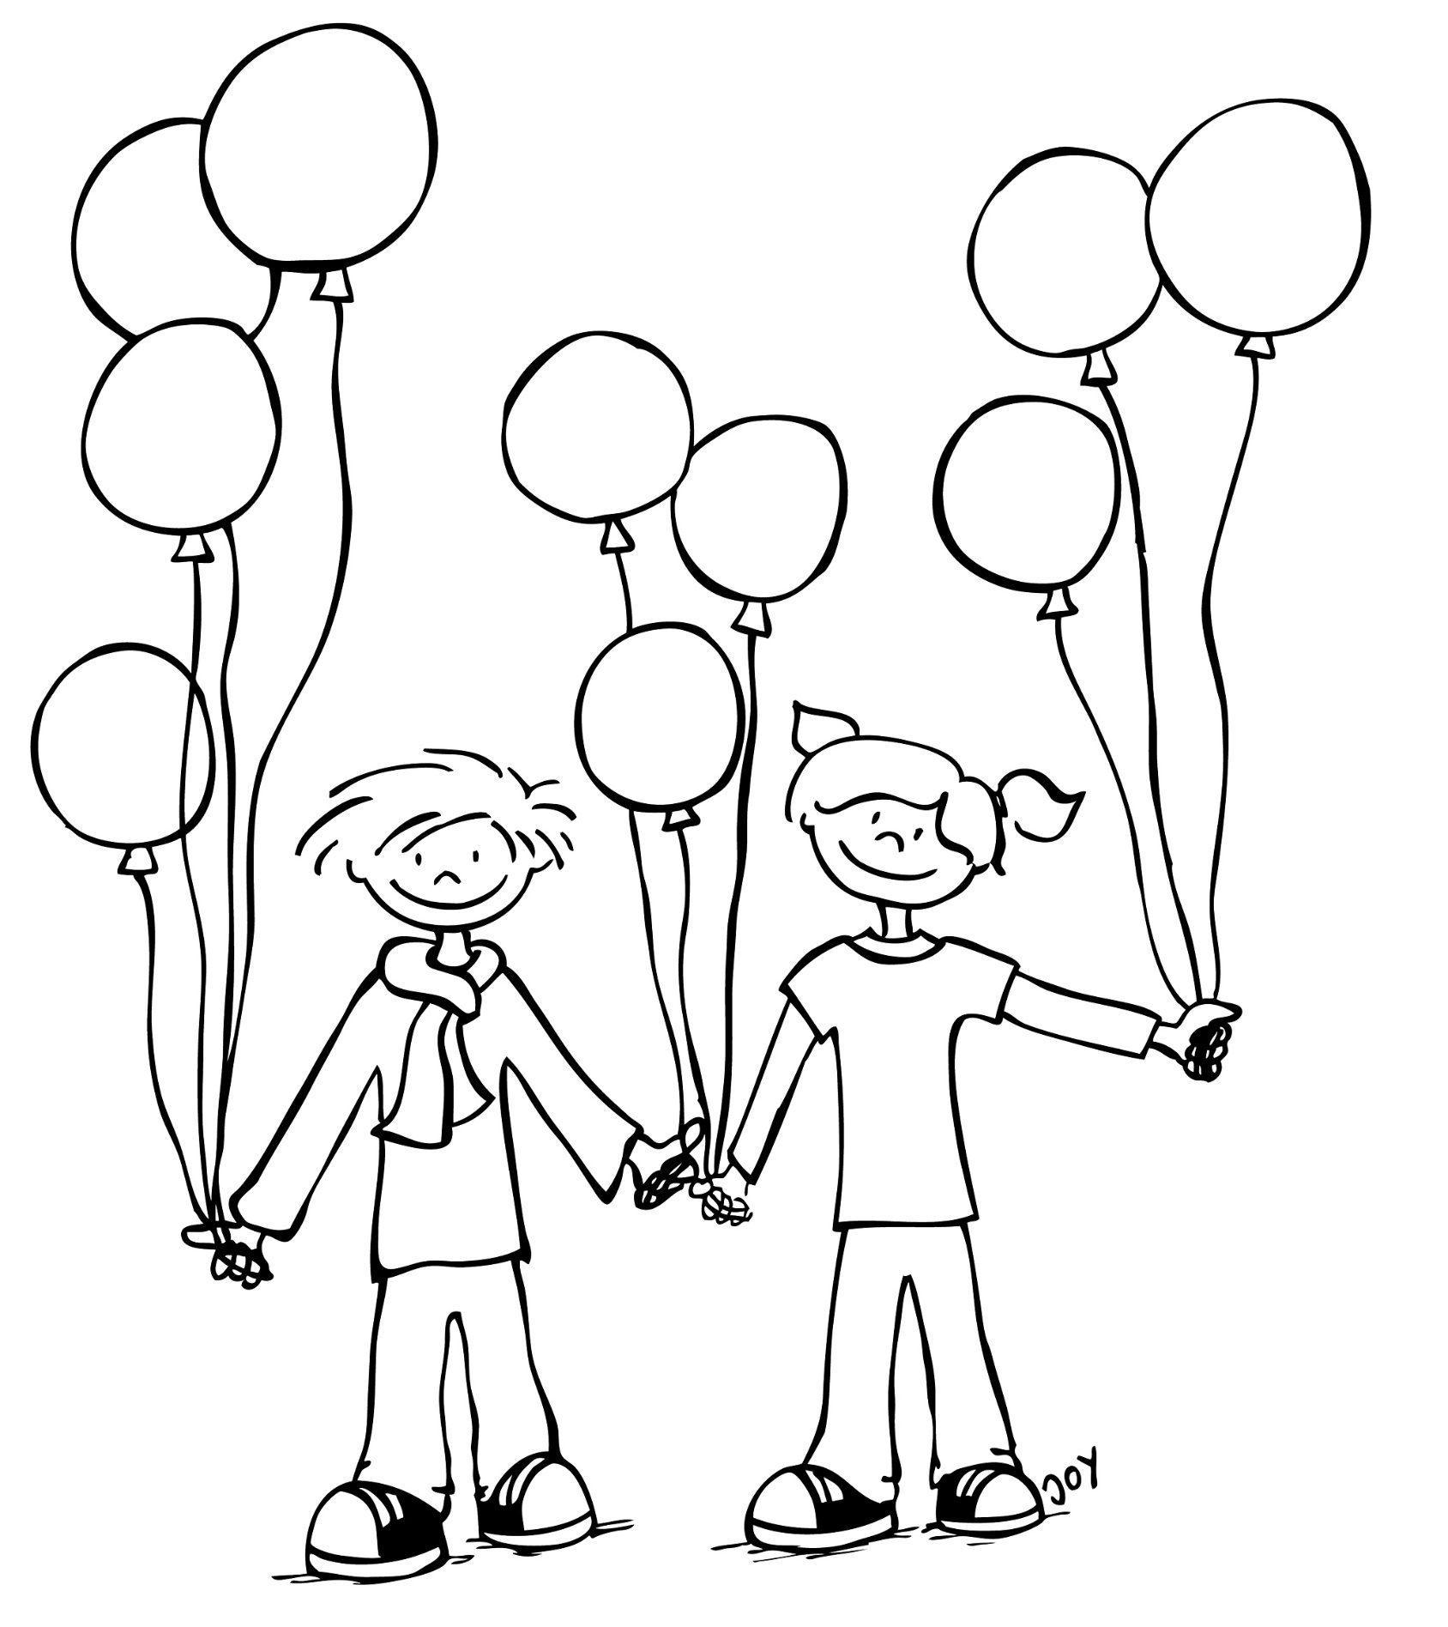
Greetings
Helau!
Alaaf!
© GET Across Borders
11

Slide 12
Essen (food)
Berliner / Pfannkuchen
(special doughnuts filled with jam)
© Pixabay
© GET Across Borders
12

Slide 13
Verkleidungen (Costumes)
Pirat – Piratin Clown
Prinz – Prinzessin Cowboy - Cowgirl
© GET Across Borders
13

Slide 14
Sources
http://archiv.nationalatlas.de/wp-content/art_pdf/Band10_60-61_archiv.pdf
https://www.brauchtum.de/de/fruehjahr/fastnacht-fasching-karneval/unterseiten/naerrisch-im-fasching.html
https://pixabay.com/de/photos/fasnacht-fasching-fasnet-karneval-2092819/
https://pixabay.com/de/photos/karneval-maske-kost%C3%BCm-menschen-1192414/
© GET Across Borders
14

Slide 15
Sources
https://pixabay.com/de/photos/hut-konfetti-luftschlangen-bunt-3128511/
https://pixabay.com/de/photos/krapfen-berliner-lebensmittel-3081959/
https://pixabay.com/de/photos/menschen-karneval-fest-fastnacht-3158517/
https://pixabay.com/de/photos/fasching-kinder-karneval-farbenfroh-4871101/
© GET Across Borders
15

Slide 16
Thank you for learning German with us! ☺
DISCLAIMER: Please note that any resources uploaded to this website are purely for educational purposes only. If any of the items, photos or texts uploaded are in infringement of copyright then please do not hesitate to contact us and we will have them removed.
© 2020 – GET Across Borders and © Leap4Joy

