Slide 1





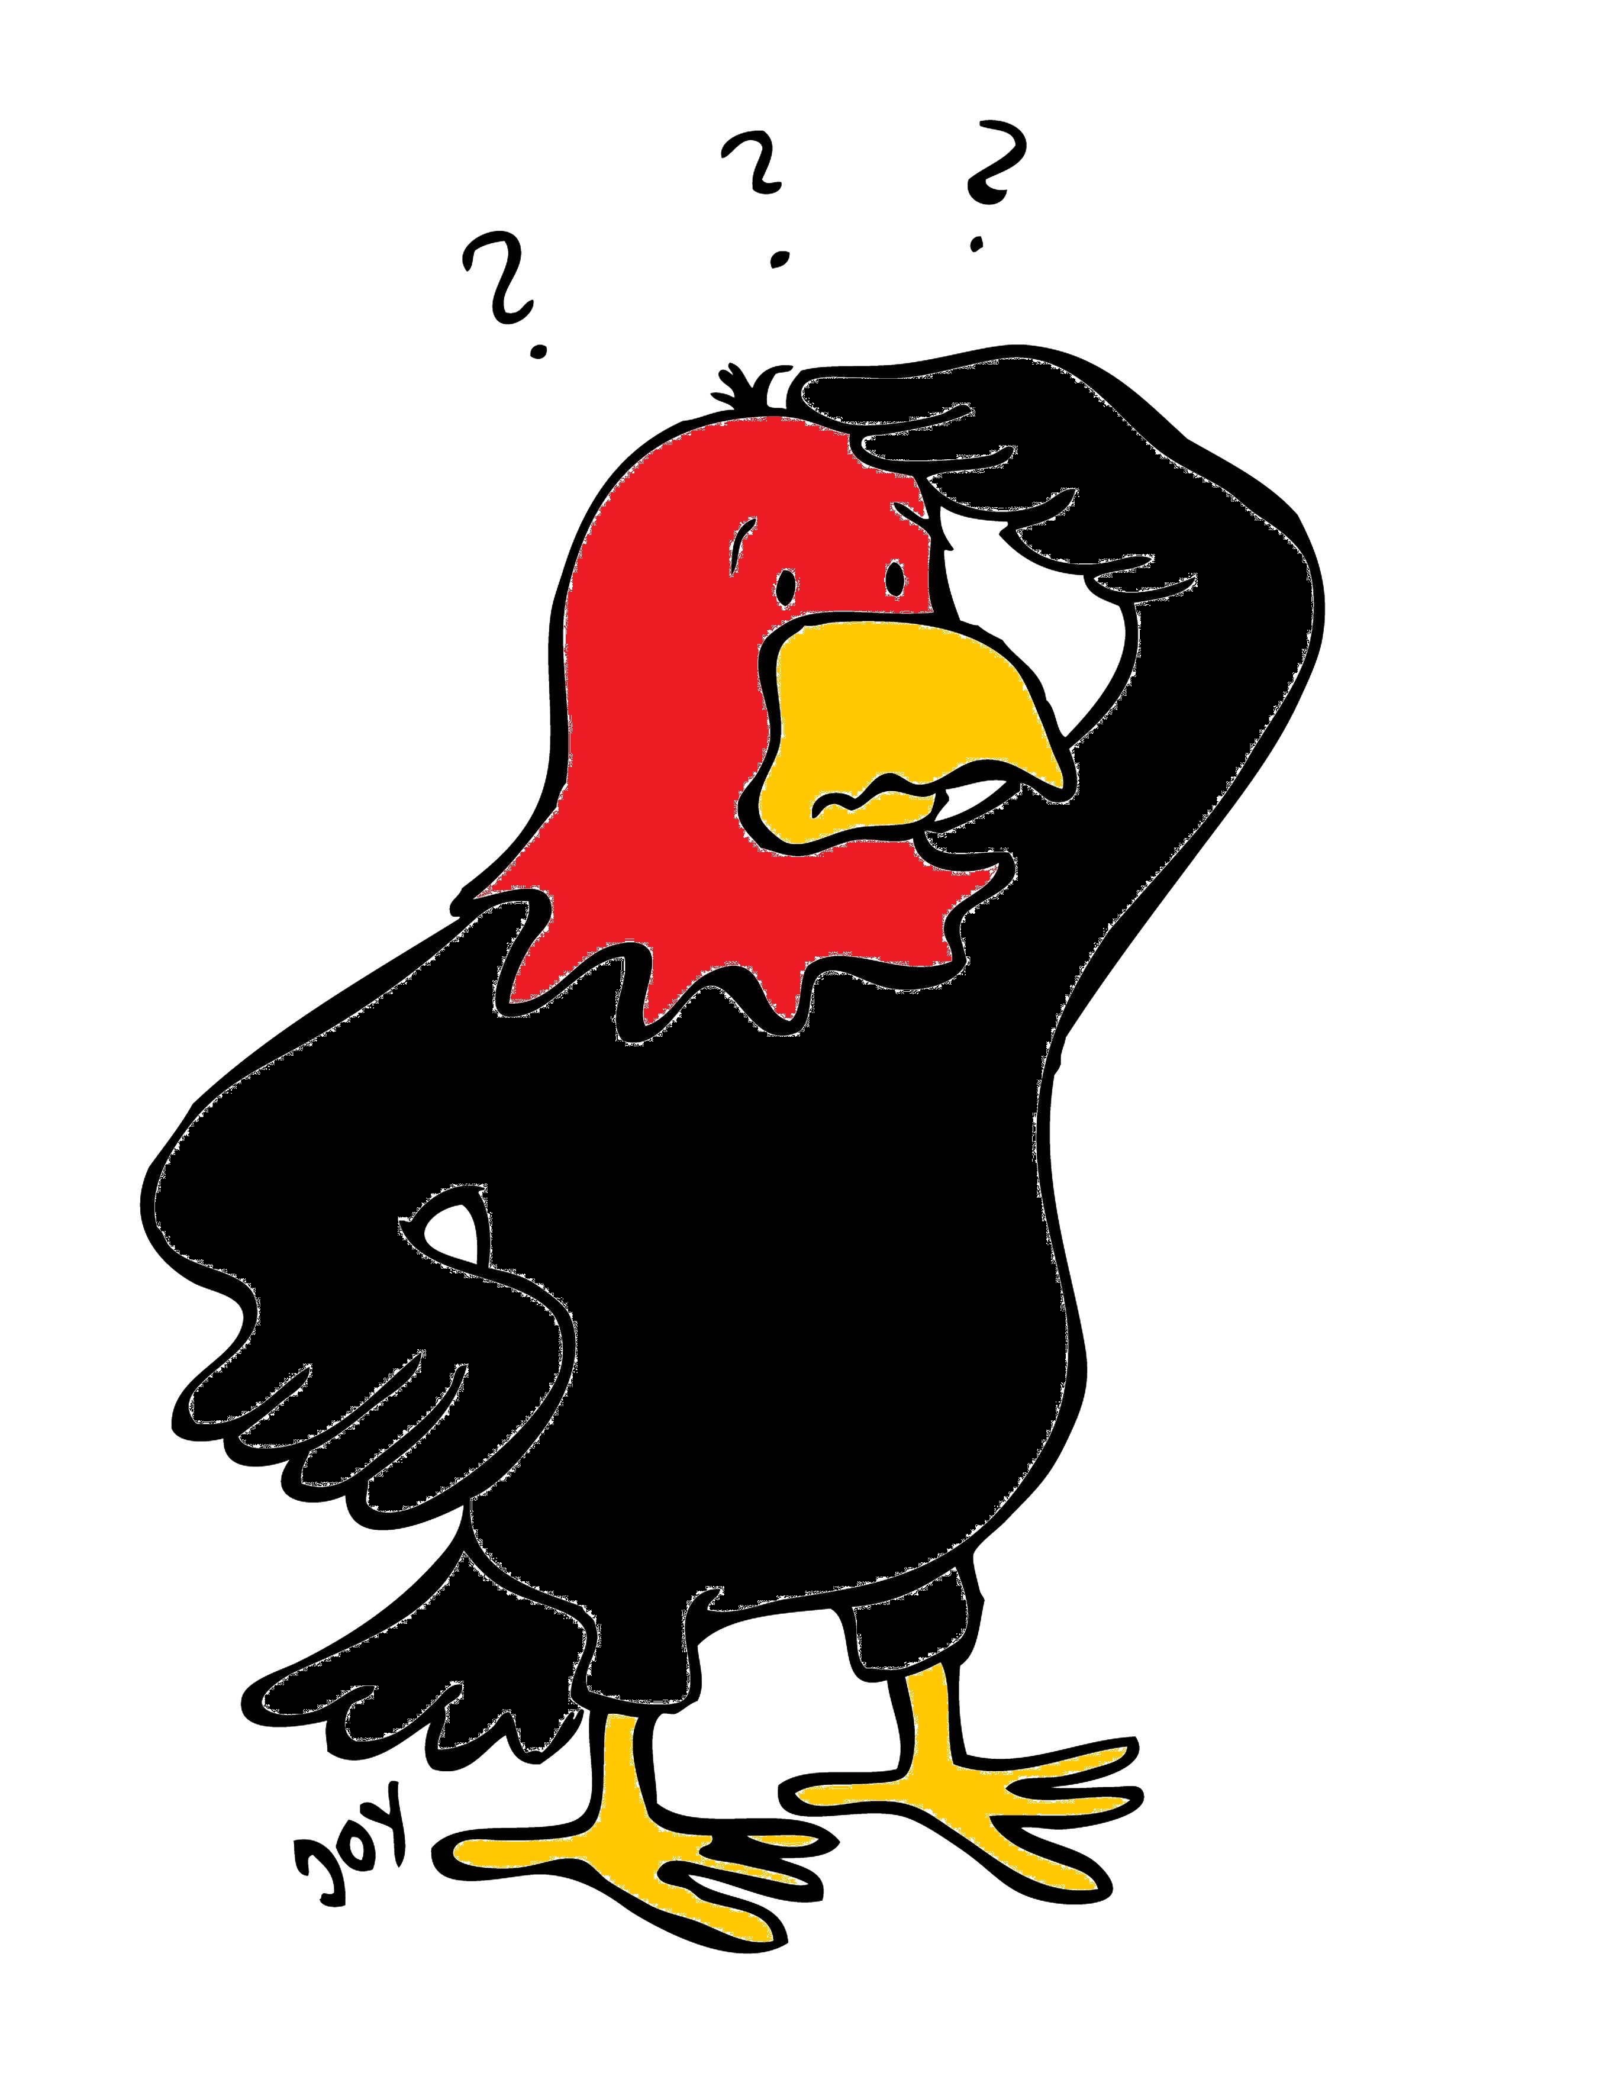
GET Buddied Up
German with Ali, the Eagle
get-across-borders@uni-mainz.de
© 2020 - GET Across Borders

Slide 2
Deutsch lernen mit Ali, unserem Adler
Sigrid Rieuwerts get-across-borders@uni-mainz.de

Slide 3

Willkommen!
Today we are going to learn…
how to wish someone Happy Easter in German.
some German Easter symbols.
how Germans celebrate Easter.
© GET Across Borders
3

Slide 4

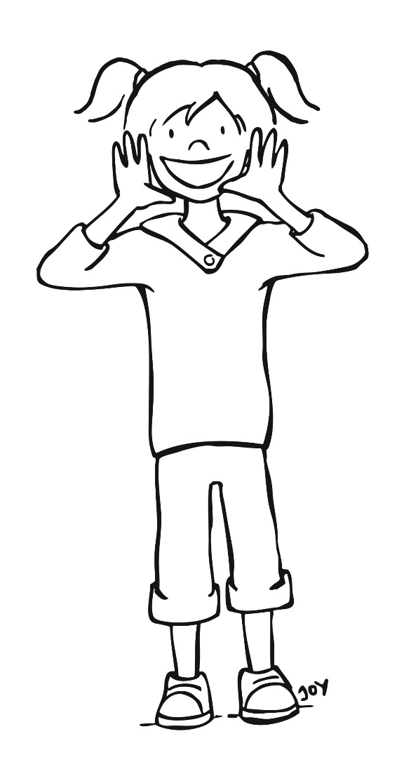
Frohe Ostern!
Frohe Ostern!
(Happy Easter!)
© GET Across Borders
4

Slide 5

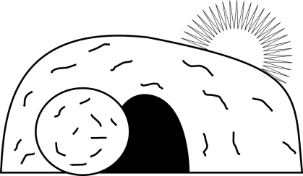

Osterfeiertage in Deutschland
(Easter holidays in Germany)
Karfreitag
→ On the Friday before Easter we think of the crucifixion of Jesus Christ.
Ostersonntag und Ostermontag
→ On Sunday and Monday we celebrate the resurrection of Jesus Christ.
Freitag
Sonntag
Montag
© GET Across Borders
5

Slide 6

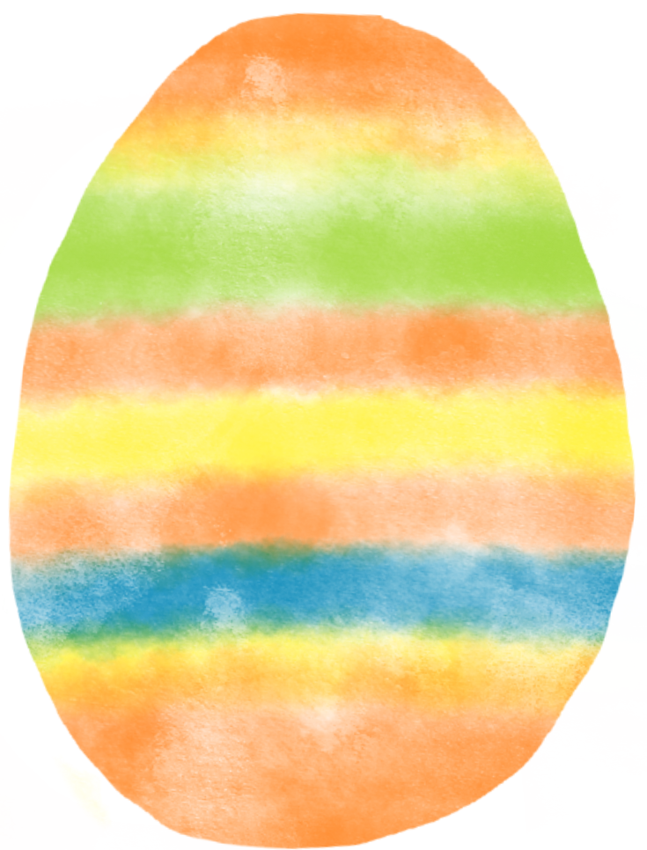
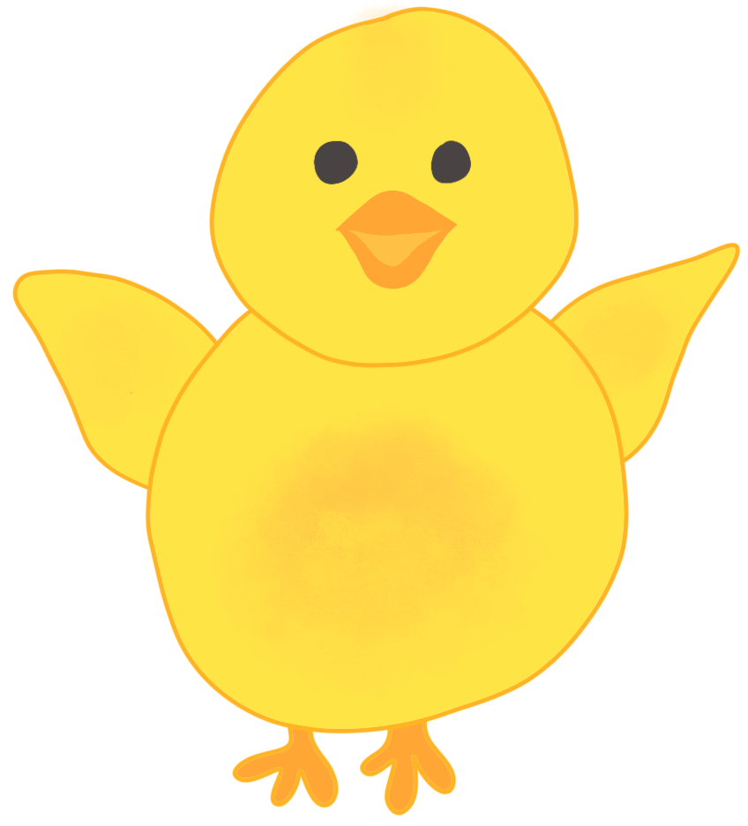

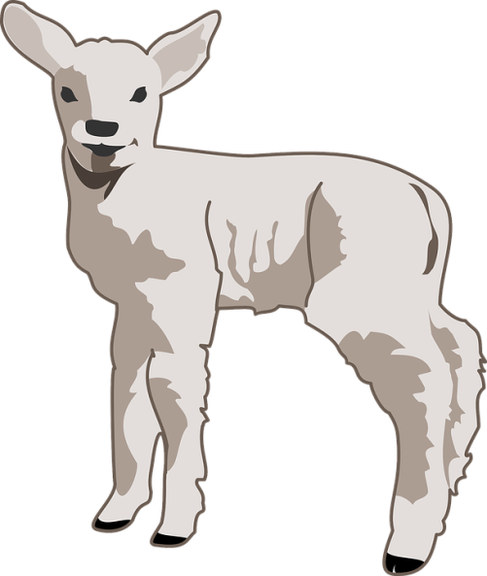
Ostersymbole
(Easter symbols)
Osterei
  (Easter egg)
Osterhase
(Easter bunny)
Osterlamm
(Easter lamb)
Osterglocke (daffodil)
Küken (chick)
© Pixabay
© Pixabay
© GET Across Borders
6

Slide 7
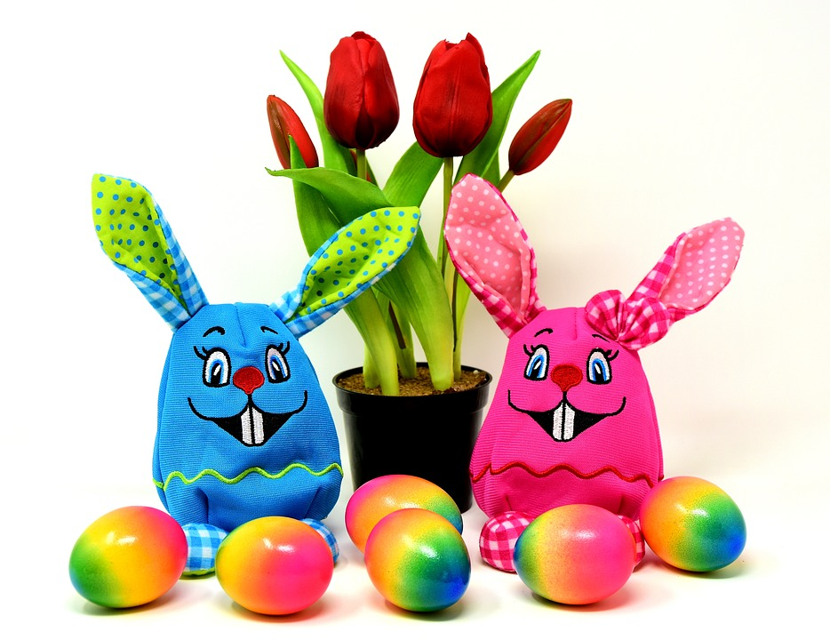
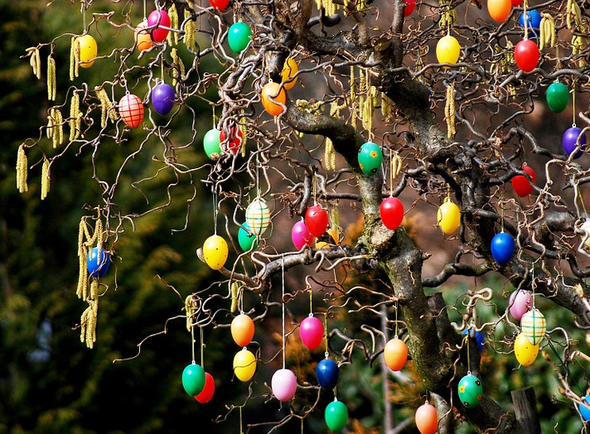
Ostertraditionen
(Easter traditions)
Wir schmücken das Haus und den Garten.
  (We decorate the house and the garden.)
© Pixabay
© Pixabay
© GET Across Borders
7

Slide 8
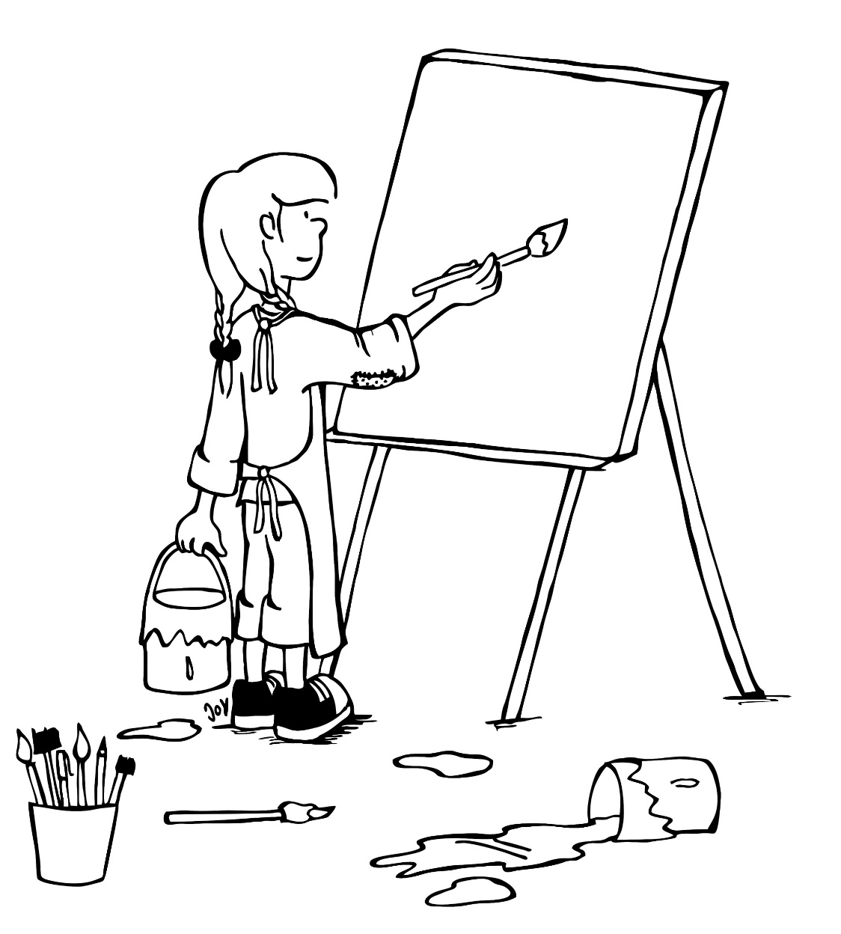
Ostertraditionen
Wir malen Ostereier an. (We colour Easter eggs.)
© GET Across Borders
8

Slide 9
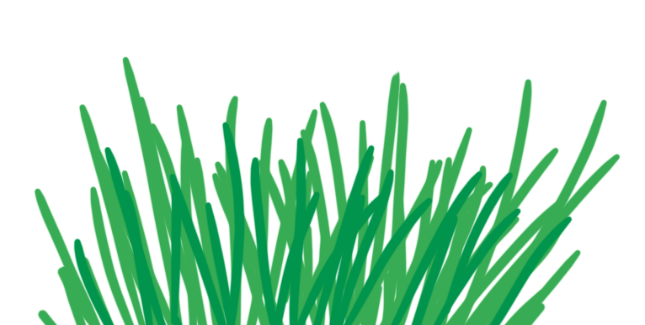

Ostertraditionen
Der Osterhase versteckt die Ostereier.
  (The Easter bunny hides the Easter eggs.)
© Pixabay
© GET Across Borders
9

Slide 10

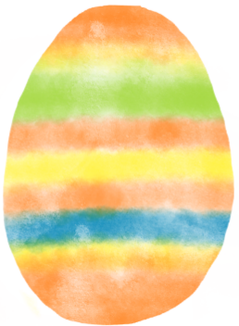
Ostertraditionen
Wir suchen die Ostereier.
  (We search for the Easter eggs.)
© GET Across Borders
10

Slide 11
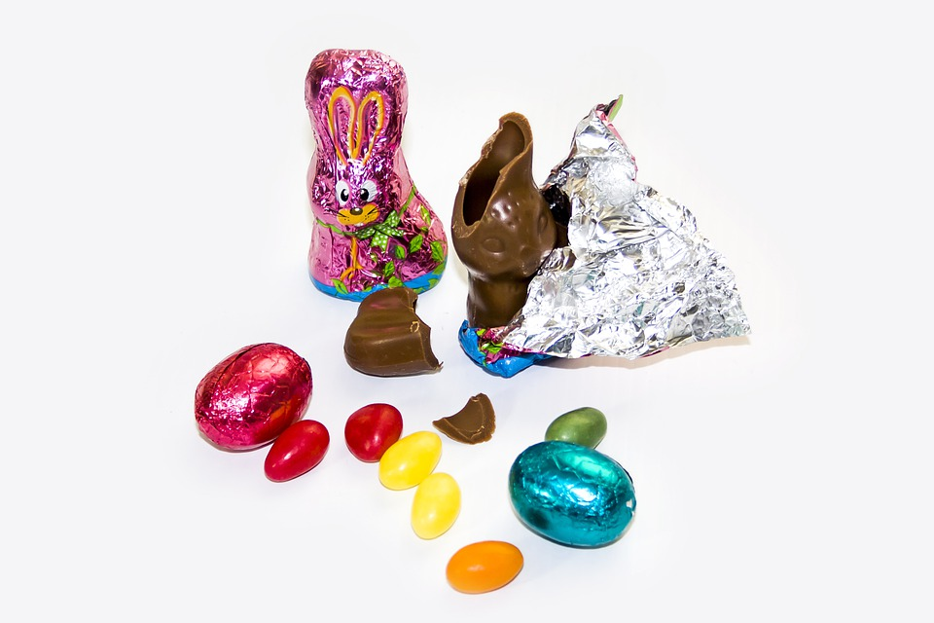

Ostereier suchen
(Searching for Easter eggs)
In former times, children received boiled eggs for Easter.
Today, they mostly receive chocolate eggs or chocolate bunnies.
© Pixabay
© GET Across Borders
11

Slide 12
Sources
https://pixabay.com/de/photos/ostern-strauch-garten-754351/
https://pixabay.com/de/photos/ostern-osterhase-bunt-farbig-hase-3270982/
https://pixabay.com/de/photos/ostern-osterhase-hase-osterfest-4928489/
https://pixabay.com/de/vectors/osterhase-ostern-hase-1324889/
https://pixabay.com/de/vectors/lamm-jung-tier-nachkommen-weich-30748/
© GET Across Borders
12

Slide 13
Thank you for learning German with us! ☺
DISCLAIMER: Please note that any resources uploaded to this website are purely for educational purposes only. If any of the items, photos or texts uploaded are in infringement of copyright then please do not hesitate to contact us and we will have them removed.
© 2020 – GET Across Borders and © Leap4Joy

