Slide 1
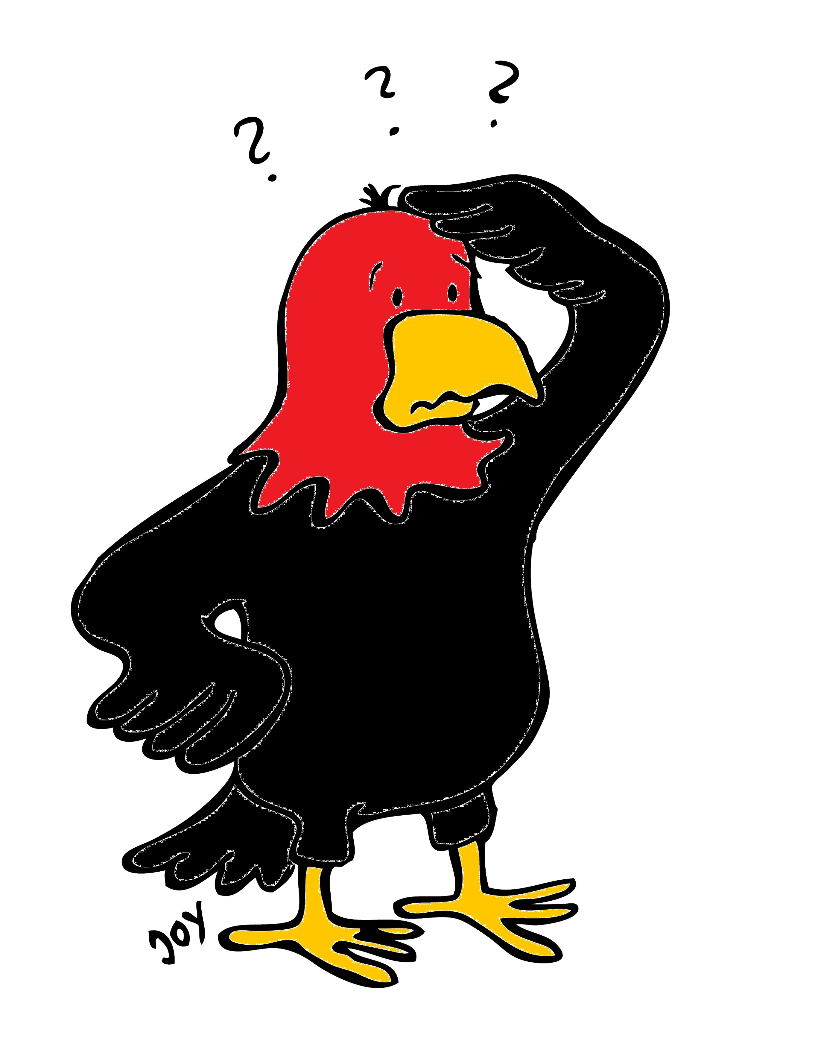
GET Buddied Up
German with Ali, the Eagle
get-across-borders@uni-mainz.de
© 2020 - GET Across Borders

Slide 2
Deutsch lernen mit Ali, unserem Adler Sigrid Rieuwerts get-across-borders@uni-mainz.de

Slide 3
Willkommen!
Today we are going to learn…
how Germans celebrate New Year’s Eve.
how to wish someone a happy New Year in German.
German words for fireworks and New Year’s symbols.
© GET Across Borders
3

Slide 4
Silvester (New Year’s Eve)
Dezember
31
© Pixabay
© GET Across Borders
4

Slide 5
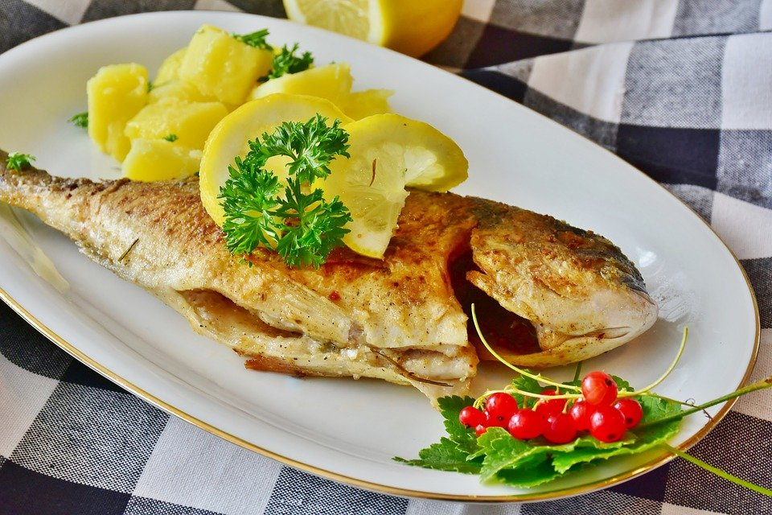
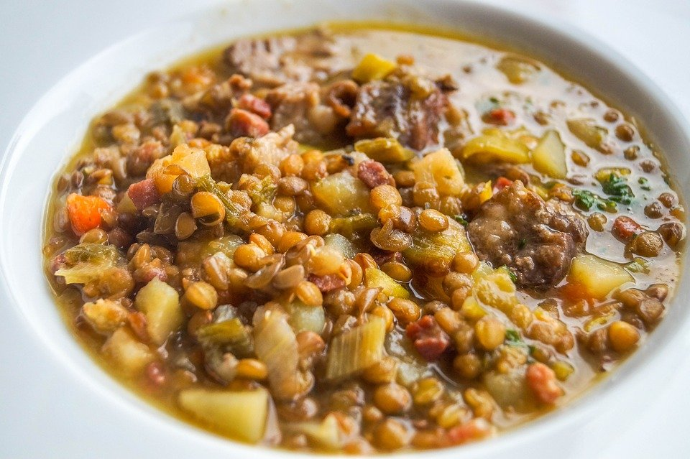
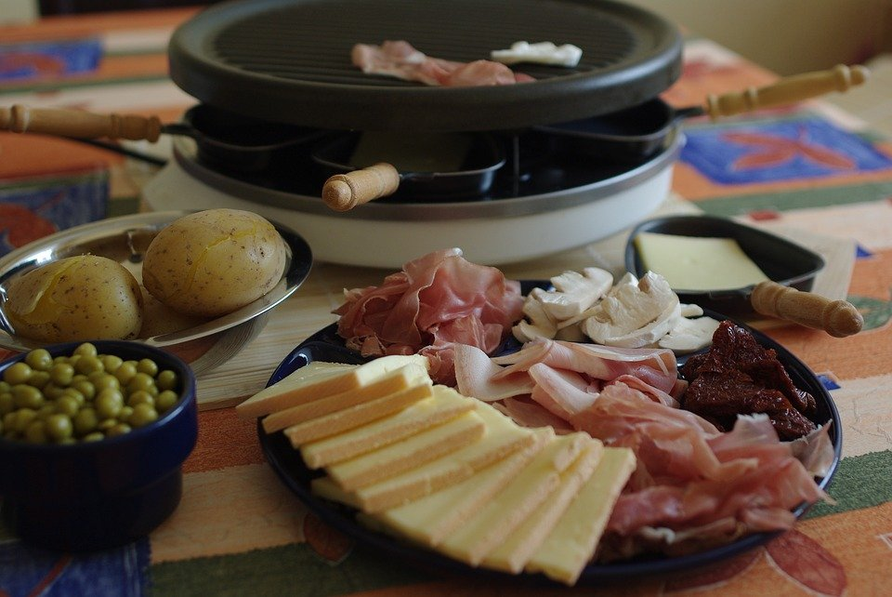
Essen (food)
Karpfen (fish)
Linsen Raclette
(lentils) (raclette)
© Pixabay
© Pixabay
© Pixabay
© GET Across Borders
5

Slide 6
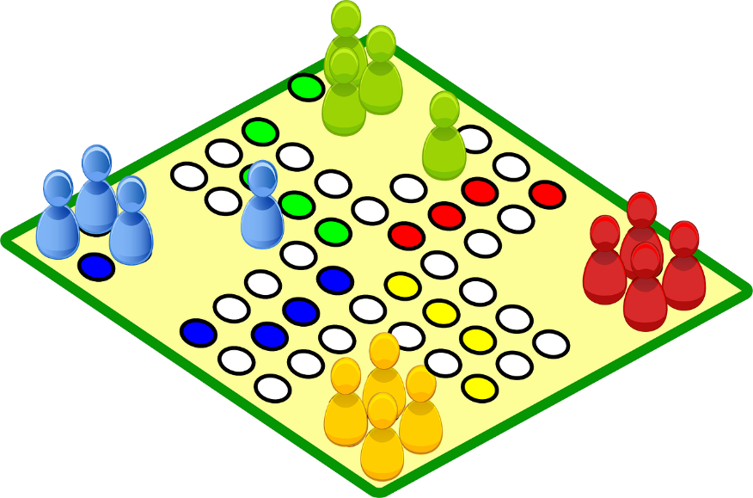
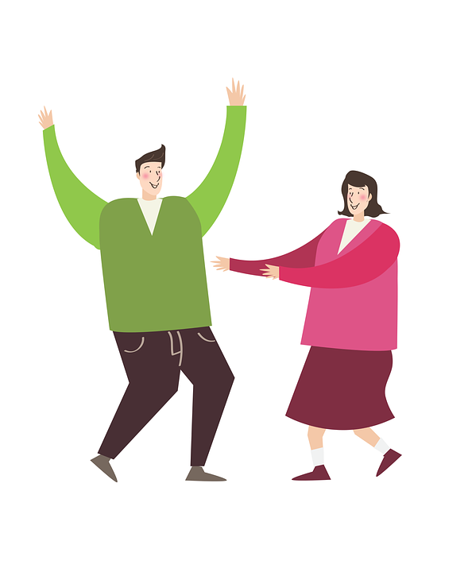
Activities on New Year’s Eve
Spiele (games)
Tanzen (dancing)
Filme (movies)
© Pixabay
© Pixabay
© Pixabay
© GET Across Borders
6

Slide 7
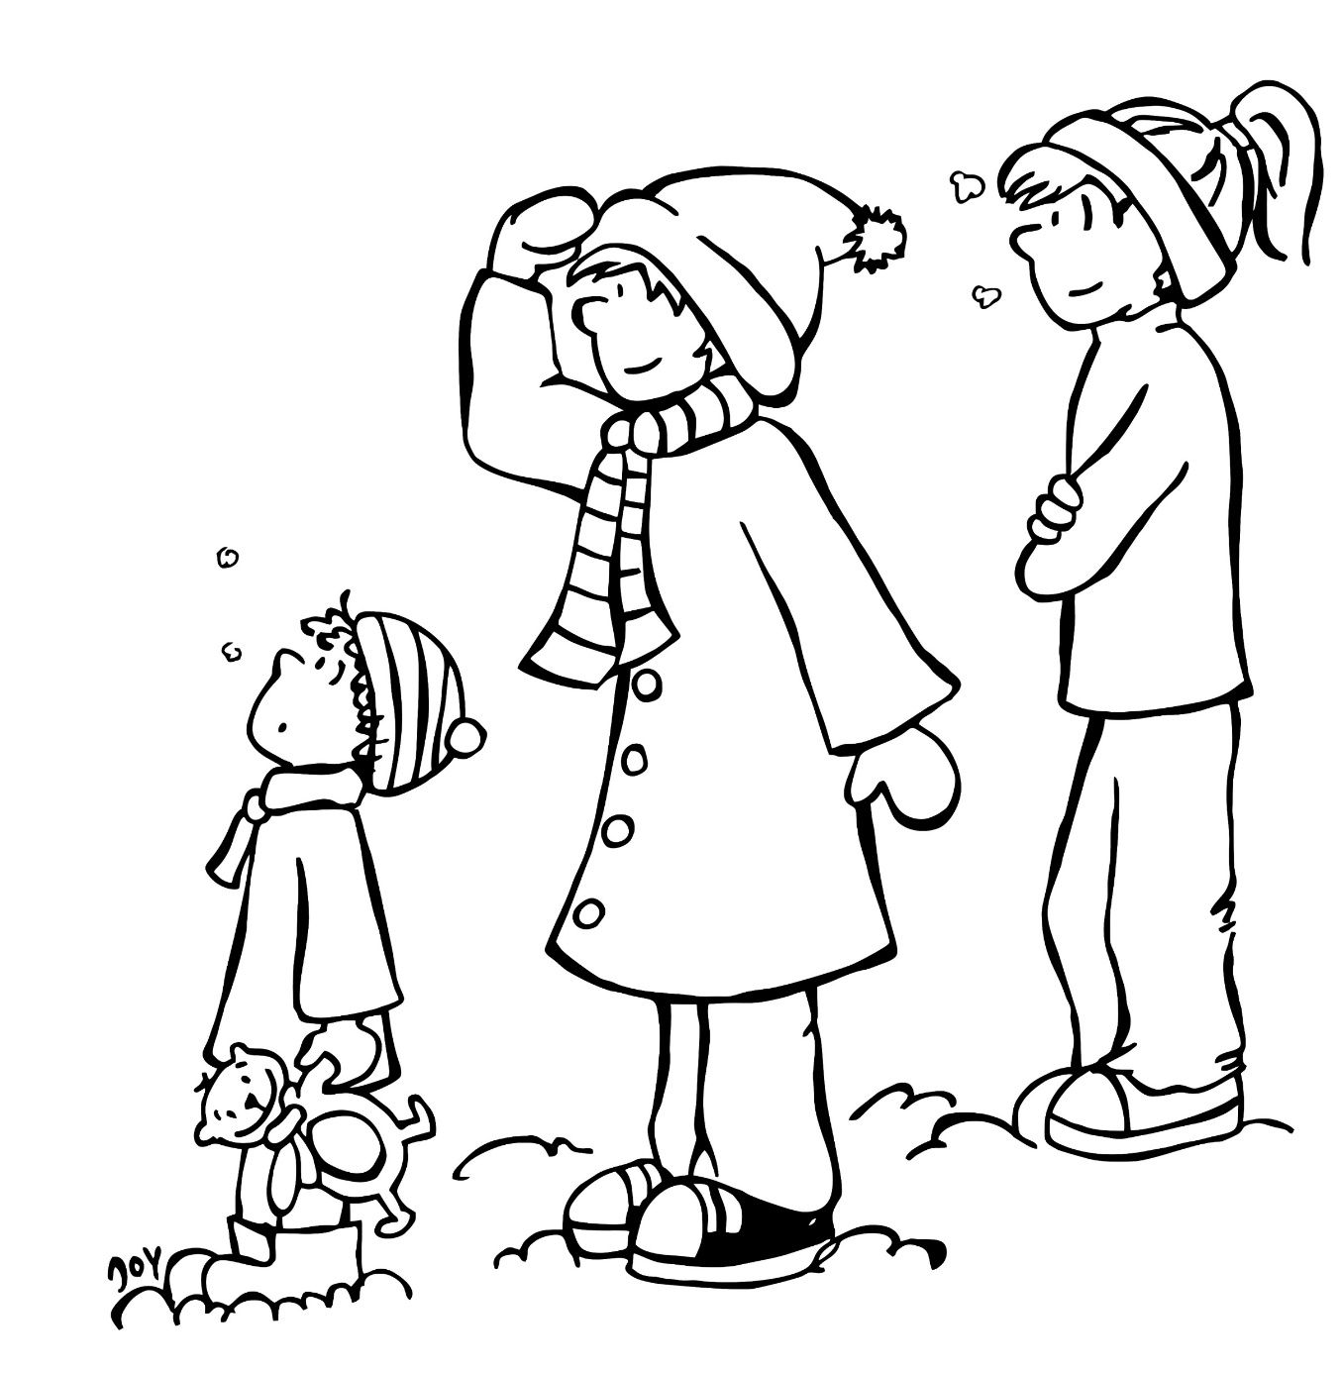
Guten Rutsch
Jewish “Gut Rosch” = Beginning
This is how people greet each other before the new year has come.
It means something like “May you have a nice beginning of the New Year”.
source: https://www.focus.de/wissen/mensch/silvesterbraeuche-so-feiert-deutschland_id_6583812.html
© GET Across Borders
7

Slide 8
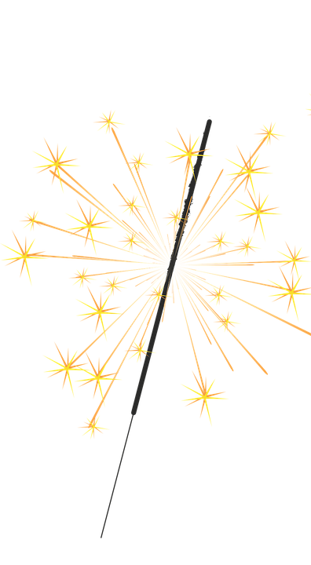
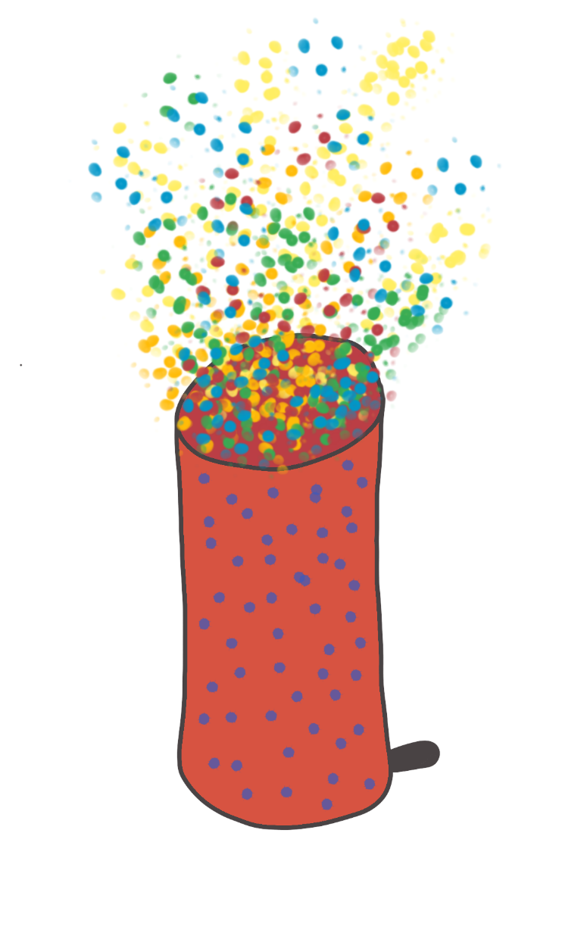
Feuerwerk (fireworks)
Rakete Wunderkerze Tischfeuerwerk
(rocket) (sparkler) (table firework)
© Pixabay
© Pixabay
© GET Across Borders
8

Slide 9
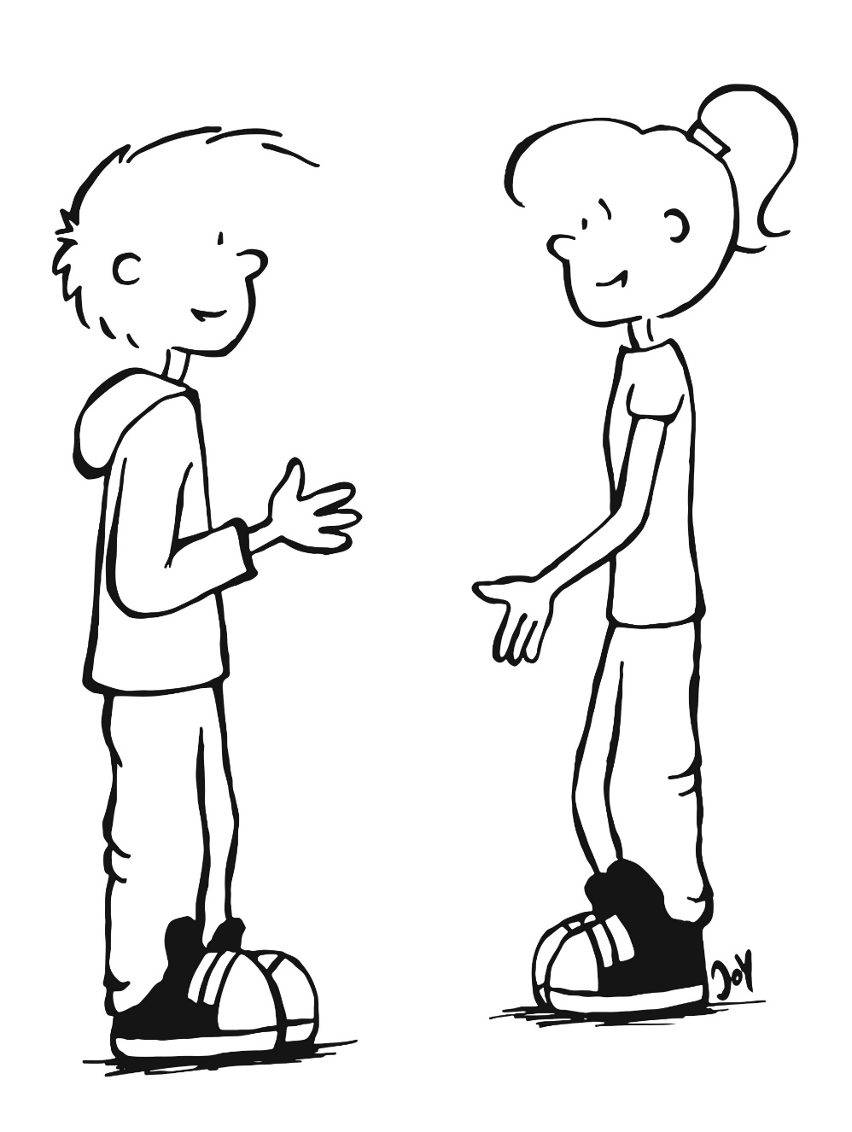
Frohes neues Jahr!
Danke gleichfalls!
(Thank you, the same to you!)
Frohes neues Jahr!
(Happy New Year!)
© GET Across Borders
9

Slide 10
Symbols for good luck
Hufeisen (horseshoe)
Schornsteinfeger (chimney sweeper)
Kleeblatt (shamrock)
Schwein (pig)
Marienkäfer (ladybug)
© GET Across Borders
10

Slide 11
Sources
https://www.focus.de/wissen/mensch/silvesterbraeuche-so-feiert-deutschland_id_6583812.html
https://pixabay.com/de/vectors/feuerwerk-silvester-jahreswechsel-1993221/
https://pixabay.com/de/photos/linsensuppe-speise-nahrung-essen-2325144/
https://pixabay.com/de/photos/raclette-lebensmittel-schinken-k%C3%A4se-1293573/
https://pixabay.com/de/photos/fisch-dorade-kartoffeln-k%C3%BCche-3483465/
https://pixabay.com/de/vectors/brett-spiel-ludo-freizeit-gl%C3%BCck-48117/
© GET Across Borders
11

Slide 12
Sources
https://pixabay.com/de/illustrations/mann-frauen-paar-freude-tanzen-2956377/
https://pixabay.com/de/illustrations/fernseher-schauen-glotzen-fernsehen-1015427/
https://pixabay.com/de/illustrations/wunderkerzen-feuer-spr%C3%BChen-festlich-1134199/
https://pixabay.com/de/vectors/rakete-silvester-pyrotechnik-1115779/
© GET Across Borders
12

Slide 13
Thank you for learning German with us! ☺
DISCLAIMER: Please note that any resources uploaded to this website are purely for educational purposes only. If any of the items, photos or texts uploaded are in infringement of copyright then please do not hesitate to contact us and we will have them removed.
© 2020 – GET Across Borders and © Leap4Joy

