Slide 1
GET Buddied Up
German with Ali, the Eagle
get-across-borders@uni-mainz.de
© 2020 - GET Across Borders

Slide 2
Deutsch lernen mit Ali, unserem Adler Sigrid Rieuwerts get-across-borders@uni-mainz.de

Slide 3
Willkommen!
Today we are going to learn…
how to wish someone “Merry Christmas” in German.
the German words for some Christmas decorations.
how Germans celebrate Christmas.
© GET Across Borders
3

Slide 4
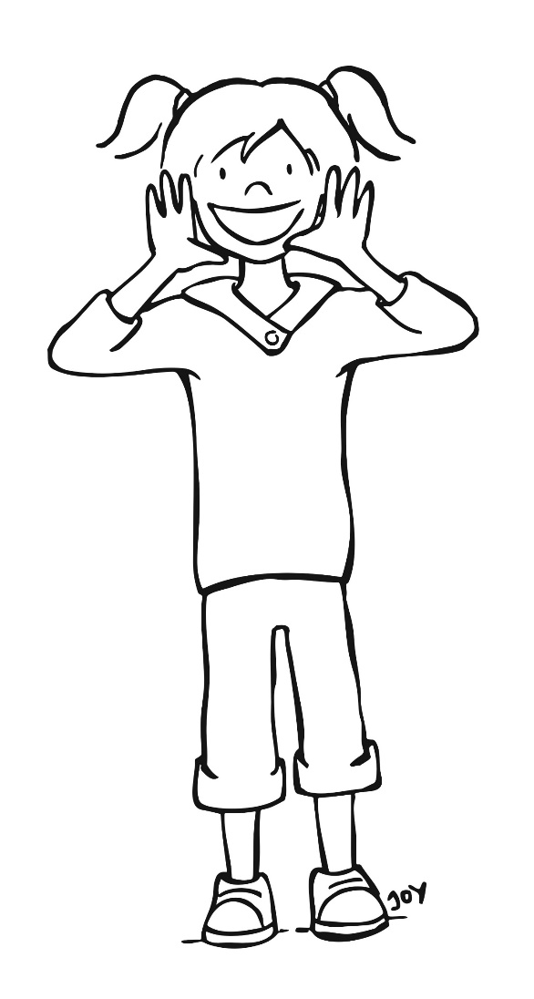
Frohe Weihnachten!
Frohe Weihnachten!
Merry Christmas!
© GET Across Borders
4

Slide 5
Weihnachtsbaum (Christmas tree)
Weihnachtskugeln (Christmas baubles)
Lichter (lights)
Stern (star)
© Pixabay
© GET Across Borders
5

Slide 6
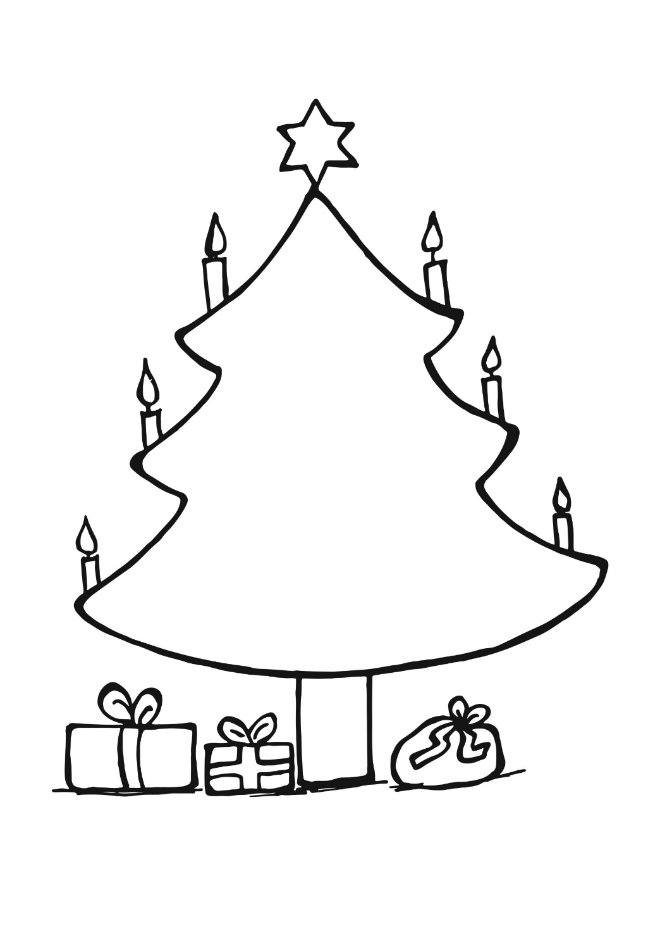
Weihnachten in Deutschland (Christmas in Germany)
Heiliger Abend (Holy evening)
Dezember
24
© GET Across Borders
6

Slide 7
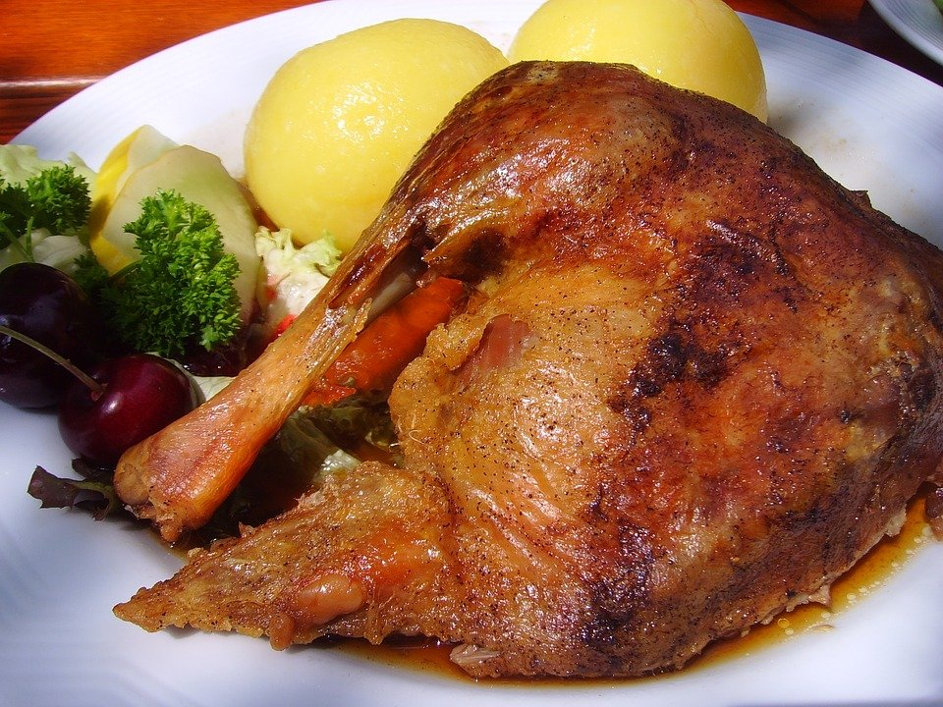
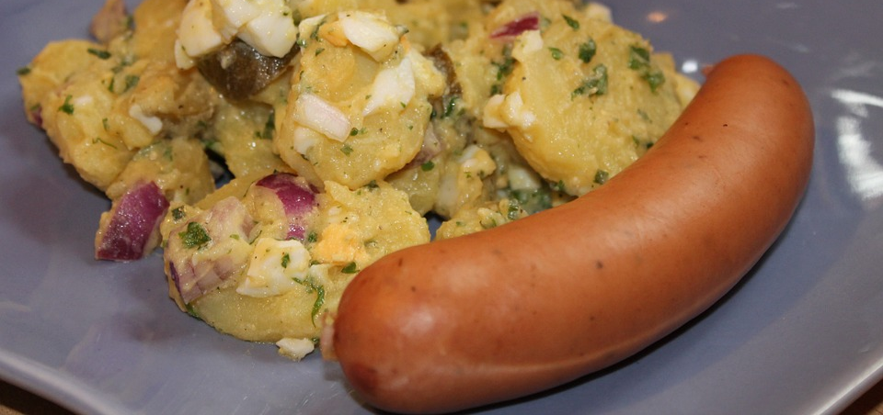
Weihnachtsessen (Christmas dinner)
Gänsebraten
(roast goose)
Kartoffelsalat und Würstchen
(potato salad and sausages)
© Pixabay
© Pixabay
© GET Across Borders
7

Slide 8
Bescherung
This is what we call the sharing of the presents.
© GET Across Borders
8

Slide 9
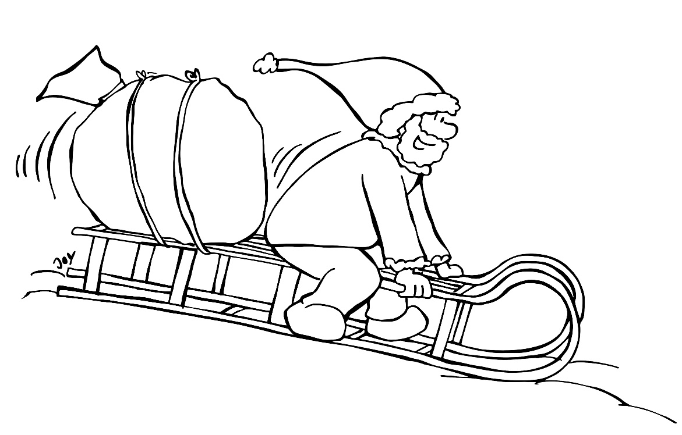
Wer bringt die Geschenke? (Who brings the presents?)
Christkind
Weihnachtsmann
distribution is taken from: www.noz.de/deutschland-welt/gut-zu-wissen/artikel/1607700/unterschied-fuer-kinder-weihnachtsmann-oder-christkind
9
© GET Across Borders

Slide 10
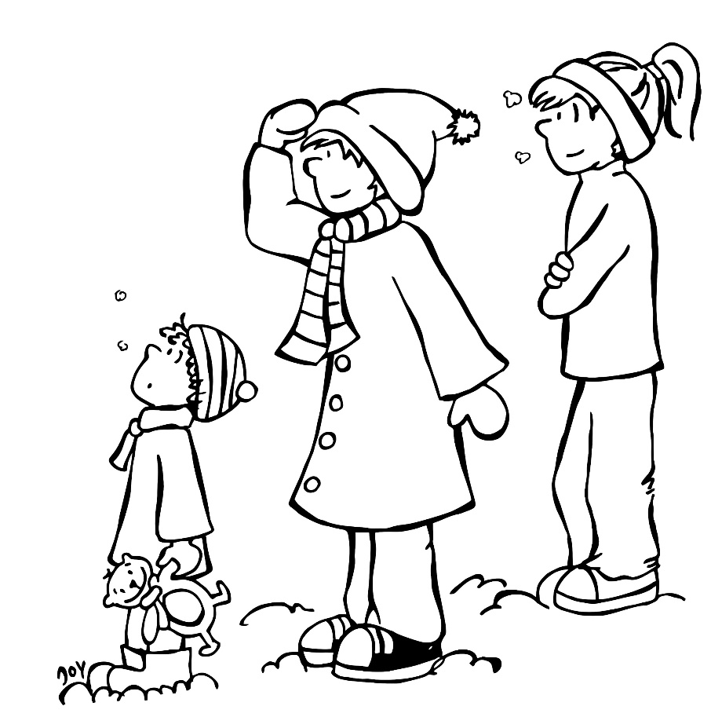
Weihnachtsfeiertage (Christmas holidays)
People usually meet their friends and families on these days.
Dezember
Dezember
25
26
© GET Across Borders
10

Slide 11
Sources
https://cdn.pixabay.com/photo/2012/04/25/00/47/christmas-tree-41452_1280.png
https://cdn.pixabay.com/photo/2016/11/15/14/55/roast-goose-1826465_1280.jpg
https://cdn.pixabay.com/photo/2014/04/05/12/06/bockwurst-316788_1280.jpg
www.noz.de/deutschland-welt/gut-zu-wissen/artikel/1607700/unterschied-fuer-kinder-weihnachtsmann-oder-christkind
© GET Across Borders
11

Slide 12
Thank you for learning German with us! ☺
DISCLAIMER: Please note that any resources uploaded to this website are purely for educational purposes only. If any of the items, photos or texts uploaded are in infringement of copyright then please do not hesitate to contact us and we will have them removed.
© 2020 – GET Across Borders and © Leap4Joy

