Slide 1
GET Buddied Up
German with Ali, the Eagle
get-across-borders@uni-mainz.de
© 2020 - GET Across Borders

Slide 2
Deutsch lernen mit Ali, unserem Adler Sigrid Rieuwerts get-across-borders@uni-mainz.de

Slide 3
Willkommen!
Today we are going to learn…
who Nikolaus is.
what Germans celebrate on the 6th of December.
what is inside of a “Nikolaus-Stiefel”.
© GET Across Borders
3

Slide 4
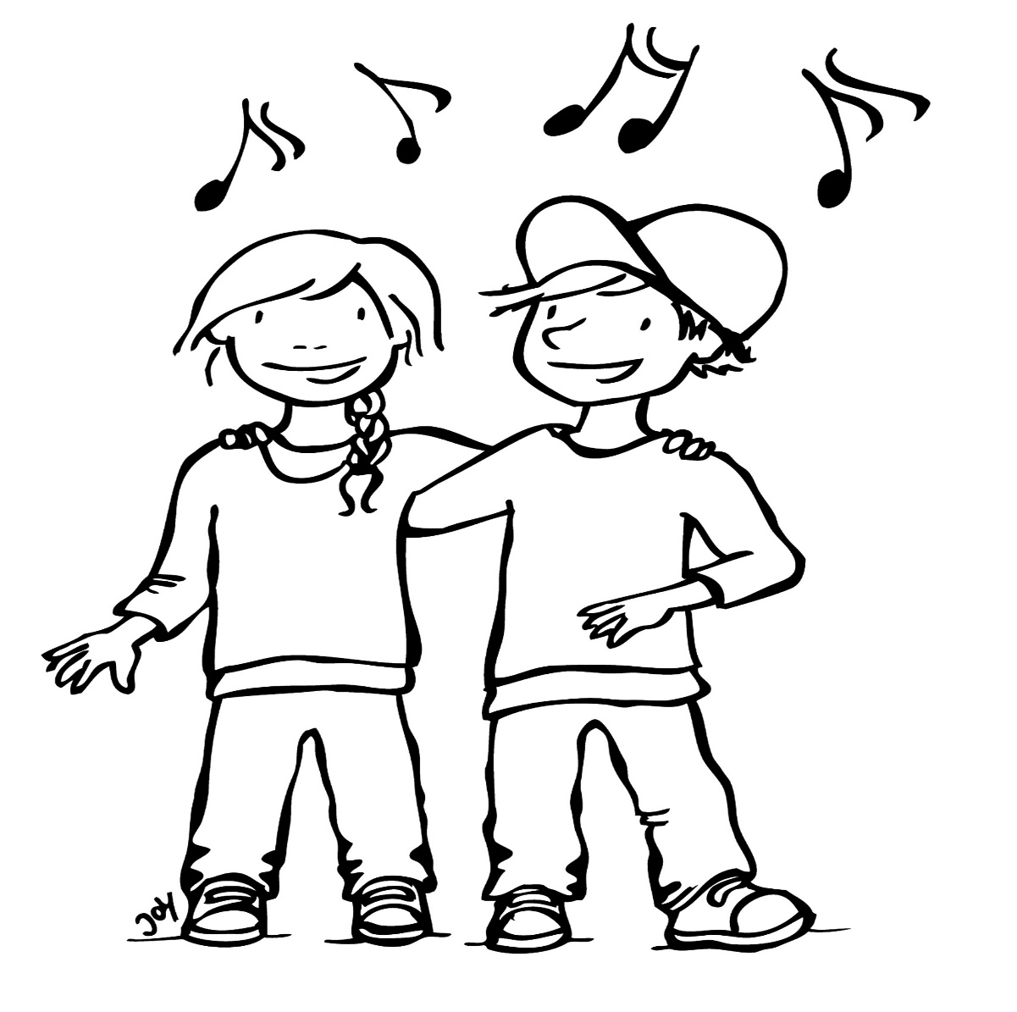
Lied: “Lasst uns froh und munter sein“
Lasst uns froh und munter sein und uns recht von Herzen freu‘n! Lustig, lustig, tralalalala! Bald ist Nikolausabend da, bald ist Nikolausabend da!
© GET Across Borders
4
Notes:
Please click on the sound symbol to play the song.
English translation:
Let us be glad and happy, and let us rejoice with all of our hearts.
Jolly, jolly, tralalalala! Soon Nikolaus evening will be here.
Soon Nikolaus evening will be here.

Slide 5
Wer ist Nikolaus? (Who is Nikolaus?)
He lived 1700 years ago
in Turkey.
He was rich.
He gave money to poor children.
He threw bags with money through the windows.
Source: Koerrenz, M. (2013). Entdeckungsreise Kirchenjahr: Unterrichtsmaterialien für die Grundschule. Göttingen: Vandenhoeck & Ruprecht.
© GET Across Borders
5

Slide 6
Nikolaustag (Nikolaus Day)
A special day in Germany
Children get little presents from the Nikolaus.
Dezember
6
© GET Across Borders
6

Slide 7
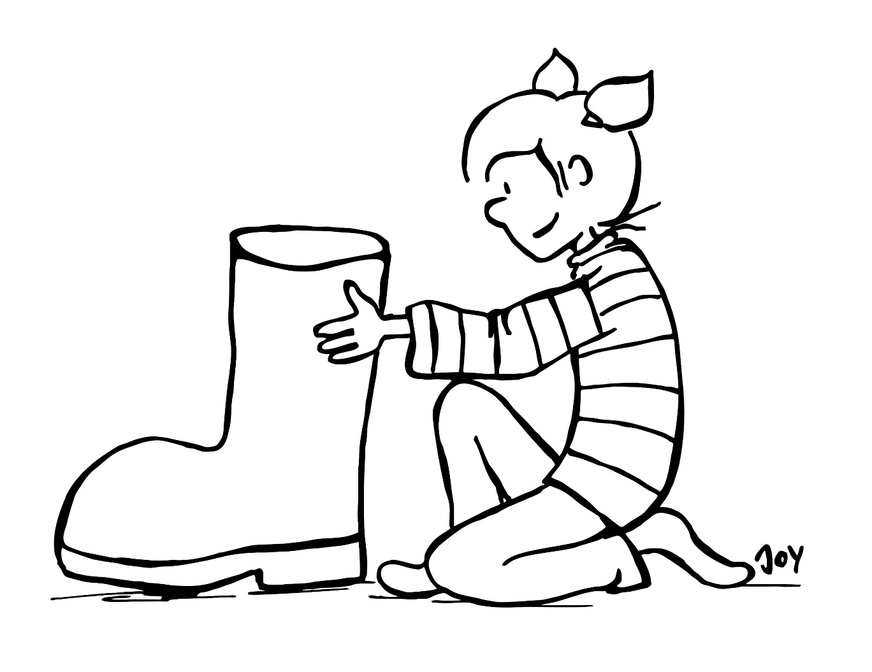
Der Tag davor... (The day before...)
Dezember
5
Wir putzen den Stiefel.
(We clean the boot.)
Wir stellen den Stiefel an die Tür.
(We put the boot to the door.)
© GET Across Borders
7

Slide 8
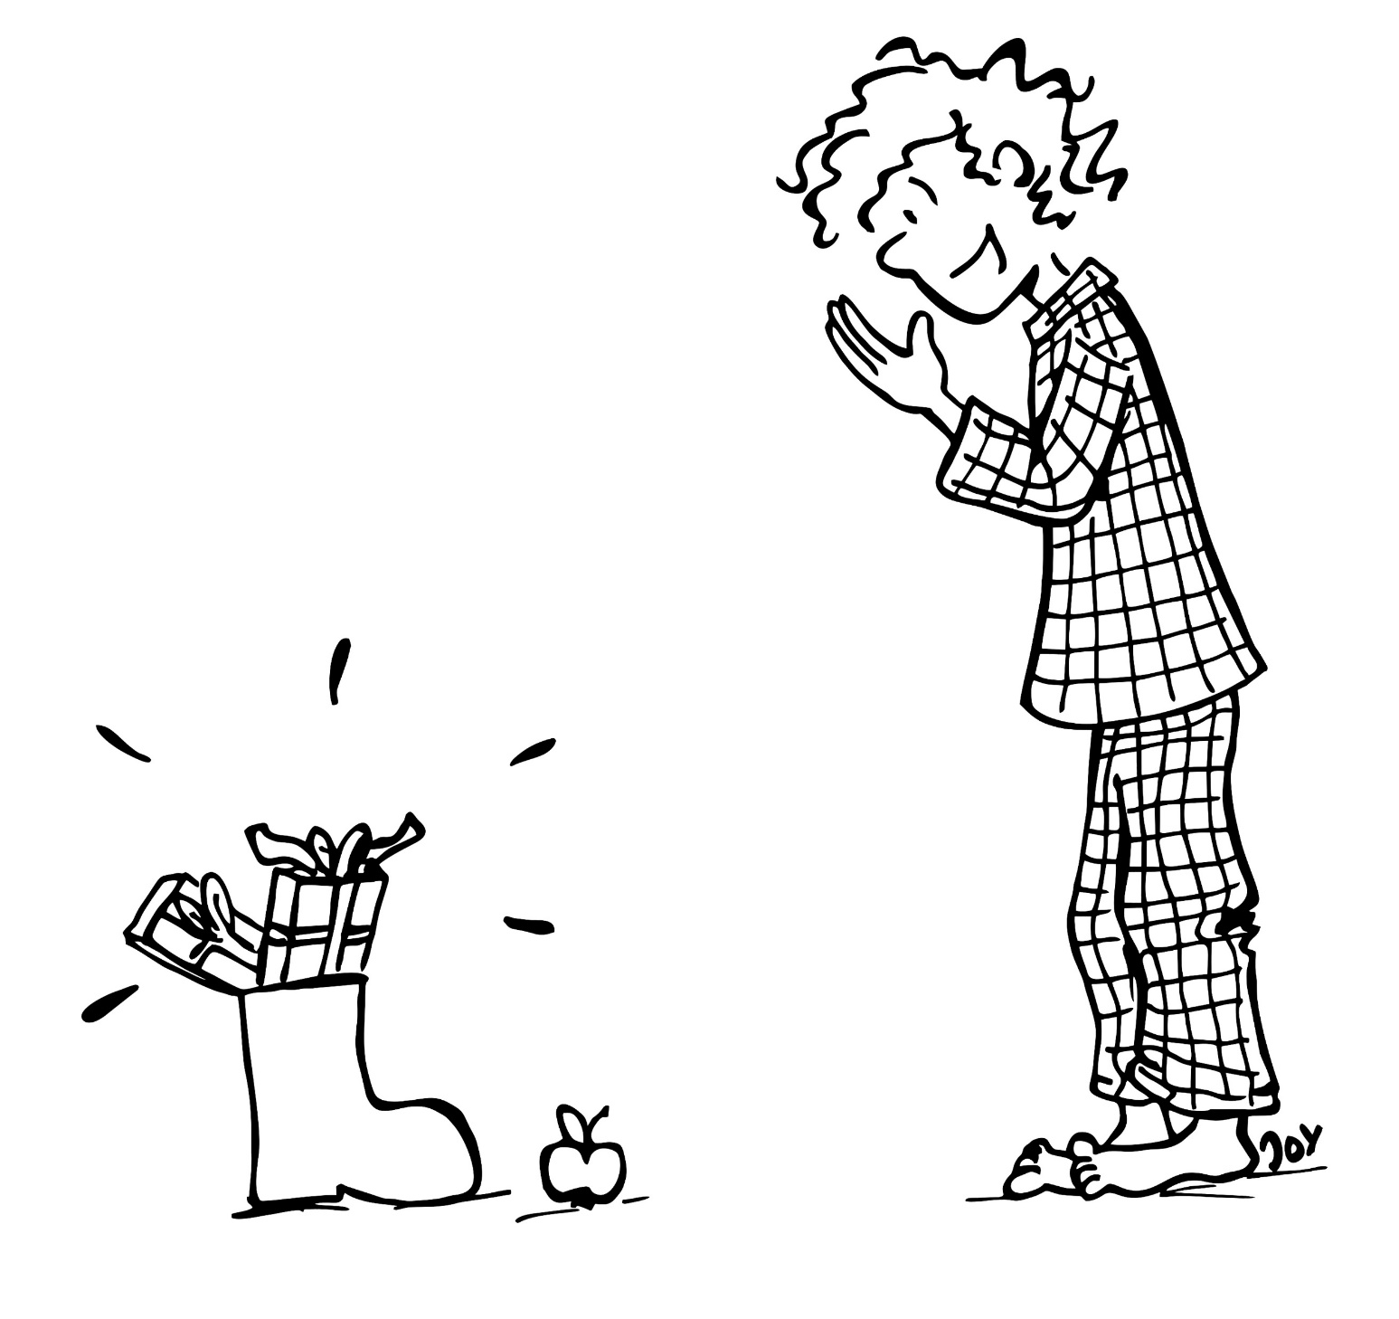
Es ist Nikolaustag! (It’s Nikolaus Day!)
Dezember
6
Wir stehen früh auf.
(We get up early.)
In unserem Stiefel sind Geschenke.
(There are gifts in our boot.)
© GET Across Borders
8

Slide 9
Was ist im Nikolaus-Stiefel? (What is inside of a „Nikolaus-Stiefel“?)
Schokolade
(chocolate)
Mandarinen
(tangerines)
Nüsse (nuts) Stiefel (boot)
© GET Across Borders
9

Slide 10
Sources
Koerrenz, M. (2013). Entdeckungsreise Kirchenjahr: Unterrichtsmaterialien für die Grundschule. Göttingen: Vandenhoeck & Ruprecht.
© GET Across Borders
10

Slide 11
Thank you for learning German with us! ☺
DISCLAIMER: Please note that any resources uploaded to this website are purely for educational purposes only. If any of the items, photos or texts uploaded are in infringement of copyright then please do not hesitate to contact us and we will have them removed.
© 2020 – GET Across Borders and © Leap4Joy

