Slide 1






GET Buddied Up
German with Ali, the Eagle
get-across-borders@uni-mainz.de
© 2020 - GET Across Borders

Slide 2
Deutsch lernen mit Ali, unserem Adler
Sigrid Rieuwerts get-across-borders@uni-mainz.de

Slide 3

Welcome!
Today we are talking about “My school”:
Wie beschreibe ich meine Schule?
How do I describe my school?
Wie groß ist meine Schule?
How big is my school?
Wie alt ist meine Schule?
How old is my school?
Wie viele Schüler gibt es an meiner Schule?
How many students are there at my school?
© GET Across Borders

Slide 4
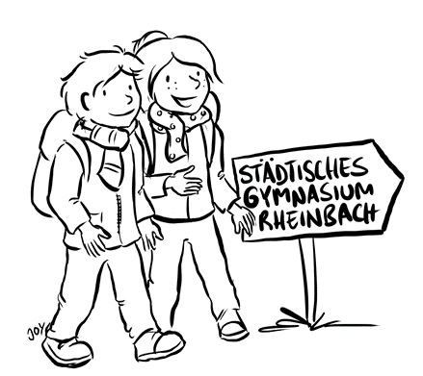
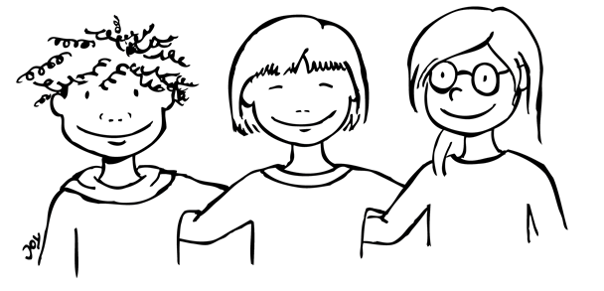
How do I describe my school?
Wie beschreibe ich meine Schule?
Es gibt viele Wege:
Ich kann
die Größe
das Alter
oder andere Besonderheiten
beschreiben.
There are many ways to describe my school:
I can describe
the size
the age
or other special features of your school.
© GET Across Borders
4

Slide 5
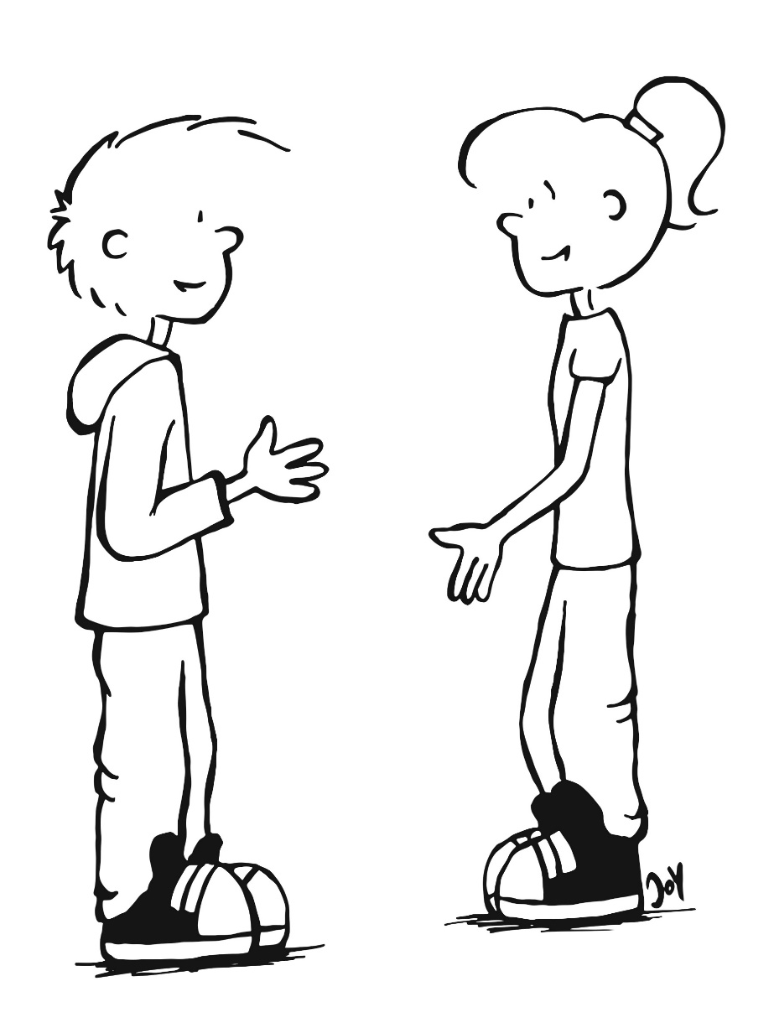
How big is my school?
Wie groß ist meine Schule?
How big is my school?
Meine Schule ist groß.
My school is big.
Meine Schule ist klein.
My school is small.
© GET Across Borders
5

Slide 6
How old is my school?
Wie alt ist meine Schule?
How old is my school?
Meine Schule ist (sehr) alt.
My school is (very) old.
Meine Schule ist (sehr) neu.
My school is (very) new.
© GET Across Borders
6

Slide 7
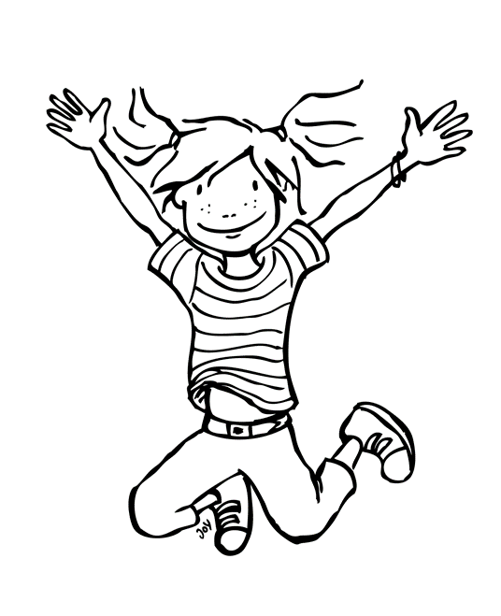

How many students are at my school?
Wie viele Schüler gibt es an meiner Schule?
How many students are at my school?
Meine Schule hat viele Schüler.
My school has many students.
Meine Schule hat wenige Schüler.
My school has only few students.
© GET Across Borders

Slide 8
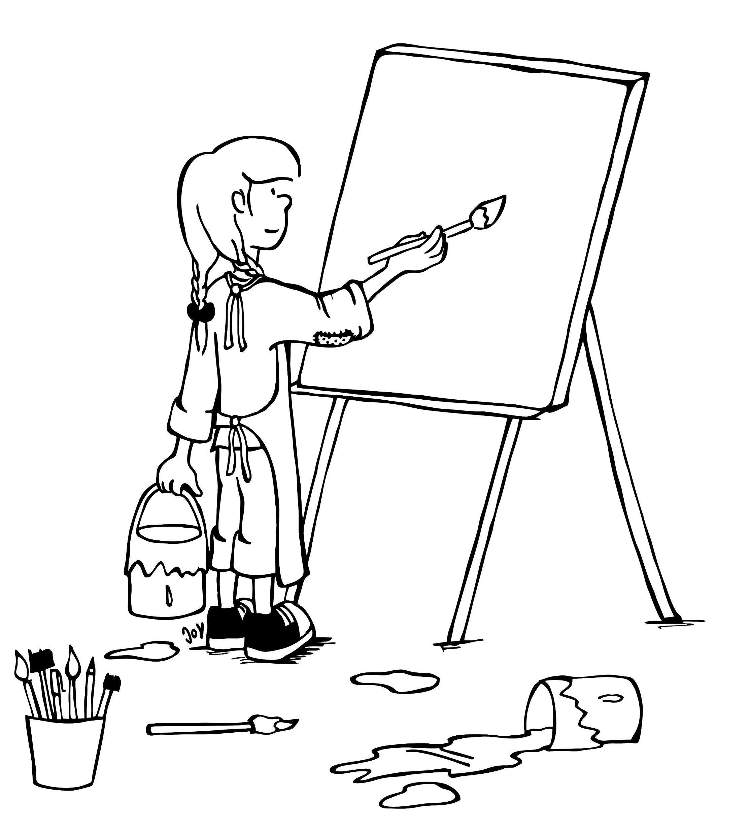
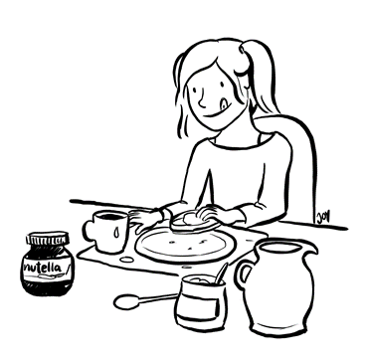
What is special at my school?
Welche Besonderheiten hat meine Schule?
What is special at my school?
Meine Schule hat eine Werkstatt.
My school has an atelier.
Meine Schule hat ein Schwimmbad.
My school has a swimming pool.
Meine Schule hat eine Küche.
My school has a kitchen.
© GET Across Borders
8

Slide 9
Exercise 1
Beschreibe deine Schule in 3 bis 4 kurzen Sätzen. Schreibe über
die Größe
das Alter
und die Besonderheiten.
Describe your school in 3 to 4 short sentences. Write about
its size
its age
and special features.
© GET Across Borders

Slide 10
Exercise 2
Teile und vergleiche deine Ergebnisse mit der Klasse. Was haben deine Mitschüler beschrieben? Was hast du beschrieben?
Share and compare your results with your classmates. Which things did they describe? Which things did you describe?
© GET Across Borders

Slide 11
Thank you for learning German with us! ☺
DISCLAIMER: Please note that any resources uploaded to this website are purely for educational purposes only. If any of the items, photos or texts uploaded are in infringement of copyright then please do not hesitate to contact us and we will have them removed.
© 2020 – GET Across Borders and © Leap4Joy

