Slide 1






GET Buddied Up
German with Ali, the Eagle
get-across-borders@uni-mainz.de
© 2020 - GET Across Borders

Slide 2
Deutsch lernen mit Ali, unserem Adler
Sigrid Rieuwerts get-across-borders@uni-mainz.de

Slide 3
Herzlich willkommen!
What we’re going to learn today…
Die Schulsachen /
The school items
Fragen /
How to ask for something
© GET Across Borders

Slide 4
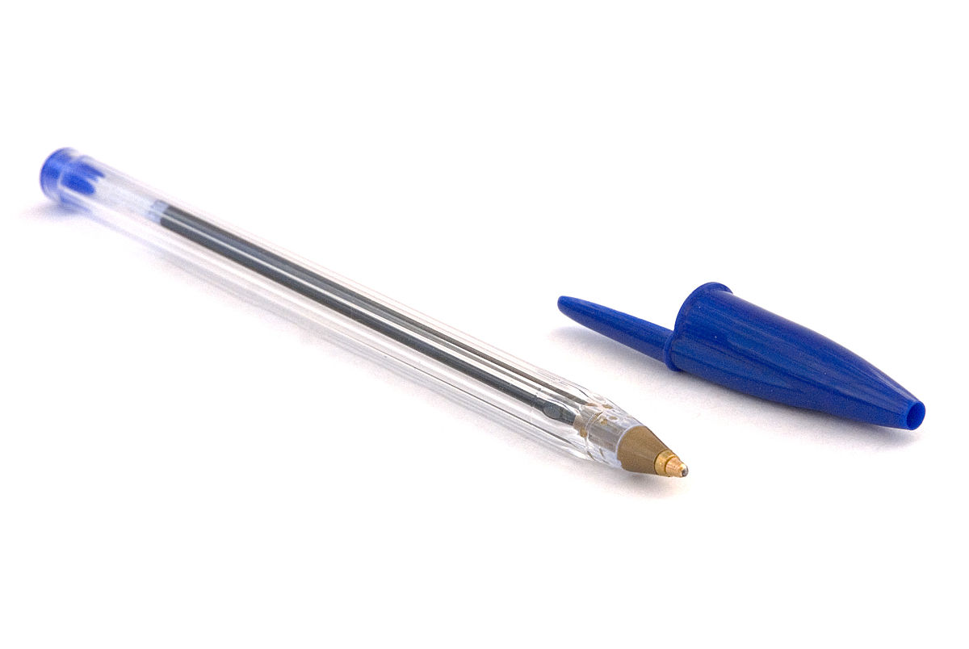


Schulsachen – school items
der Kuli
(der Kugelschreiber)
der Radiergummi
©Wikipedia
©Pixabay
© GET Across Borders
4

Slide 5


Schulsachen – school items
der Bleistift
der Buntstift
©Pexels
©Pixabay
5
© GET Across Borders

Slide 6
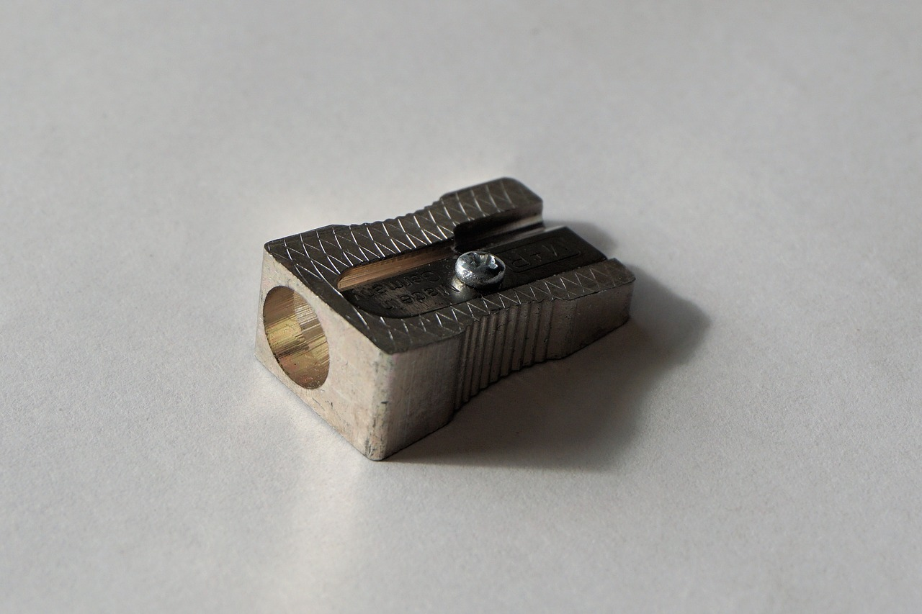
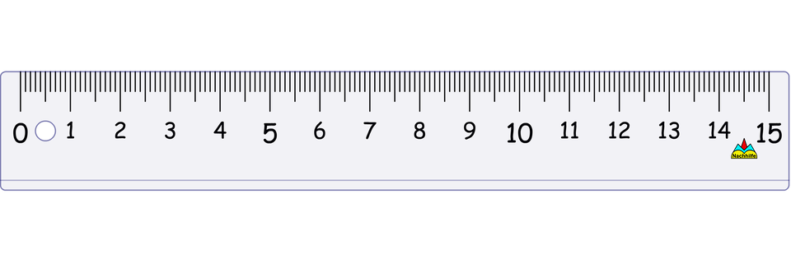
Schulsachen – school items
der Spitzer
das Lineal
©Pixabay
©Pixabay
© GET Across Borders
6

Slide 7

Schulsachen – school items
der Kleber
(der Klebstift)
die Schere
©Pixabay
©Pixabay
© GET Across Borders
7

Slide 8


Schulsachen – school items
das Heft
das Buch
©Pixabay
©pngimg
8
© GET Across Borders

Slide 9

Schulsachen – school items
das Blatt Papier
©FREE SVG
© GET Across Borders

Slide 10
Was fehlt? – What is missing?
You will see two pictures of school items on each of the following slides.
In the first step you have to name each of the items.
On the slide after that, one picture is missing. You then have to name the missing item.
© GET Across Borders

Slide 11
Was fehlt?
der Kuli
(der Kugelschreiber)
der Radiergummi
©Wikipedia
©Pixabay
© GET Across Borders
11

Slide 12
Was fehlt?
der Kuli
(der Kugelschreiber)
der Radiergummi
©Wikipedia
©Pixabay
© GET Across Borders
12

Slide 13

Was fehlt?
der Bleistift
der Buntstift
©Pexels
©Pixabay
© GET Across Borders
13

Slide 14
Was fehlt?
der Bleistift
der Buntstift
©Pexels
©Pixabay
© GET Across Borders
14

Slide 15
Was fehlt?
der Spitzer
das Lineal
©Pixabay
©Pixabay
© GET Across Borders
15

Slide 16
Was fehlt?
der Spitzer
das Lineal
©Pixabay
©Pixabay
© GET Across Borders
16

Slide 17
Was fehlt?
der Kleber
(der Klebestift)
die Schere
©Pixabay
©Pixabay
© GET Across Borders
17

Slide 18
Was fehlt?
der Kleber
(der Klebestift)
die Schere
©Pixabay
©Pixabay
© GET Across Borders
18

Slide 19
Was fehlt?
das Heft
das Buch
©Pixabay
©pngimg
19
© GET Across Borders

Slide 20
Was fehlt?
das Heft
das Buch
©Pixabay
©pngimg
20
© GET Across Borders

Slide 21
Was fehlt?
das Blatt Papier
©FREE SVG
© GET Across Borders

Slide 22
Was fehlt?
das Blatt Papier
©FREE SVG
© GET Across Borders

Slide 23
Was möchtest du?
What do you want?
Was möchtest du?
I want … please.
Ich möchte … bitte.
© GET Across Borders

Slide 24
An example
Q: Was möchtest du?
A1: Ich möchte einen Stift bitte.
A2: Ich möchte eine Schere bitte.
A3: Ich möchte ein Heft bitte.
© GET Across Borders

Slide 25
Practice Partner A
Ask Partner B for the following items in German:
pencil
glue stick
scissors
notebook/jotter
B: Was möchtest du?
A: Ich möchte einen Stift bitte. Was möchtest du?
© GET Across Borders

Slide 26
Practice Partner B
Ask Partner A for the following items in German:
rubber
ruler
piece of paper
pencil sharpener
A: Was möchtest du?
B: Ich möchte ein Lineal bitte. Was möchtest du?
© GET Across Borders

Slide 27
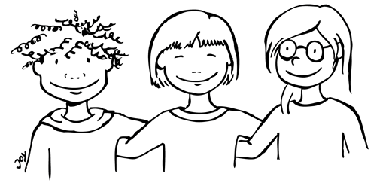

Word Bank
Create a group word bank with your classmates for school items and how to ask for them. Try to use it in every day classroom situations, even when it is not your German lesson.
© GET Across Borders
27

Slide 28
Sources
https://en.wikipedia.org/wiki/Bic_Cristal#/media/File:03-BICcristal2008-03-26.jpg
https://cdn.pixabay.com/photo/2012/04/14/14/23/eraser-34105_640.png
https://www.pexels.com/de-de/foto/bleistift-auf-weissbuch-159752/
https://pixabay.com/de/photos/buntstifte-farbstifte-sternf%C3%B6rmig-374771/
https://pixabay.com/de/photos/spitzer-bleistiftspitzer-b%C3%BCro-1237626/
https://cdn.pixabay.com/photo/2015/11/05/05/46/ruler-1023726_960_720.png
© GET Across Borders
28

Slide 29
Sources
https://pixabay.com/de/illustrations/kleber-pool-selbstklebend-behoben-1135242/
https://cdn.pixabay.com/photo/2014/04/03/10/51/scissors-311500_960_720.png
https://cdn.pixabay.com/photo/2013/07/13/13/52/school-161701_960_720.png
https://pngimg.com/download/2121
https://freesvg.org/notebook-paper
© GET Across Borders
29

Slide 30
Thank you for learning German with us! ☺
DISCLAIMER: Please note that any resources uploaded to this website are purely for educational purposes only. If any of the items, photos or texts uploaded are in infringement of copyright then please do not hesitate to contact us and we will have them removed.
© 2020 – GET Across Borders and © Leap4Joy

