Slide 1



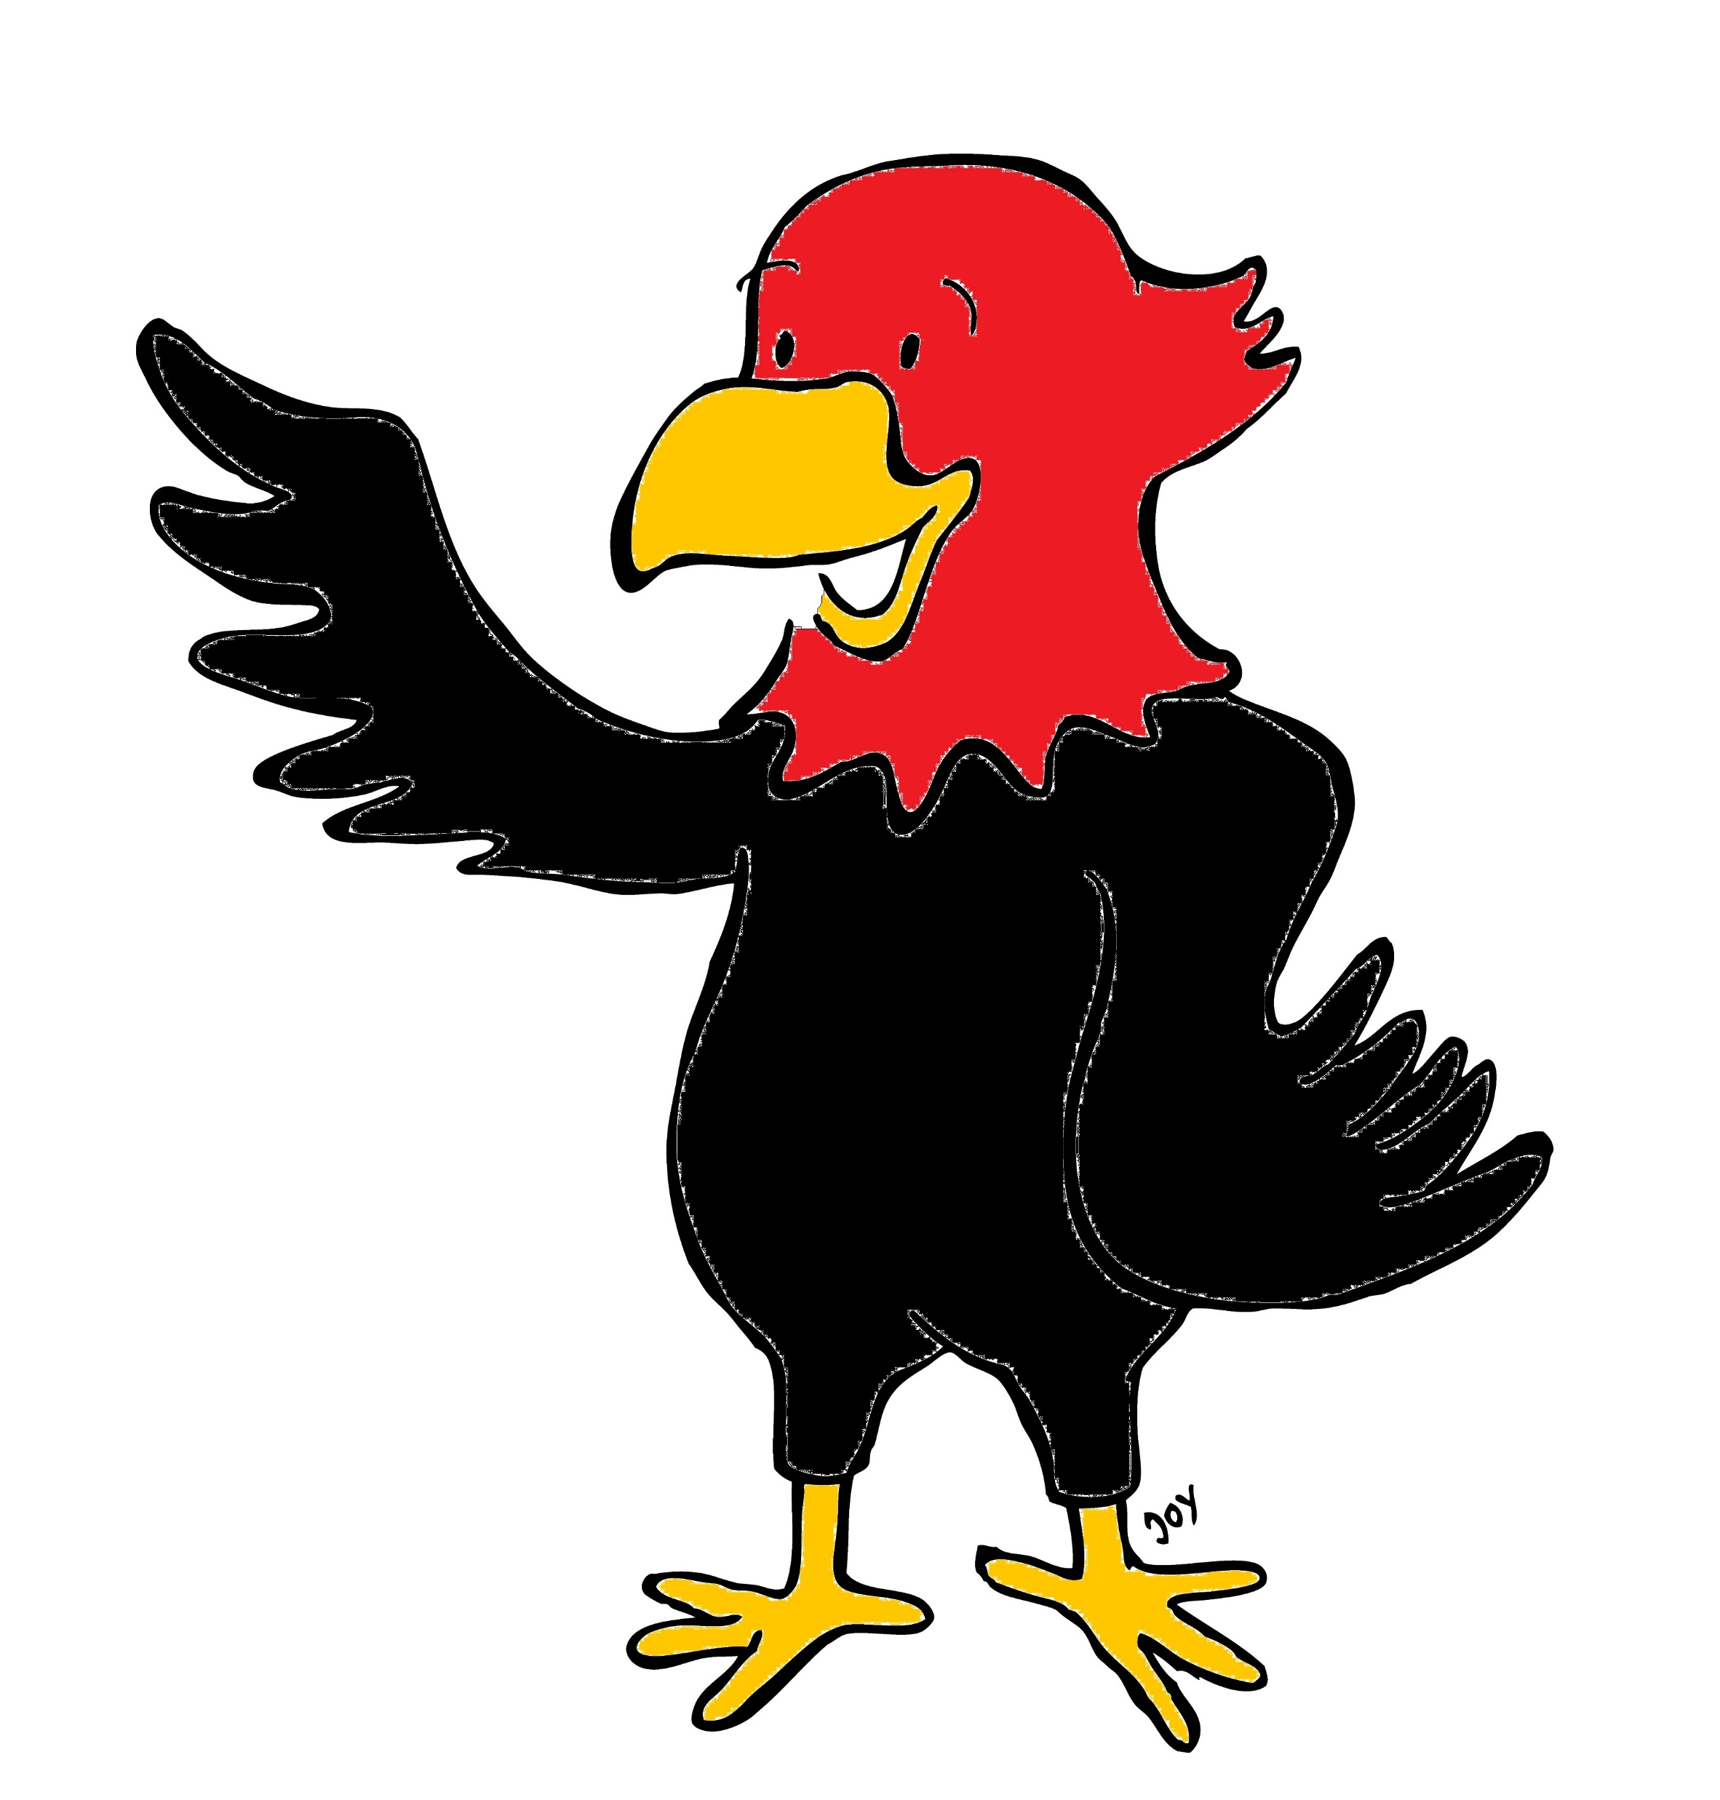

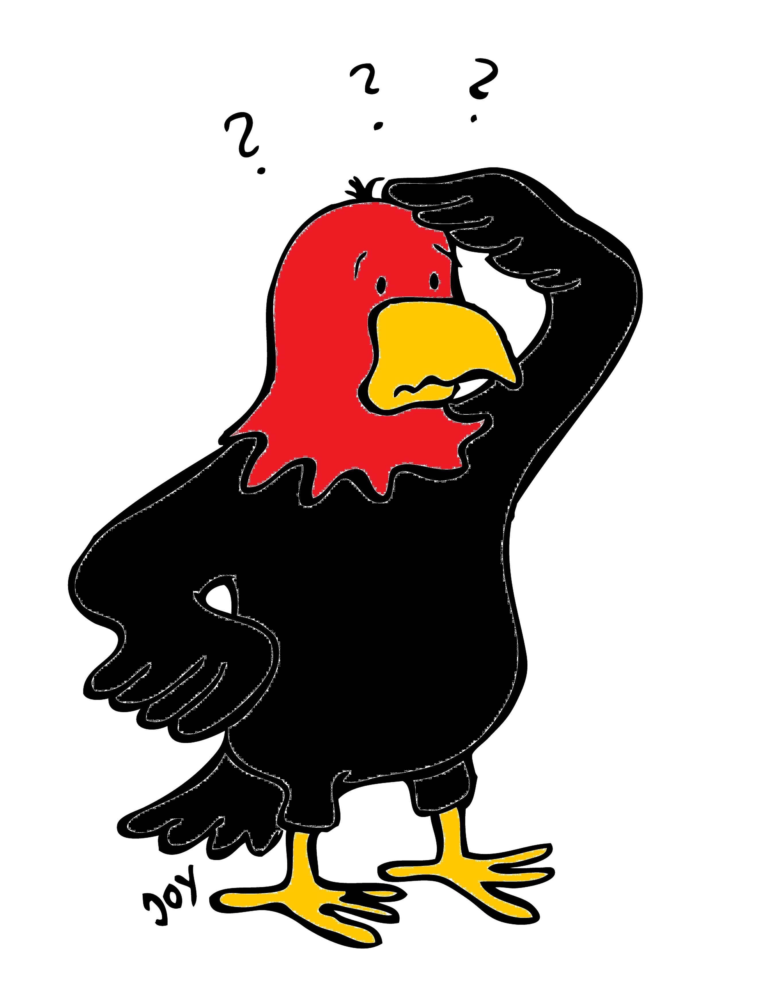
GET Buddied Up
German with Ali, the Eagle
get-across-borders@uni-mainz.de
© 2020 - GET Across Borders

Slide 2
Deutsch lernen mit Ali, unserem Adler
Sigrid Rieuwerts get-across-borders@uni-mainz.de

Slide 3
Willkommen!
Today, we will learn …
Goodbyes in German
There are part of every basic conversation.
© GET Across Borders

Slide 4
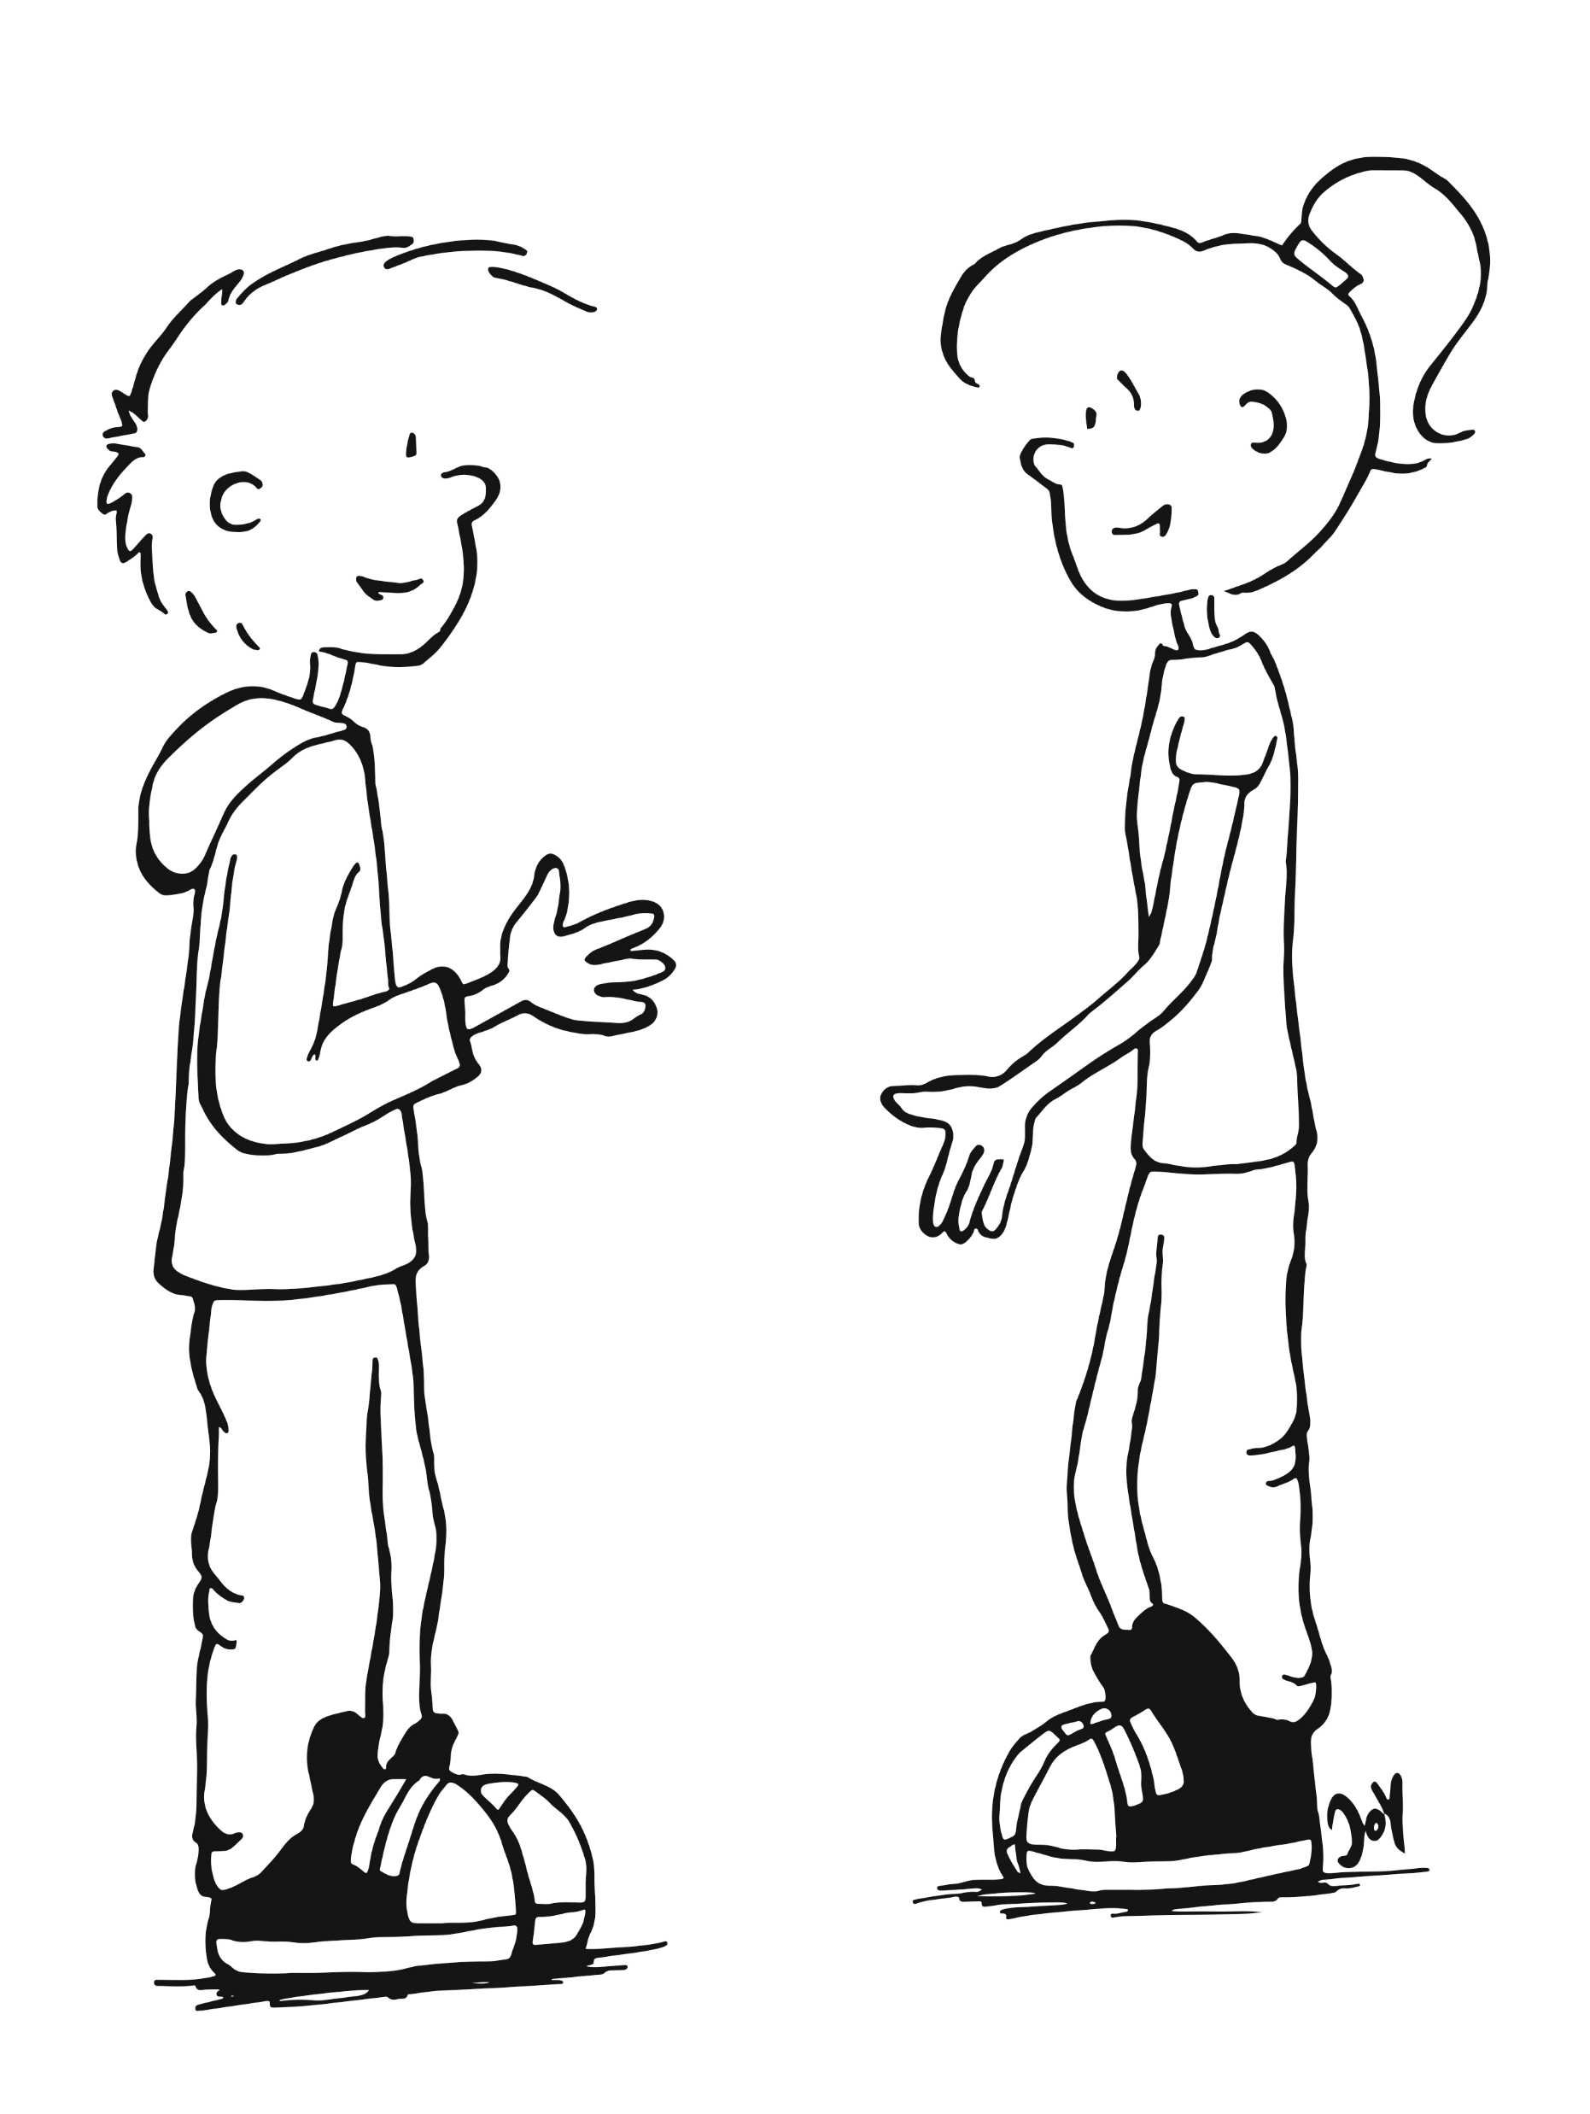

Bye! Goodbye!
Auf Wiedersehen!
Tschüss!
© GET Across Borders

Slide 5
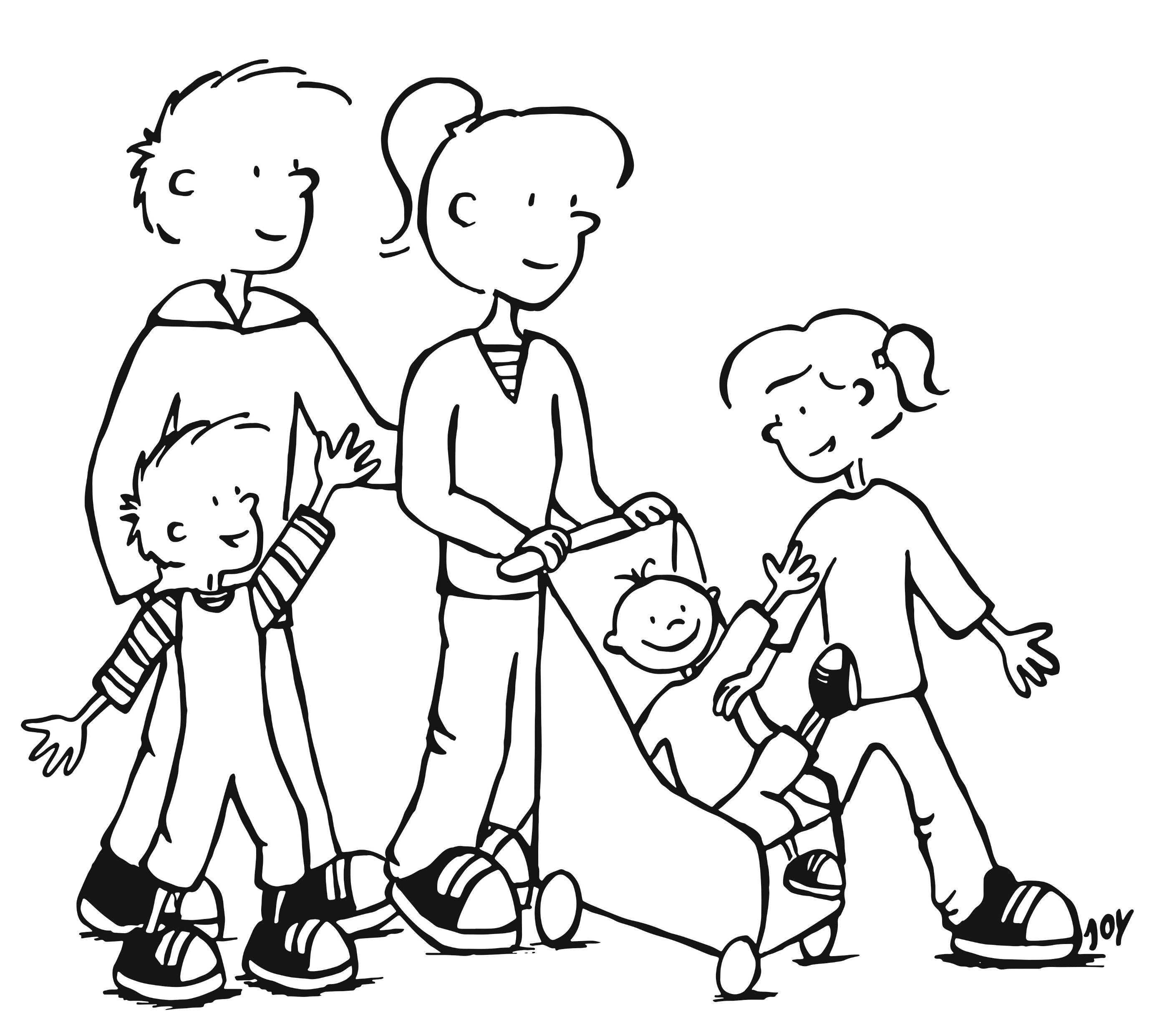
See you soon!
Bis bald!
© GET Across Borders

Slide 6
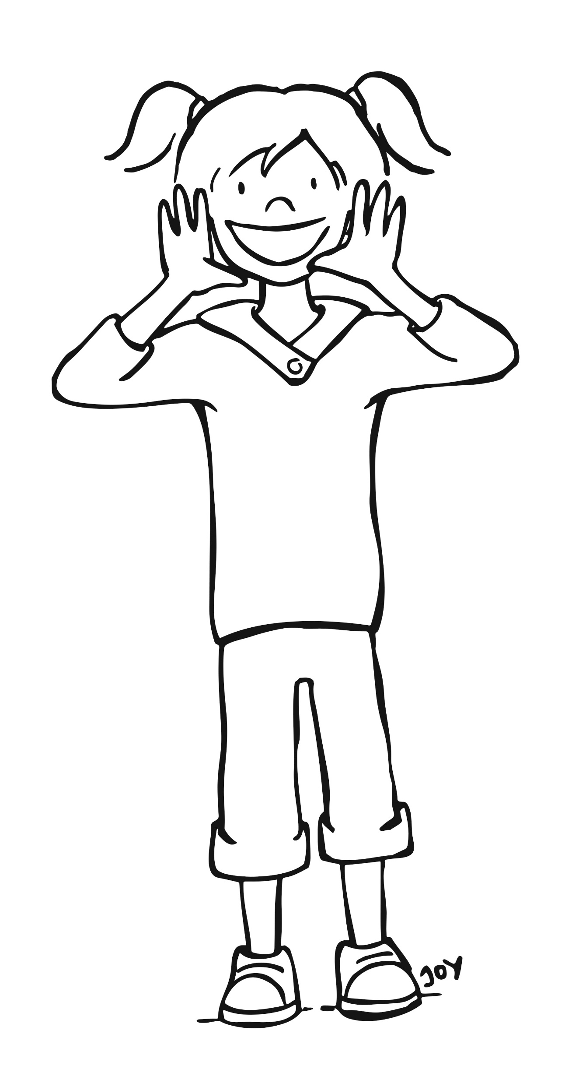
See you tomorrow!
Bis morgen!
© GET Across Borders

Slide 7
Who said what?
Match the phrase with the picture.
Tschüss!
Bis Morgen!
Auf Wiedersehen!
Bis Bald!
© GET Across Borders

Slide 8
Summary
Tschüss!
Bye!
Goodbye!
See you soon!
See you tomorrow!
Auf Wiedersehen!
Bis bald!
Bis morgen!
© GET Across Borders

Slide 9
Thank you for learning German with us! ☺
DISCLAIMER: Please note that any resources uploaded to this website are purely for educational purposes only. If any of the items, photos or texts uploaded are in infringement of copyright then please do not hesitate to contact us and we will have them removed.
© 2020 – GET Across Borders and © Leap4Joy

