Slide 1





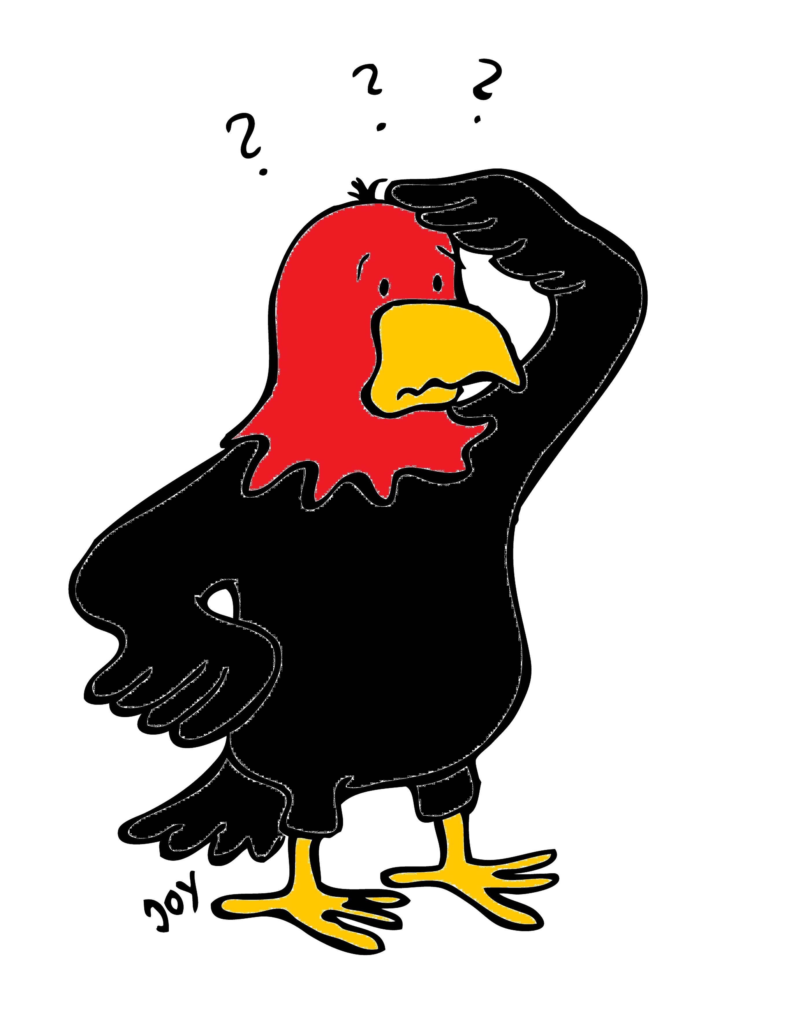
GET Buddied Up
German with Ali, the Eagle
get-across-borders@uni-mainz.de
© 2020 - GET Across Borders

Slide 2
Deutsch lernen mit Ali, unserem Adler
Sigrid Rieuwerts get-across-borders@uni-mainz.de

Slide 3
Willkommen!
Today, we will learn …
Greetings in German
This is important for every conversation with other people.
© GET Across Borders

Slide 4
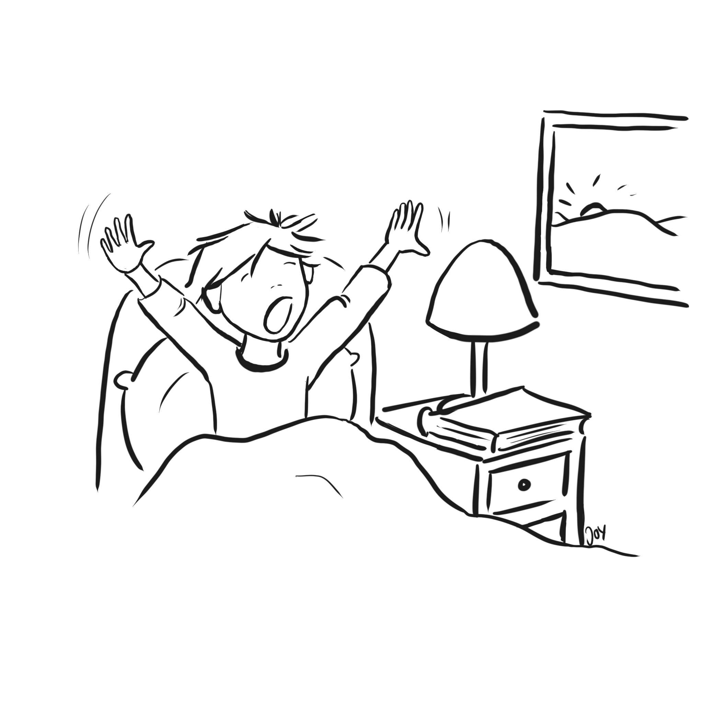

Good morning!
Guten Morgen!
© GET Across Borders
4

Slide 5
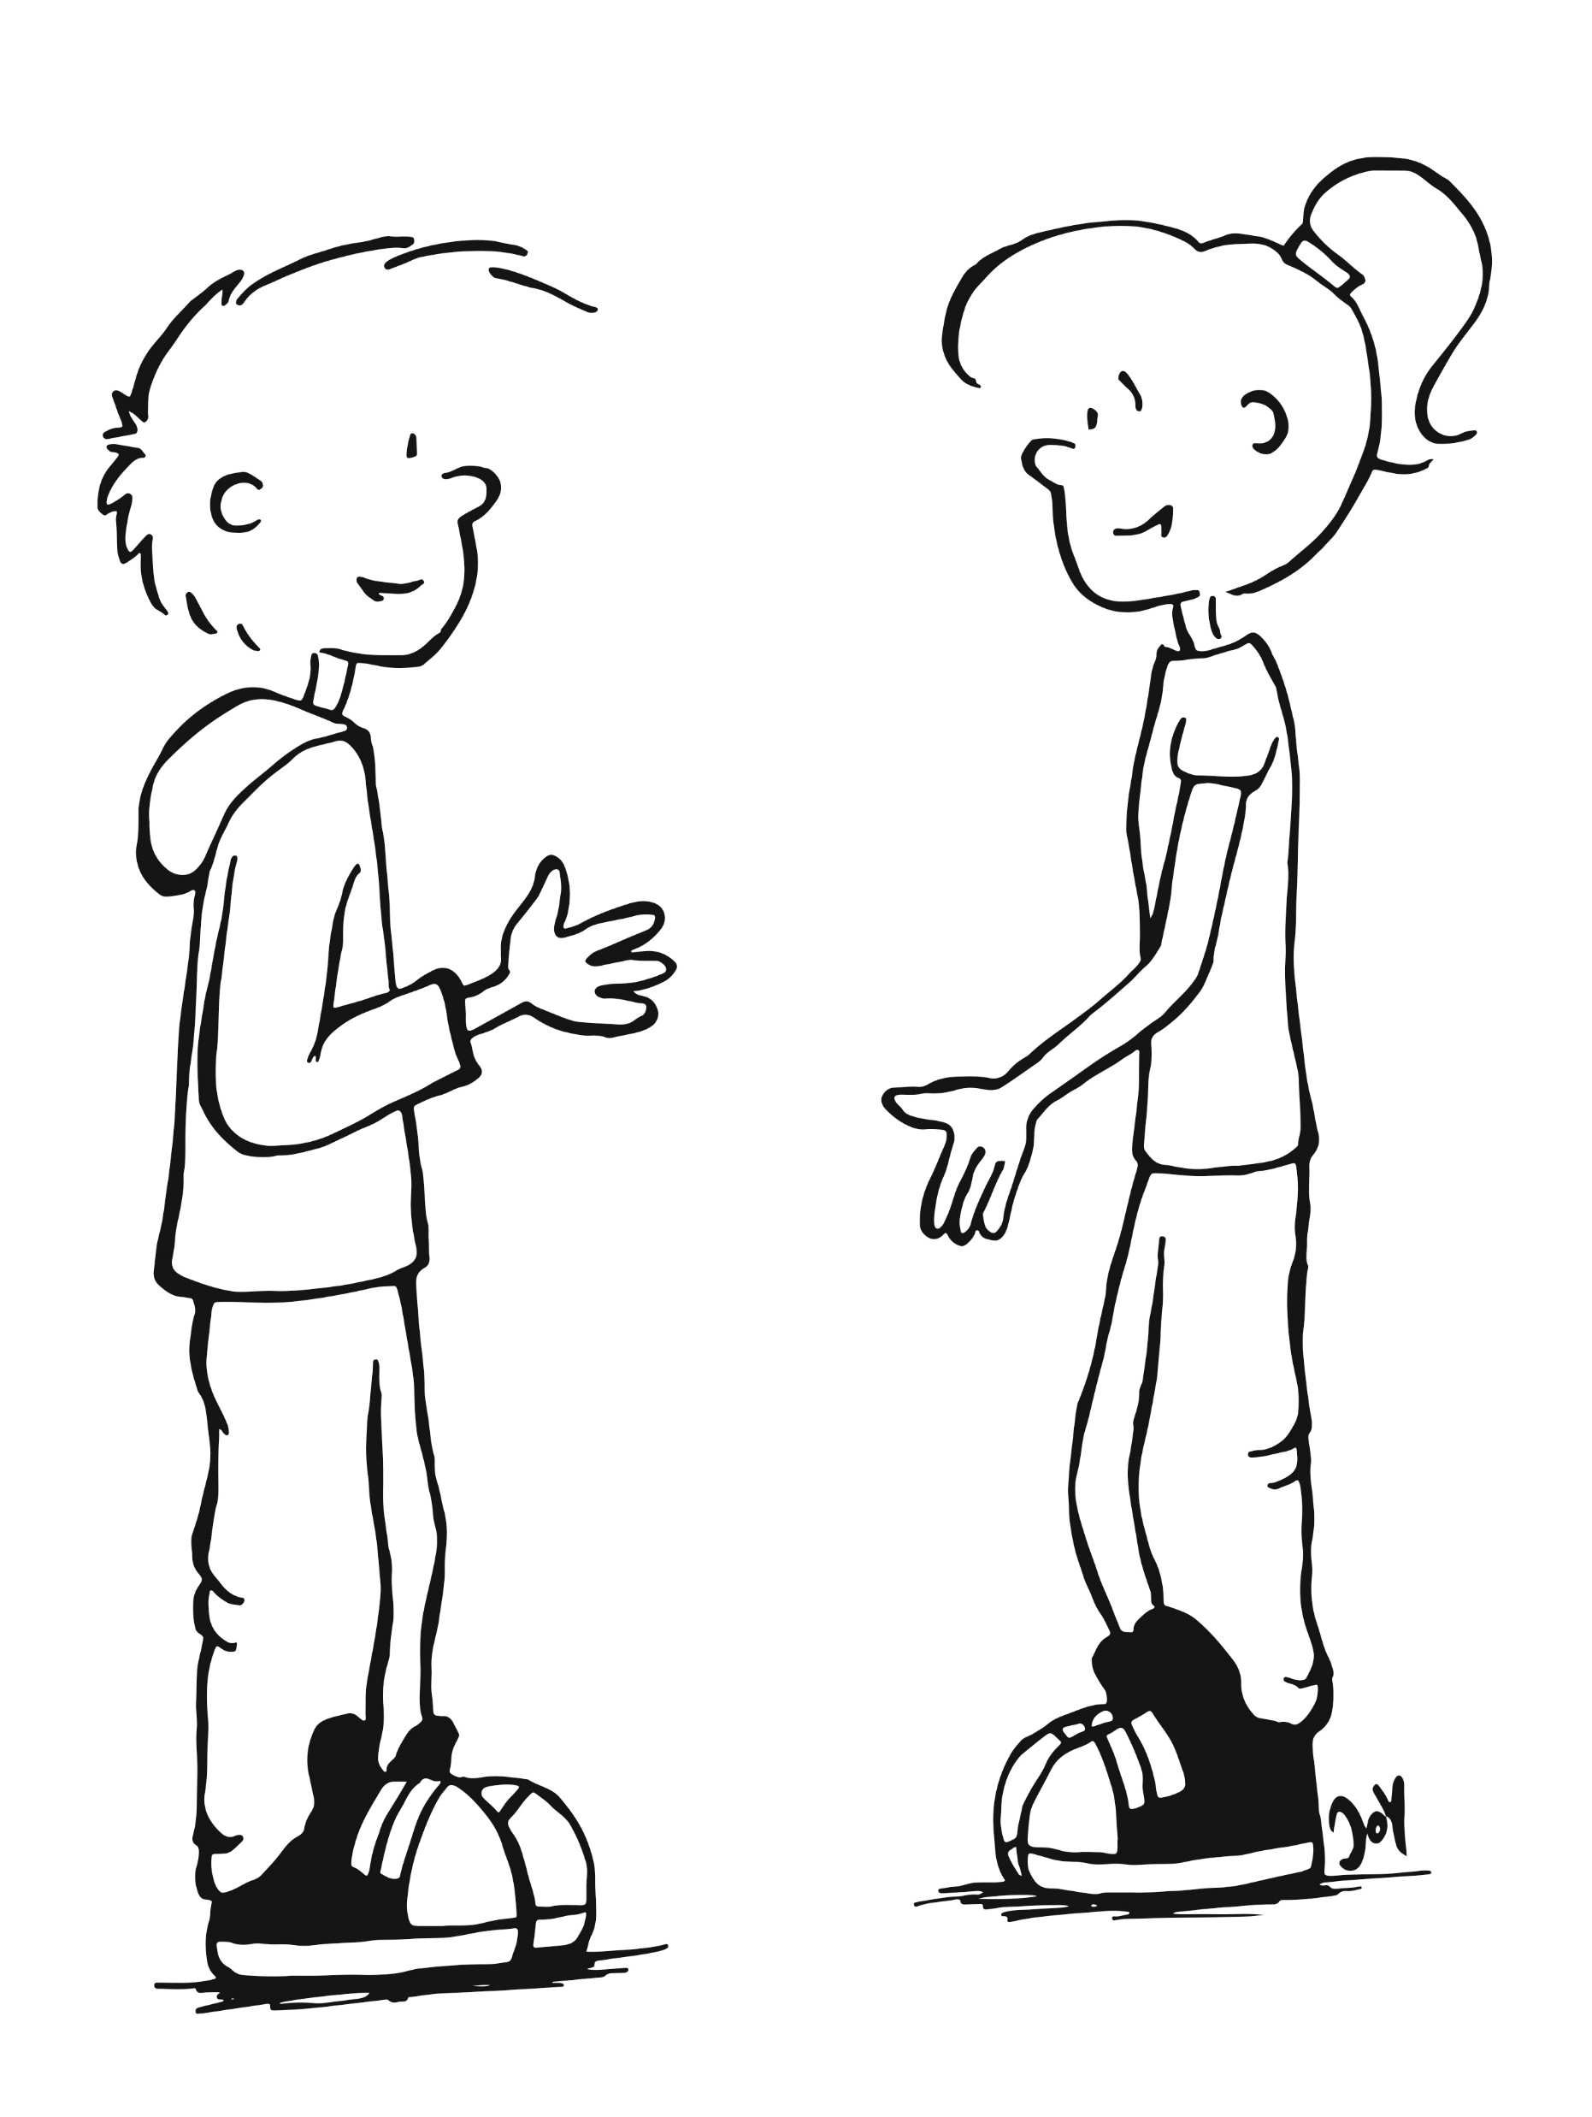
Hello!
Hallo!
Hallo!
© GET Across Borders
5

Slide 6
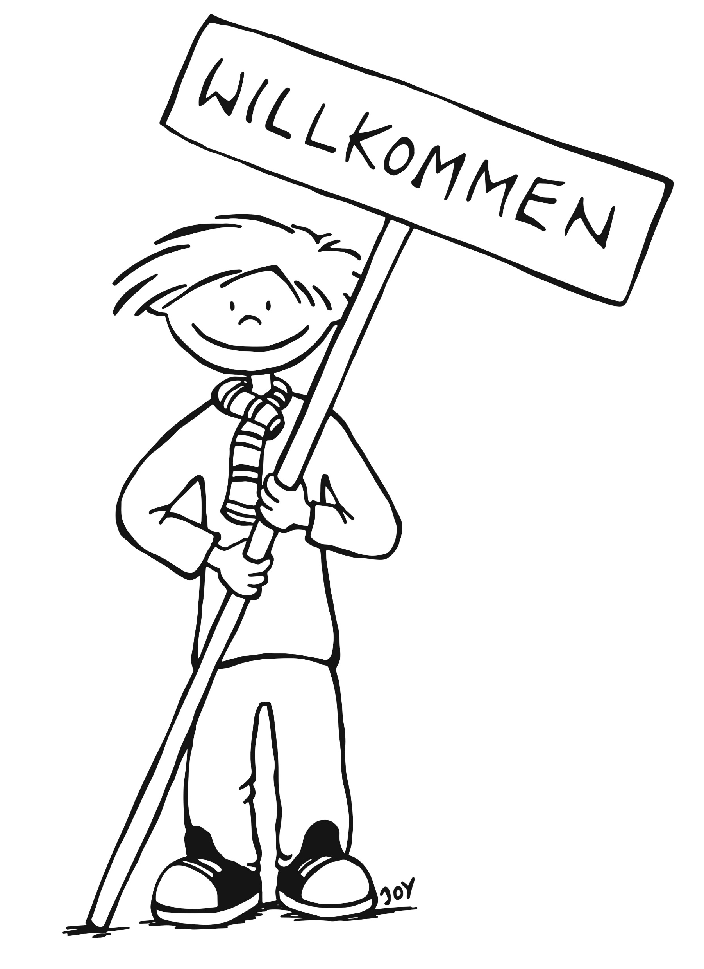
Welcome!
Willkommen!
© GET Across Borders

Slide 7


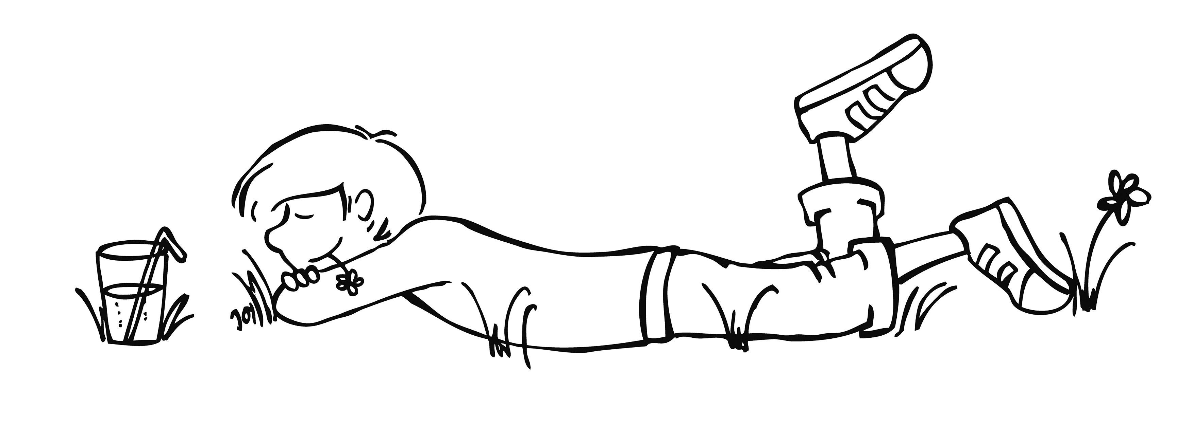
Good day!
Guten Tag!
© GET Across Borders
7

Slide 8
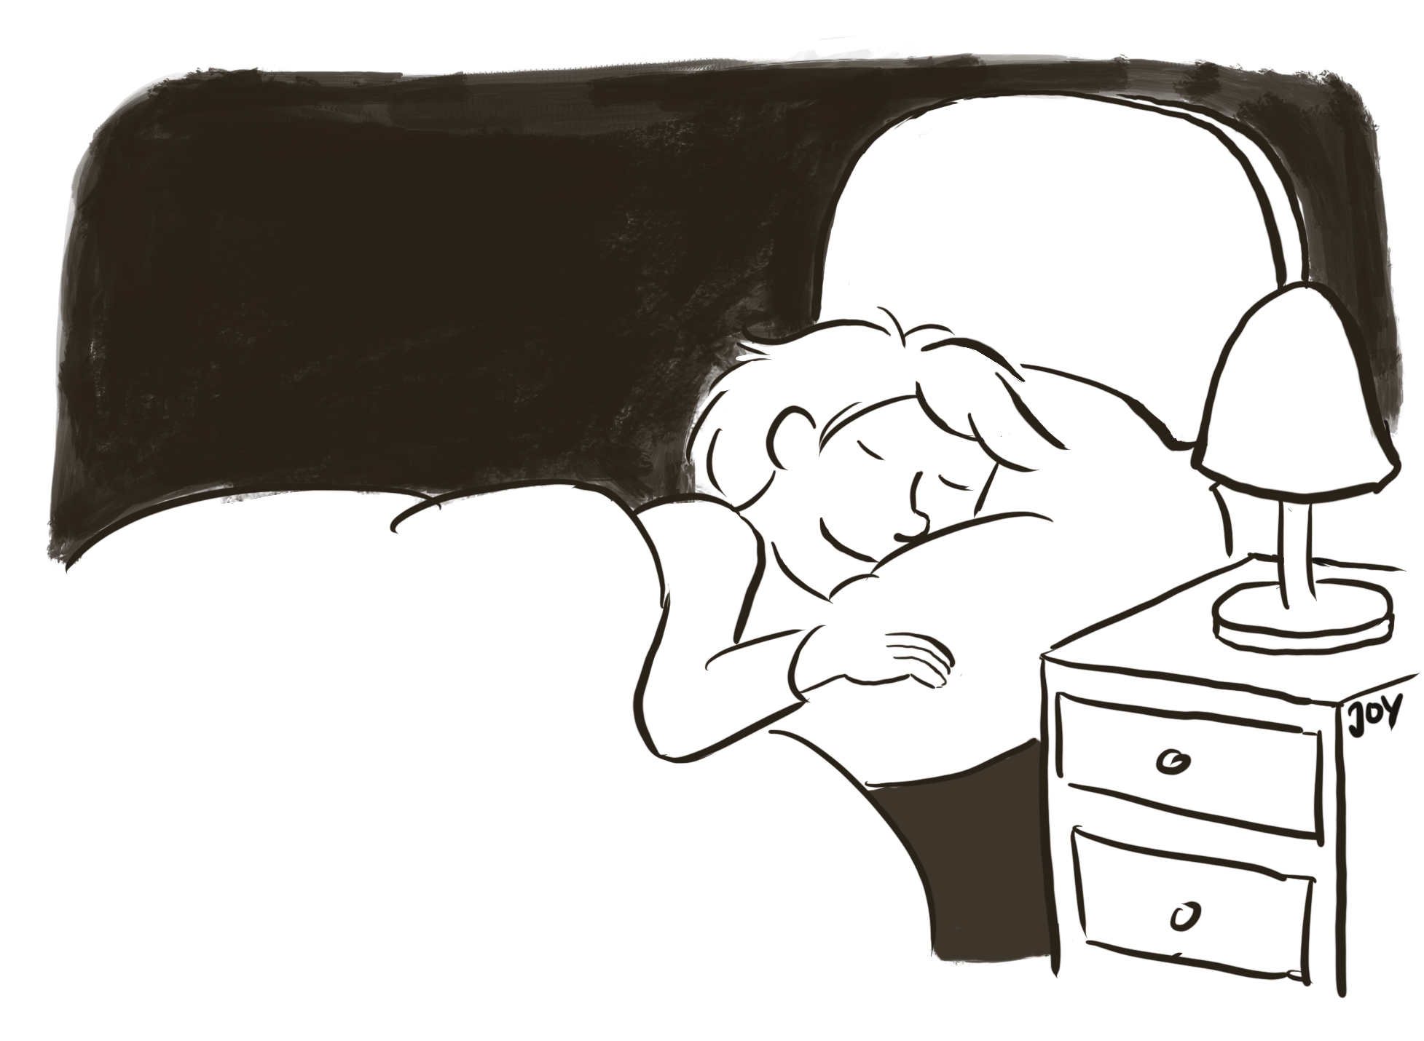
Good evening!
Guten Abend!
© GET Across Borders
8

Slide 9
Summary
Guten Morgen!
Good Morning!
Hello!
Welcome!
Good day!
Good evening!
Hallo!
Willkommen!
Guten Tag!
Guten Abend!
© GET Across Borders

Slide 10
Thank you for learning German with us! ☺
DISCLAIMER: Please note that any resources uploaded to this website are purely for educational purposes only. If any of the items, photos or texts uploaded are in infringement of copyright then please do not hesitate to contact us and we will have them removed.
© 2020 – GET Across Borders and © Leap4Joy

