Slide 1
GET Buddied Up
German with Ali, the Eagle
get-across-borders@uni-mainz.de
© 2020 - GET Across Borders

Slide 2
Deutsch lernen mit Ali, unserem Adler Sigrid Rieuwerts get-across-borders@uni-mainz.de

Slide 3
Willkommen!
Today we are going to learn…
how to ask people how they are
how to tell people how you are
different emotions / moods
© GET Across Borders

Slide 4
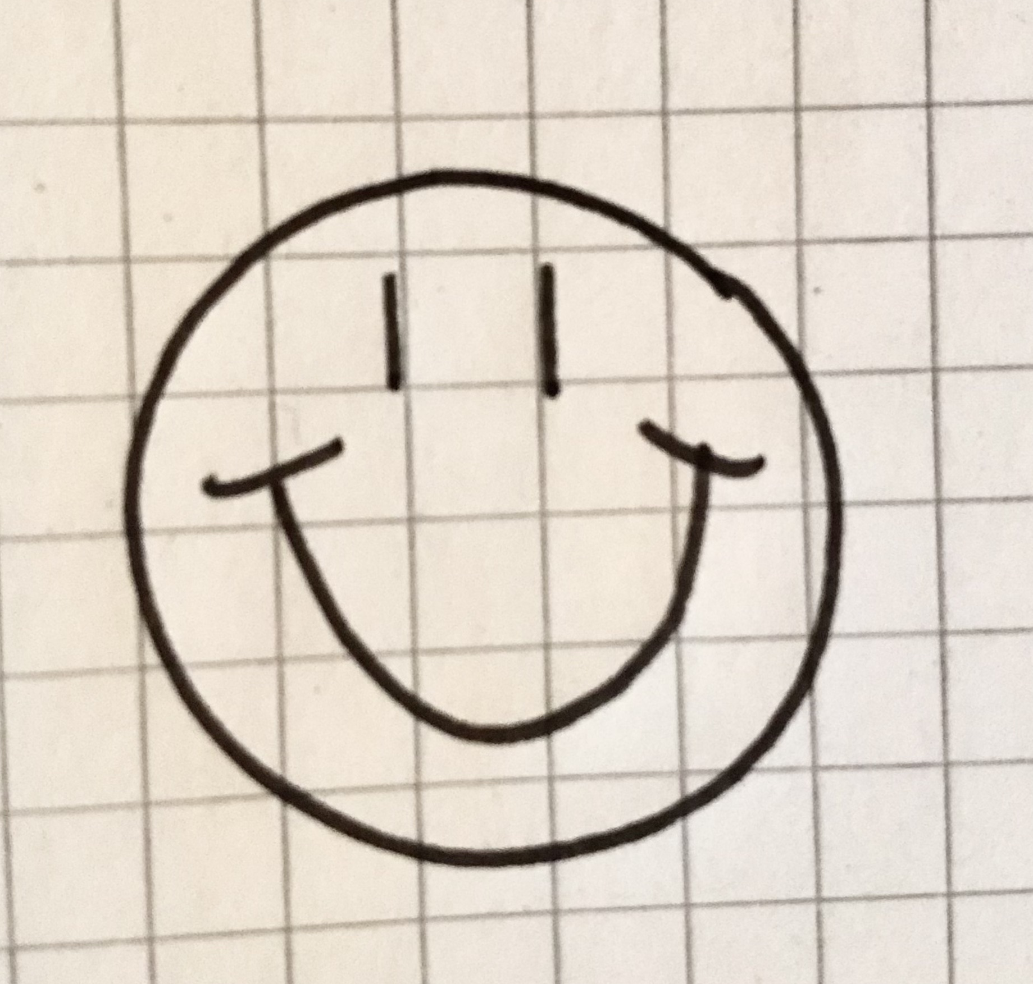
Wie geht es dir?
Wie geht es dir? How are you?
Mir geht es … I am …
prima !
great !
nicht gut / schlecht
not doing well
gut
fine
© GET Across Borders

Slide 5
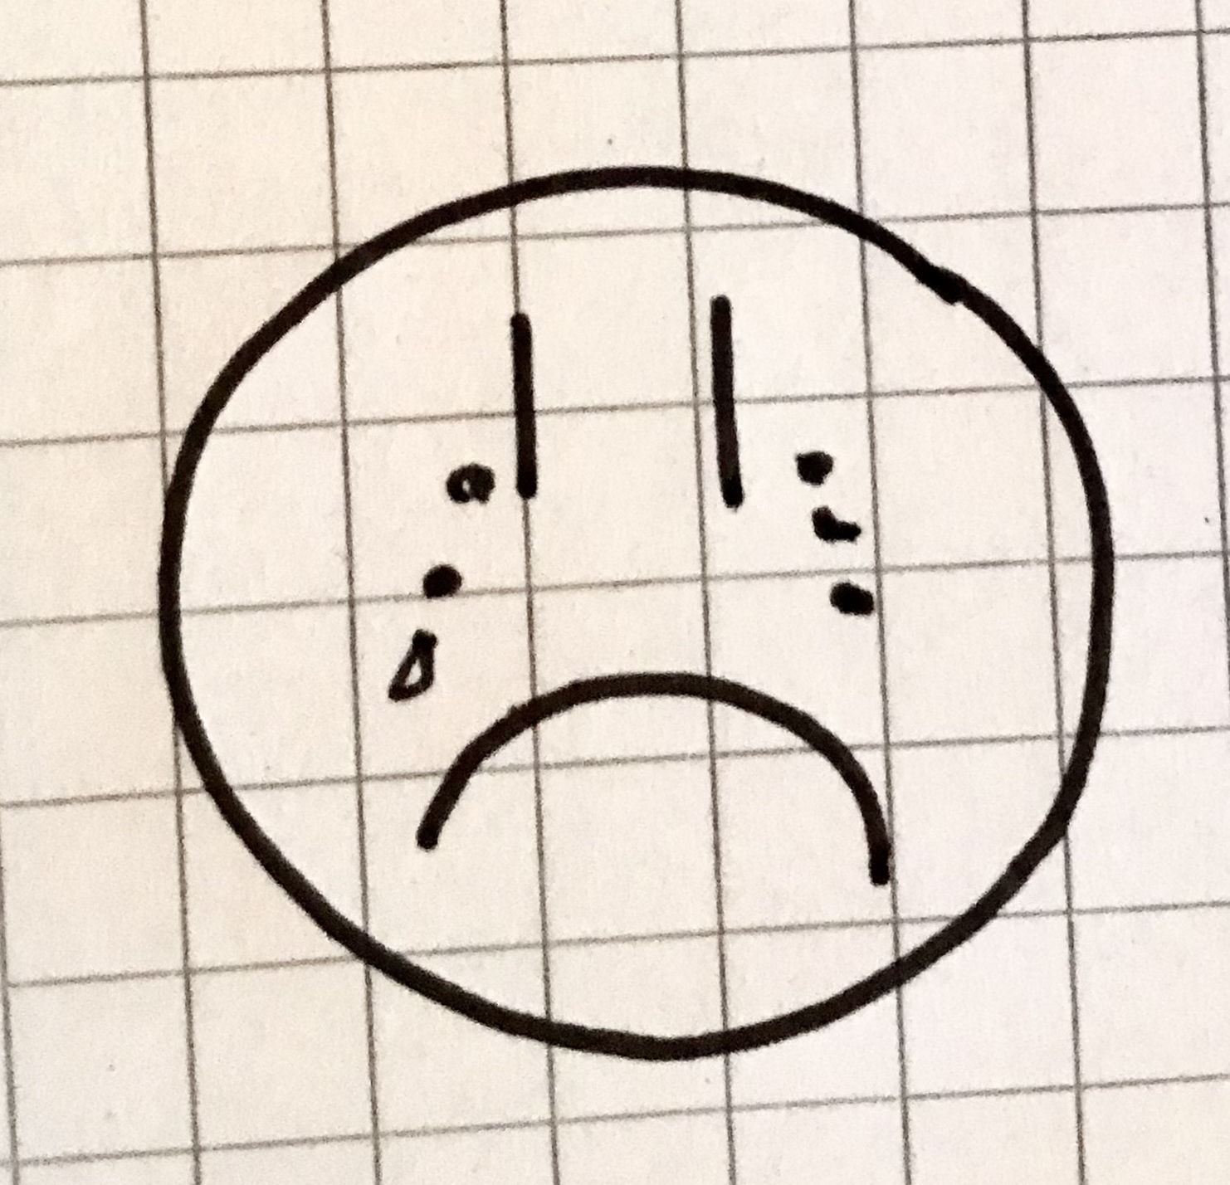
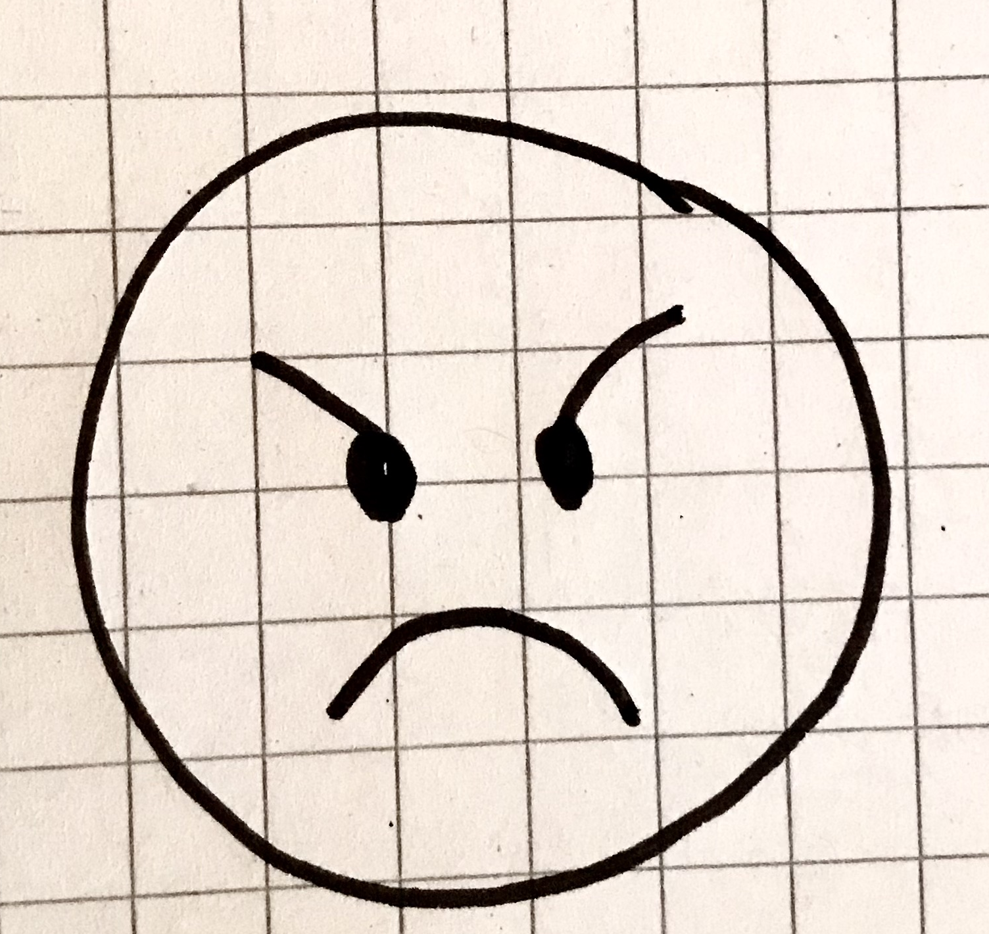
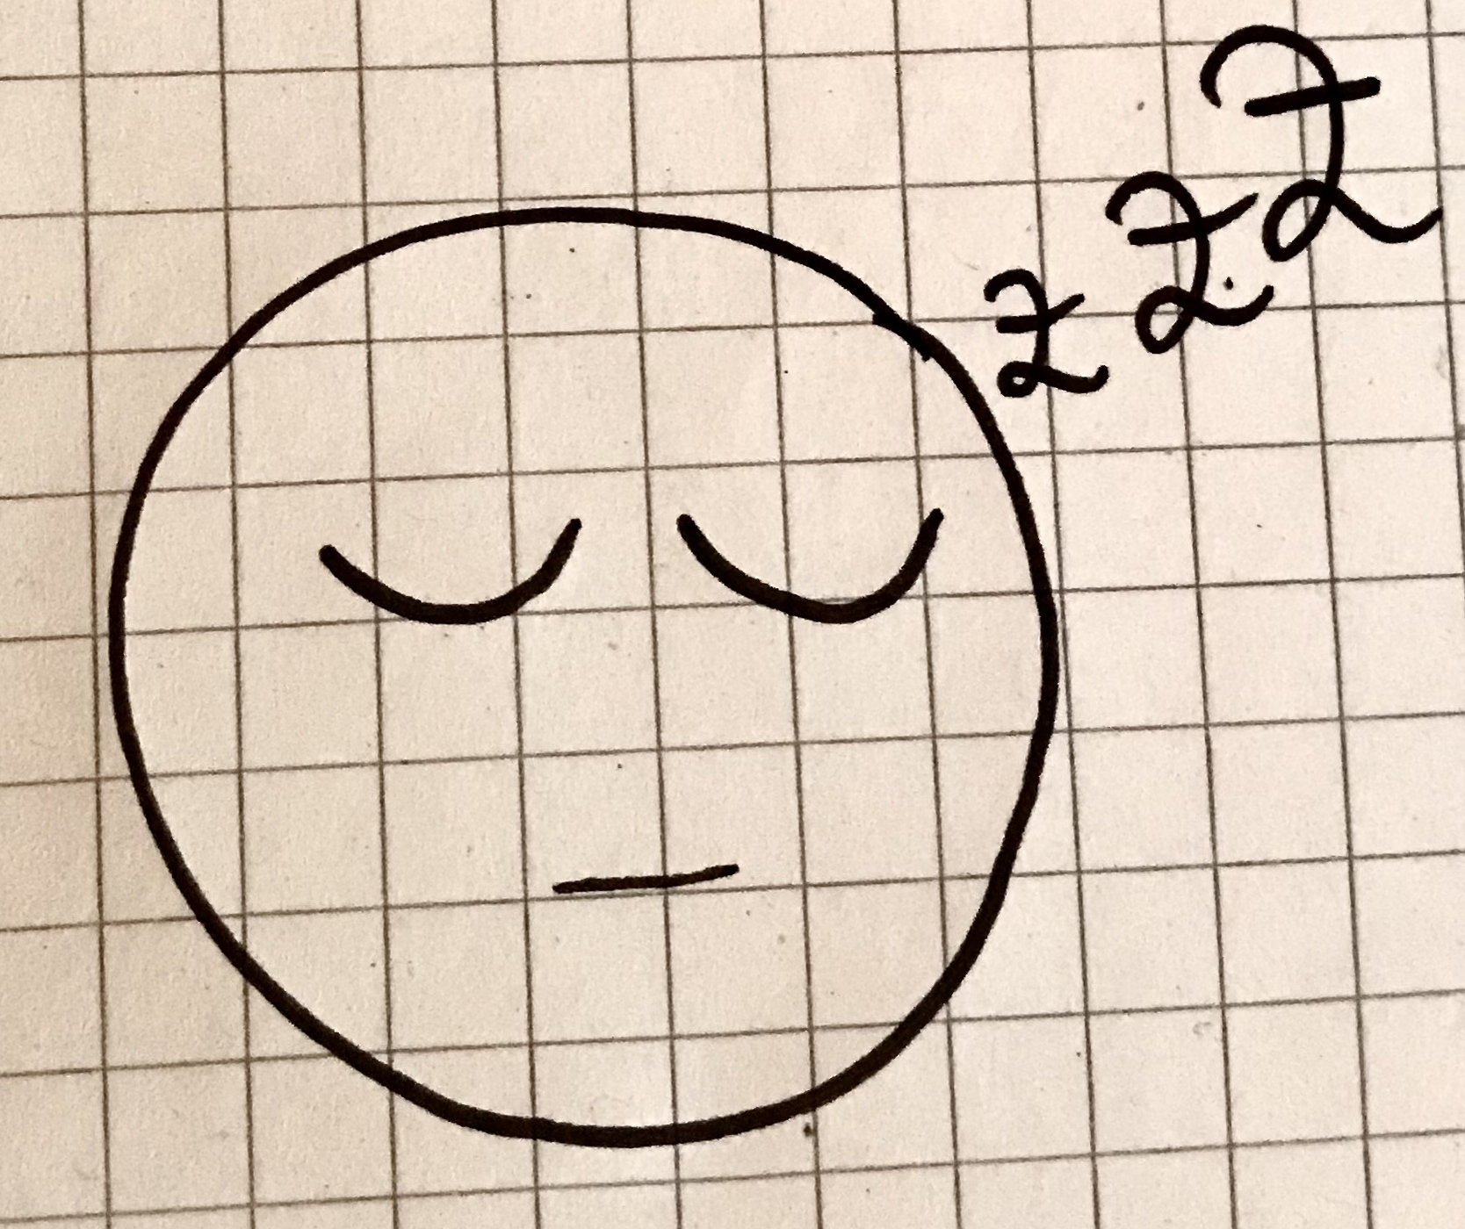
Ich bin …
glücklich (happy)
traurig (sad)
sauer (angry)
krank (sick)
müde (tired)
Ich bin… - I am…
© GET Across Borders

Slide 6
Partnerarbeit
Ask your partner how he or she is feeling today in German.
Your partner has to answer in German.
Afterwards, you change roles. Your partner asks you how you are feeling in German and you answer.
© GET Across Borders

Slide 7
Match the emojis to the right German vocabulary!
krank
glücklich
müde
traurig
sauer
© GET Across Borders

Slide 8
Pantomime
Divide the class into two teams.
One team starts.
One student stands up and performs an emotion.
The rest of the class has to guess the emotion in German.
For every right guess, the team gets a point. The team with the most points wins.
© GET Across Borders

Slide 9
Summary
Wie geht es dir?
Mir geht es …
… prima!
… gut.
… nicht gut. / schlecht.
Ich bin …
… glücklich.
… traurig.
… sauer.
… krank.
… müde.
© GET Across Borders

Slide 10
Thank you for learning German with us! ☺
DISCLAIMER: Please note that any resources uploaded to this website are purely for educational purposes only. If any of the items, photos or texts uploaded are in infringement of copyright then please do not hesitate to contact us and we will have them removed.
© 2020 – GET Across Borders and © Leap4Joy

