Slide 1



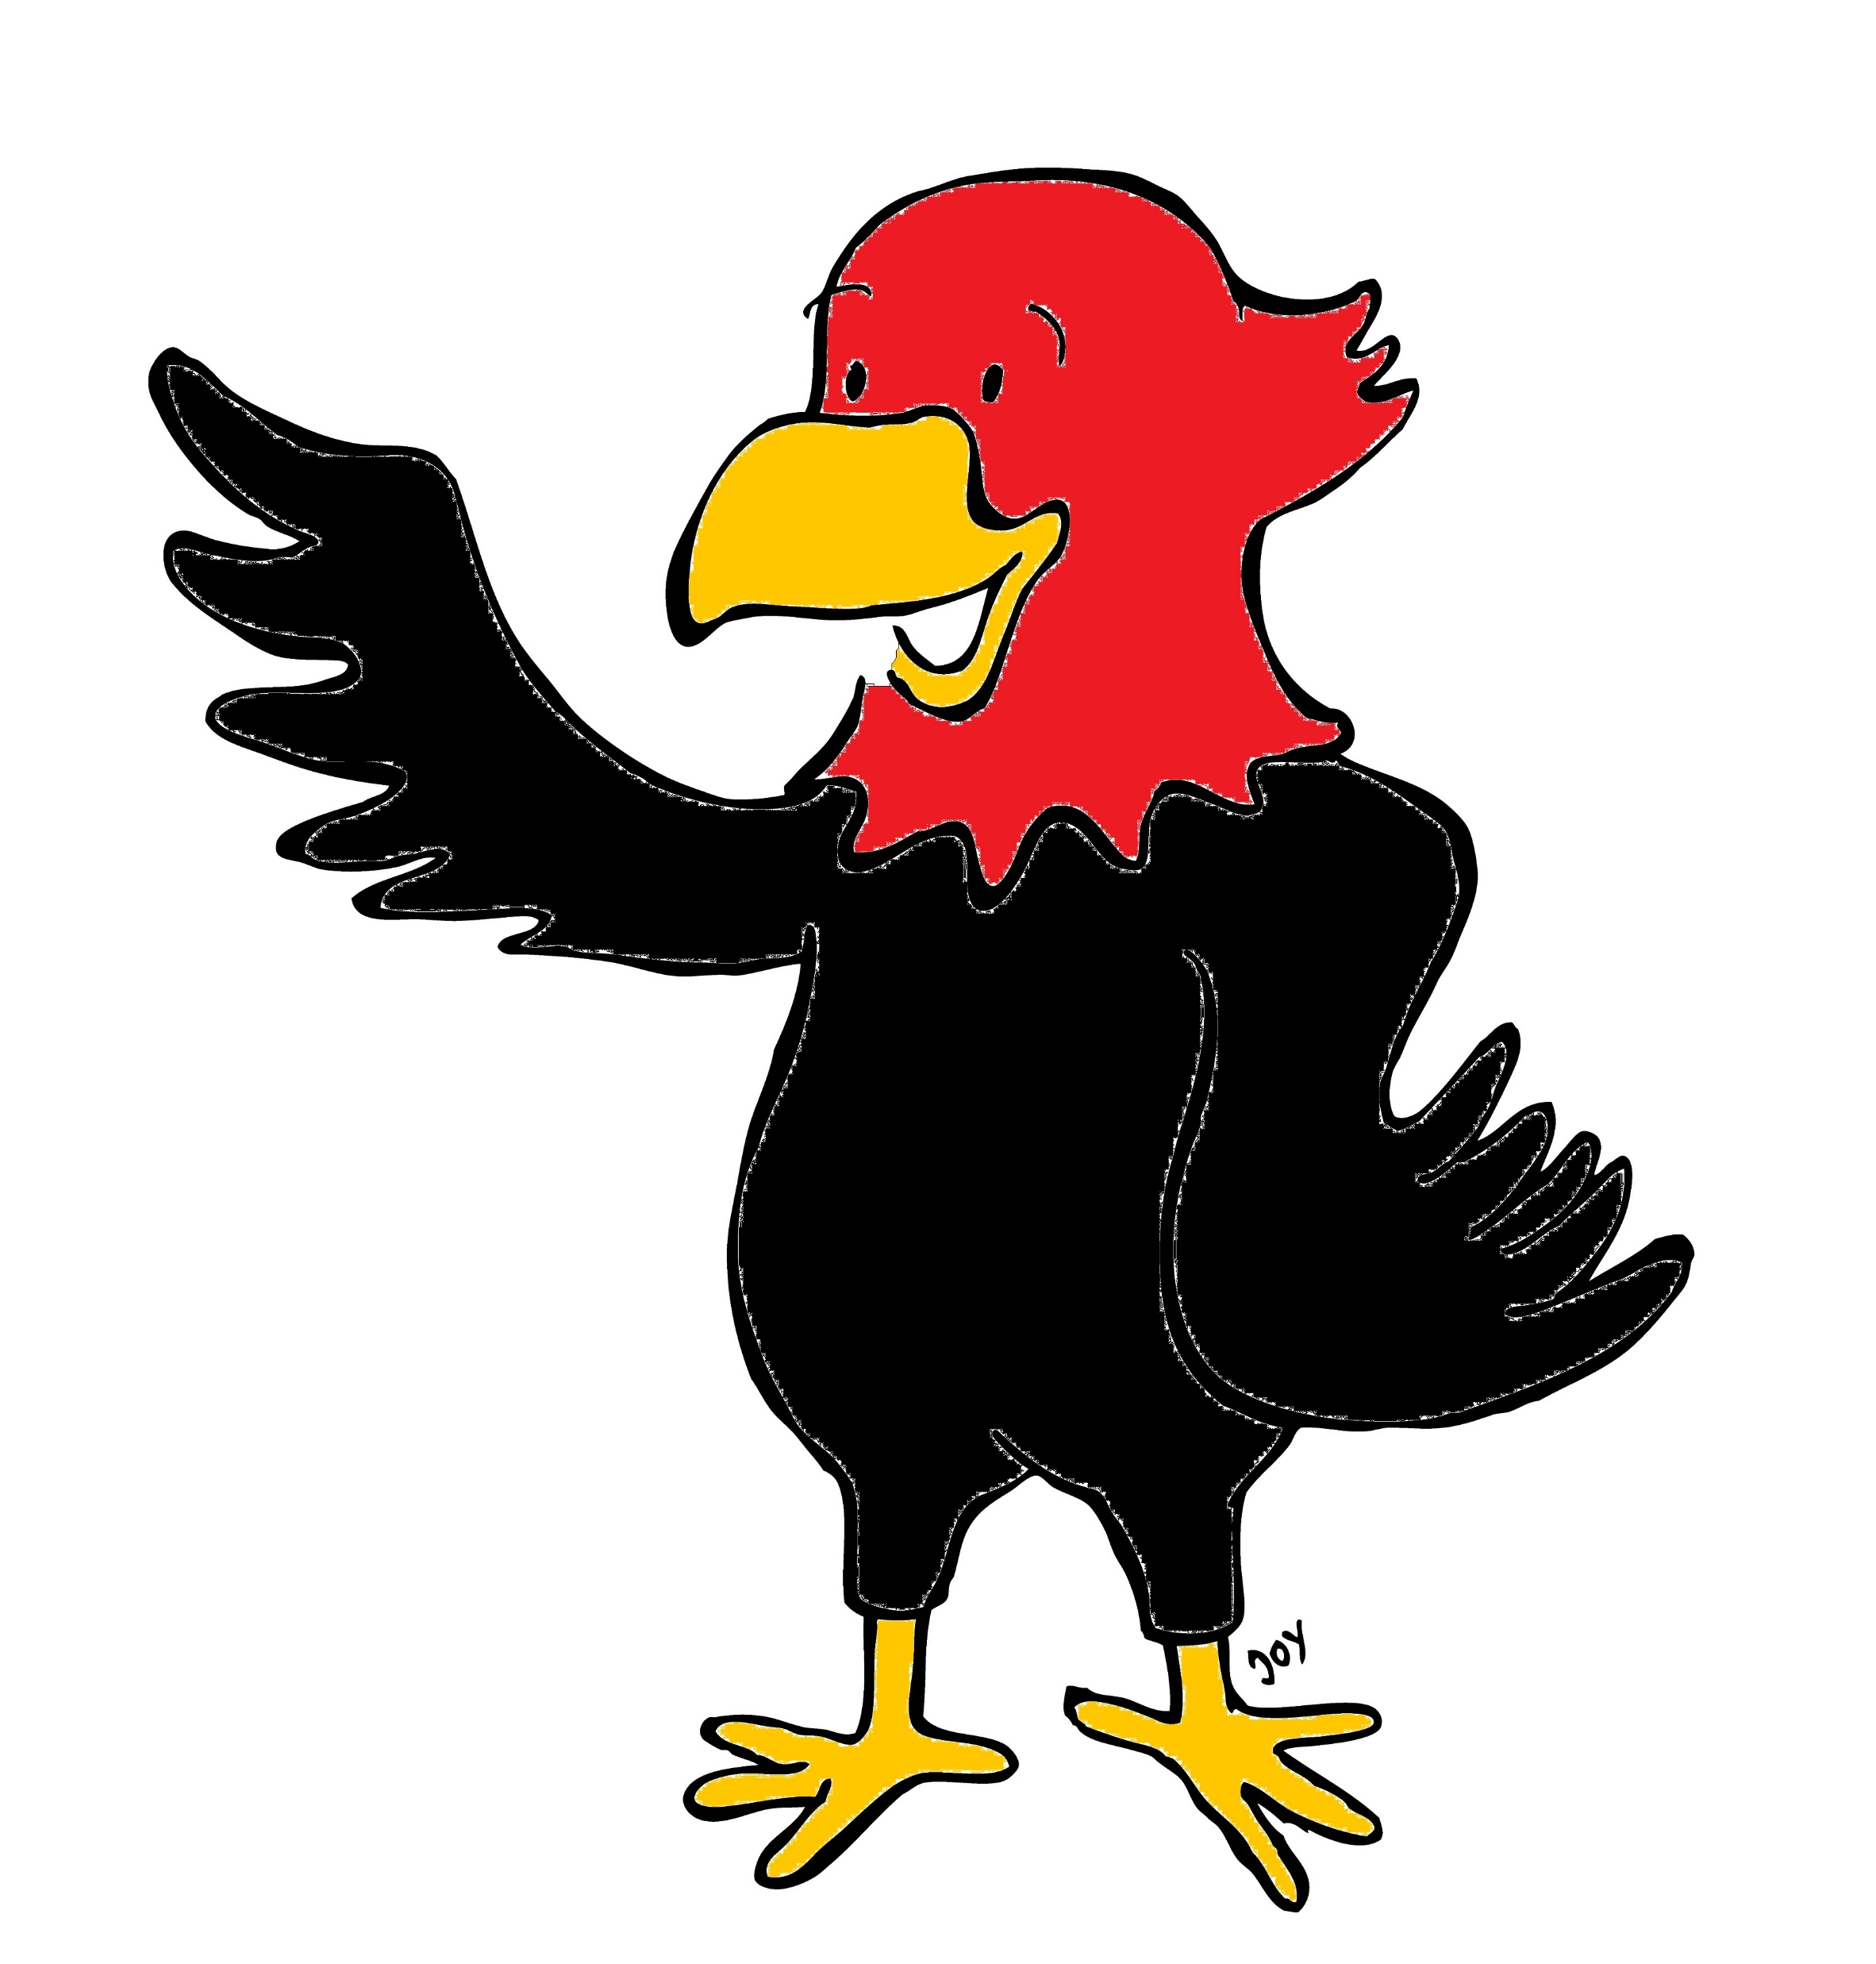

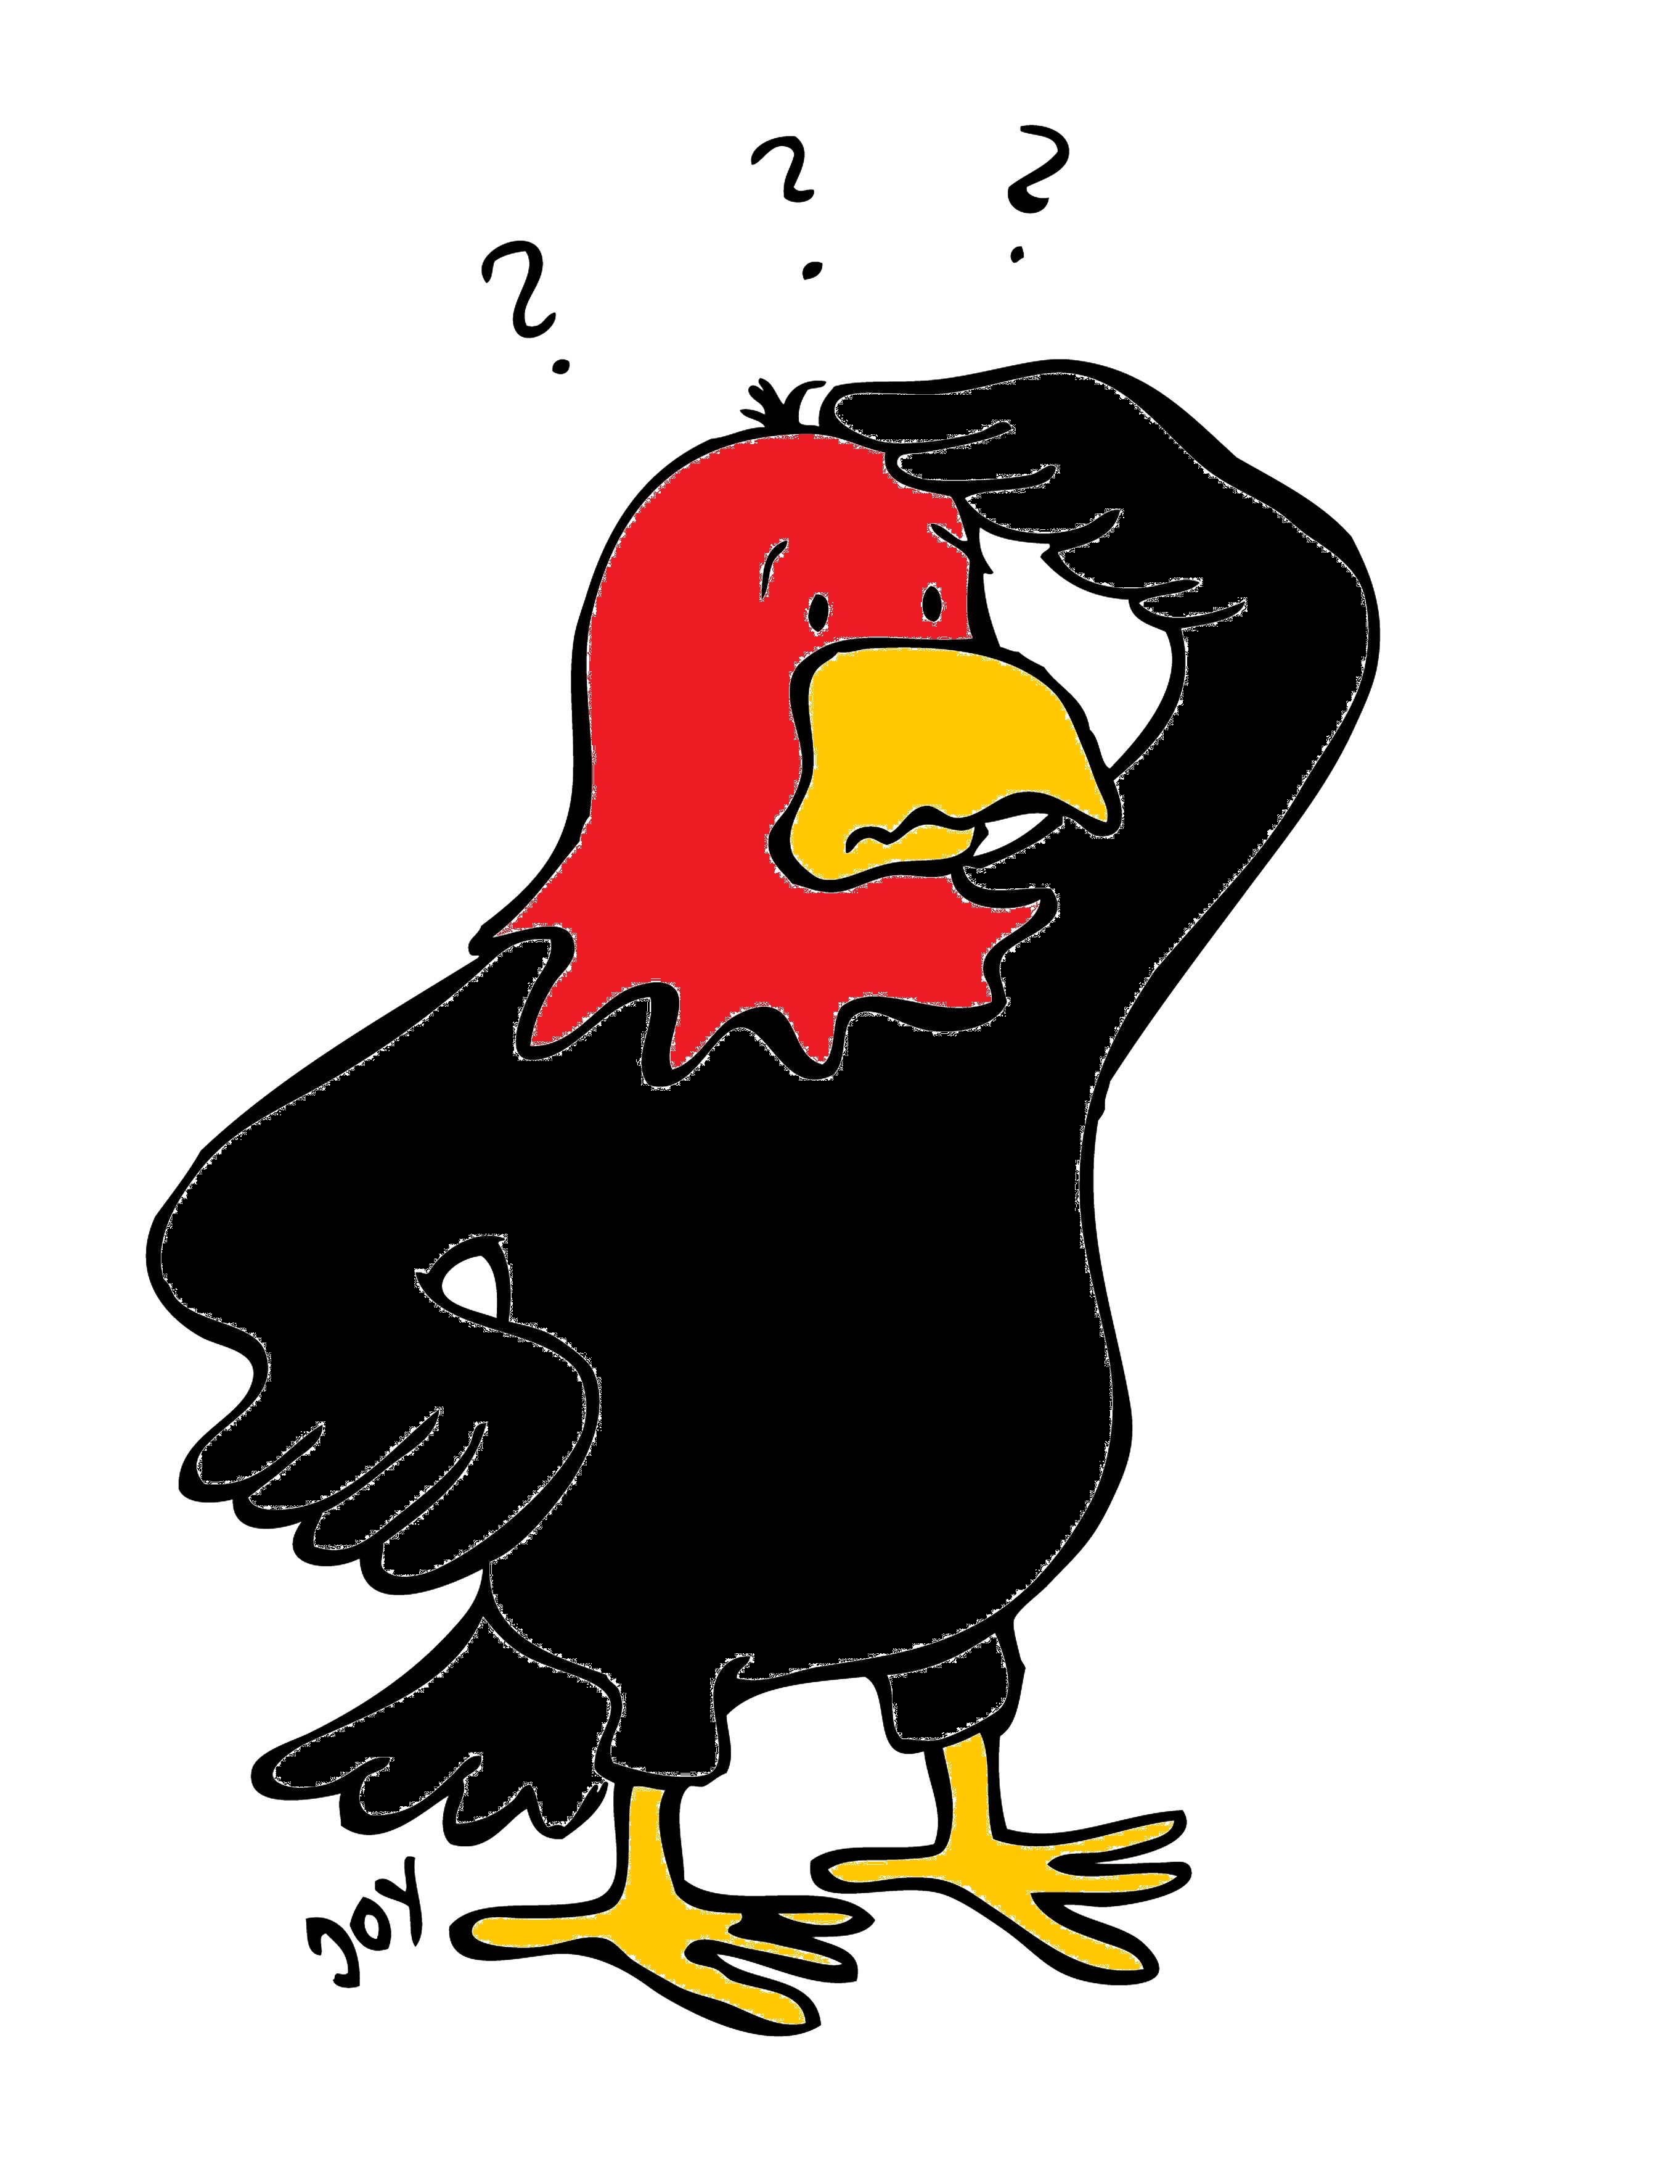
GET Buddied Up
German with Ali, the Eagle
get-across-borders@uni-mainz.de
© 2020 - GET Across Borders

Slide 2
Deutsch lernen mit Ali, unserem Adler
Sigrid Rieuwerts get-across-borders@uni-mainz.de

Slide 3
Willkommen!
Today, we will learn to …
say what you like/love in German.
say what you don’t like/hate in German.
This is important to express your opinion.
© GET Across Borders
3

Slide 4
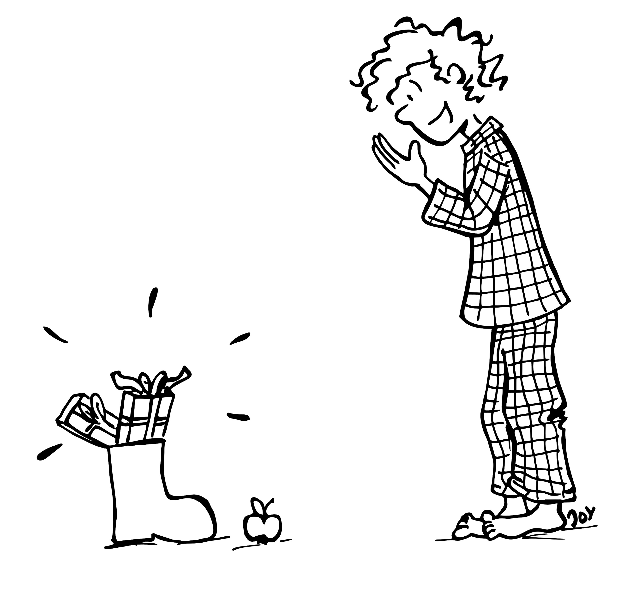

I like presents!
Ich mag Geschenke!
© GET Across Borders
4

Slide 5
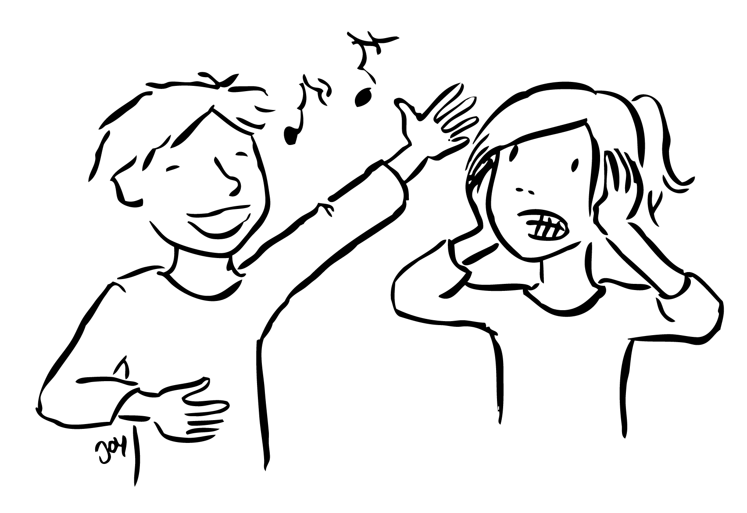
I don’t like Tom’s singing!
Ich mag Toms Gesang nicht!
© GET Across Borders
5

Slide 6
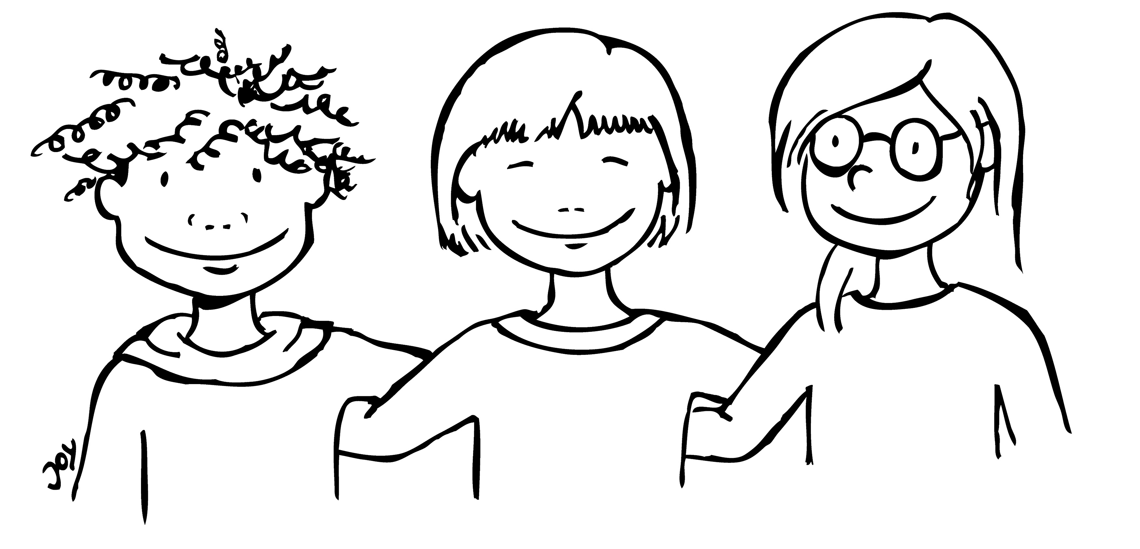
I love my friends!
Ich liebe meine Freunde!
© GET Across Borders
6

Slide 7
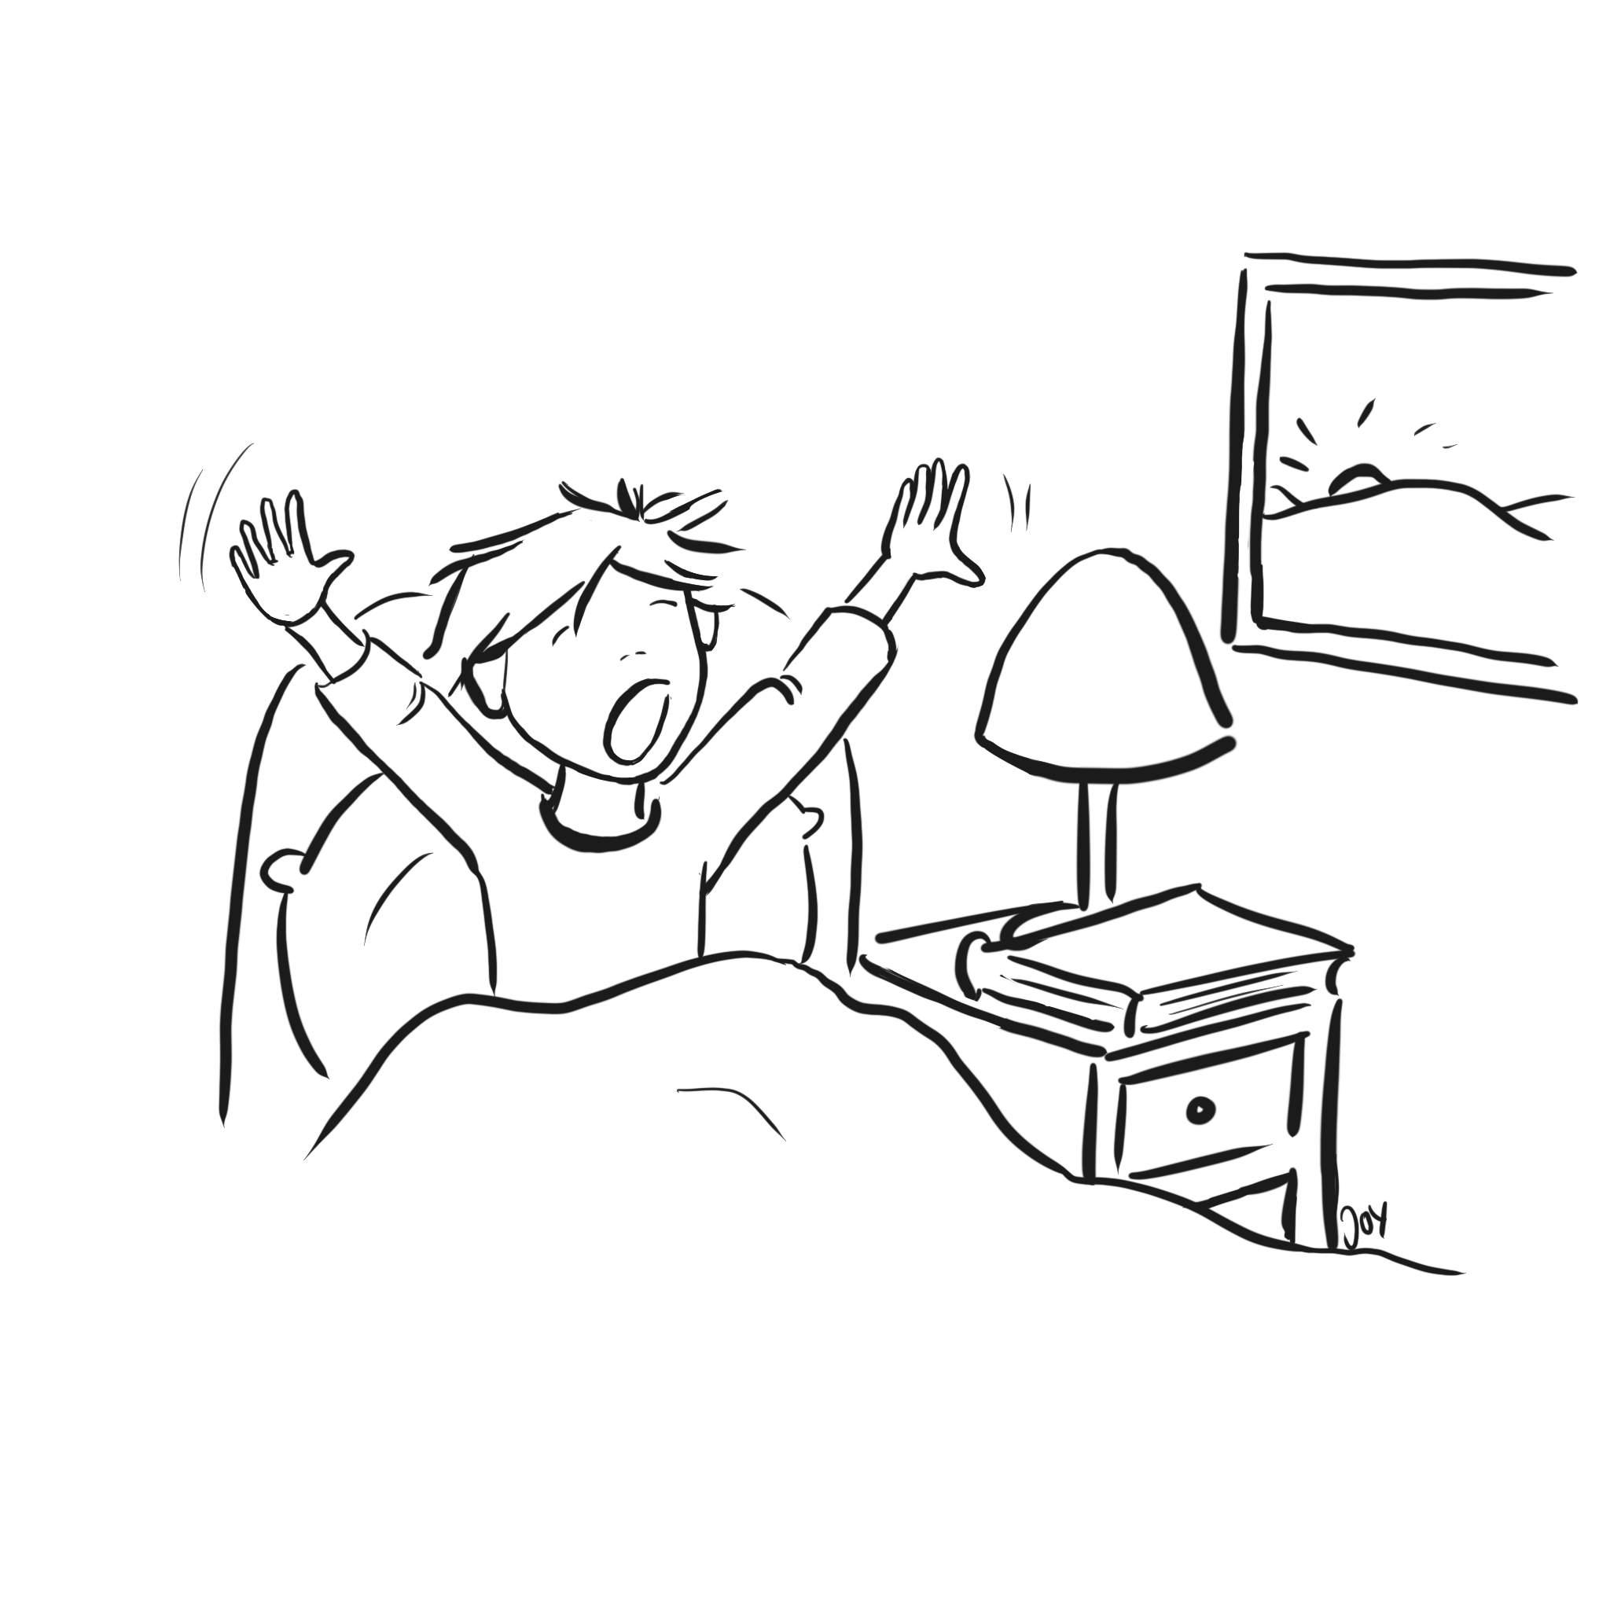
I hate getting up early!
Ich hasse früh aufstehen!
© GET Across Borders
7

Slide 8
Exercise
Tell your partner one thing you like and one thing you do not like.
Let him or her tell you a thing they love and a thing they hate.
Switch roles when you are done.
© GET Across Borders
8

Slide 9
Summary
Ich mag …!
I like …!
I don’t like …!
I love …!
I hate …!
Ich mag … nicht!
Ich liebe …!
Ich hasse …!
© GET Across Borders
9

Slide 10
Thank you for learning German with us! ☺
DISCLAIMER: Please note that any resources uploaded to this website are purely for educational purposes only. If any of the items, photos or texts uploaded are in infringement of copyright then please do not hesitate to contact us and we will have them removed.
© 2020 – GET Across Borders and © Leap4Joy

