Slide 1



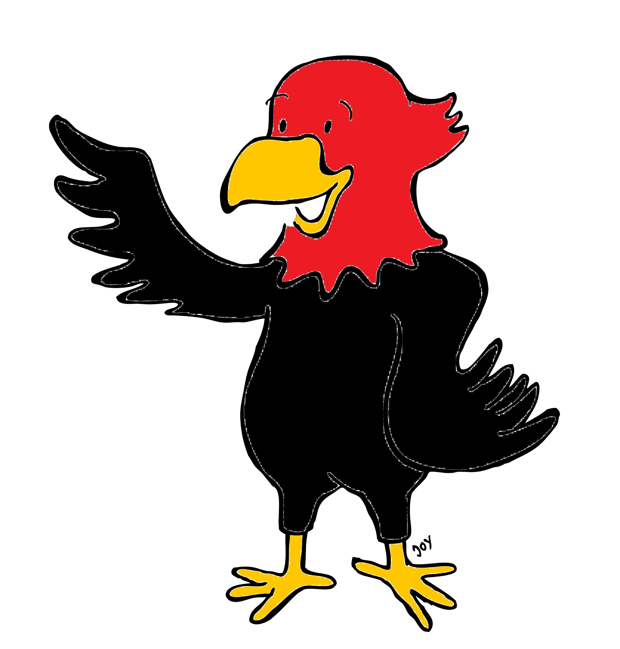

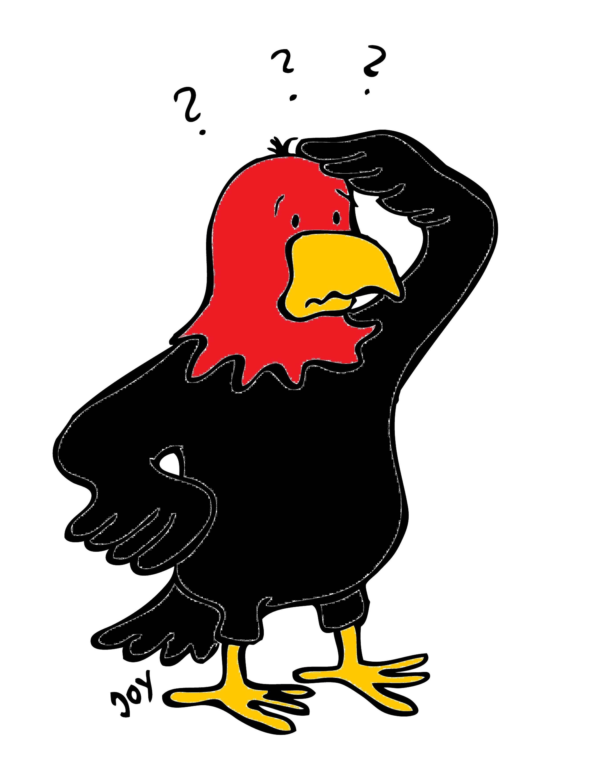
GET Buddied Up
German with Ali, the Eagle
get-across-borders@uni-mainz.de
© 2020 - GET Across Borders

Slide 2
Deutsch lernen mit Ali, unserem Adler
Sigrid Rieuwerts get-across-borders@uni-mainz.de

Slide 3
Willkommen!
Today, we will learn …
the alphabet.
It is important to know the letters and sounds of a language.
© GET Across Borders
3

Slide 4

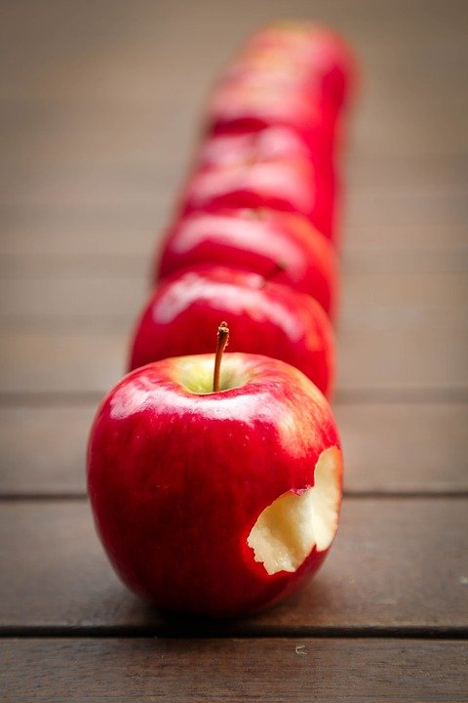
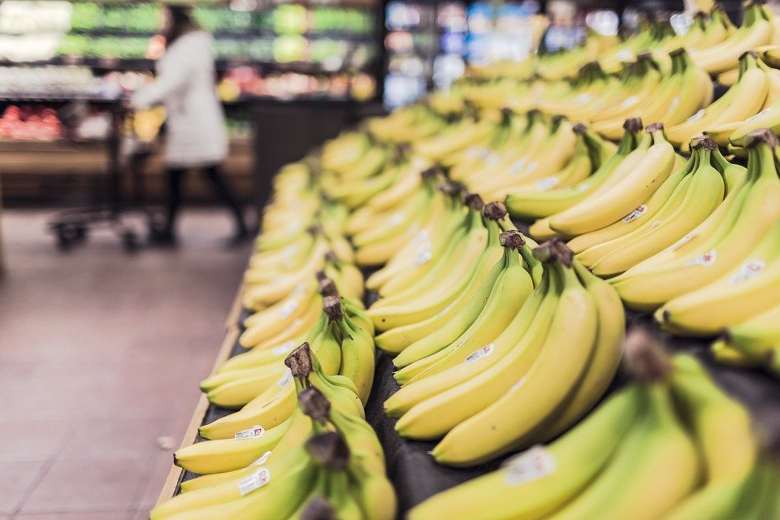
A und B
Apfel - apple
Banane - banana
© Pixabay
© Pixabay
© GET Across Borders
4

Slide 5
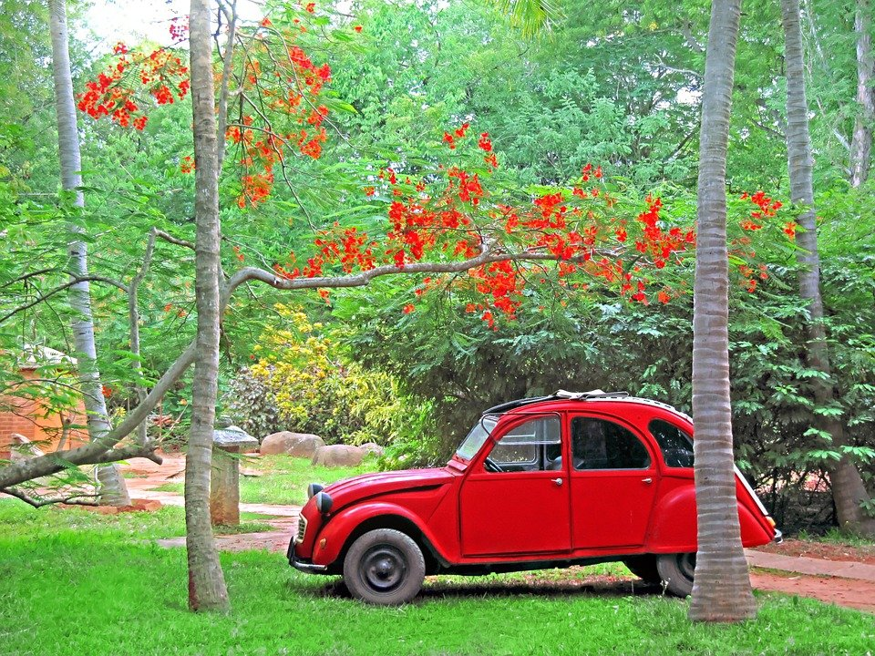
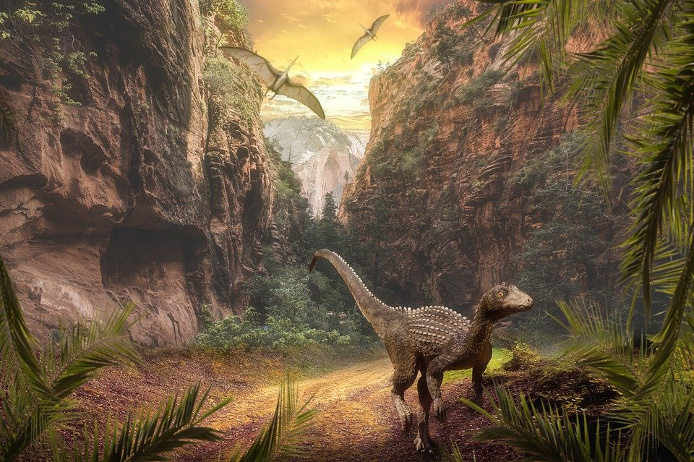
C und D
Citroen – Citroen
Dinosaurier - dinosaur
© Pixabay
© Pixabay
© GET Across Borders
5

Slide 6
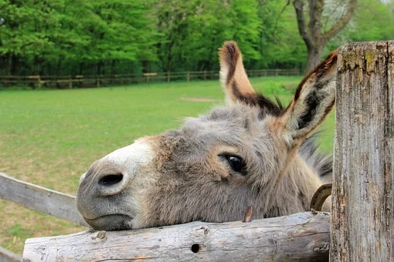
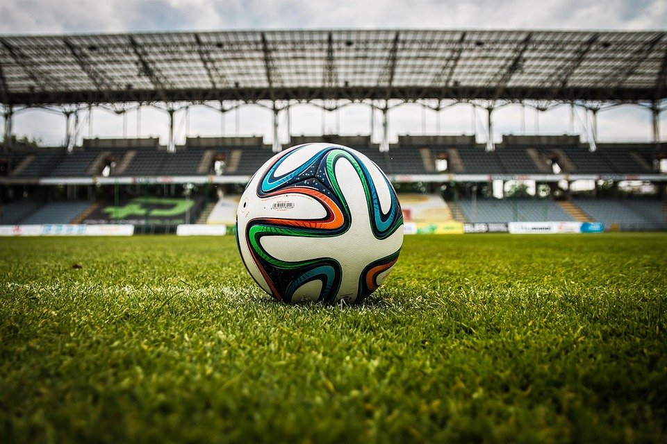
E und F
Esel - donkey
Fußball - football
© Pixabay
© Pixabay
© GET Across Borders
6

Slide 7
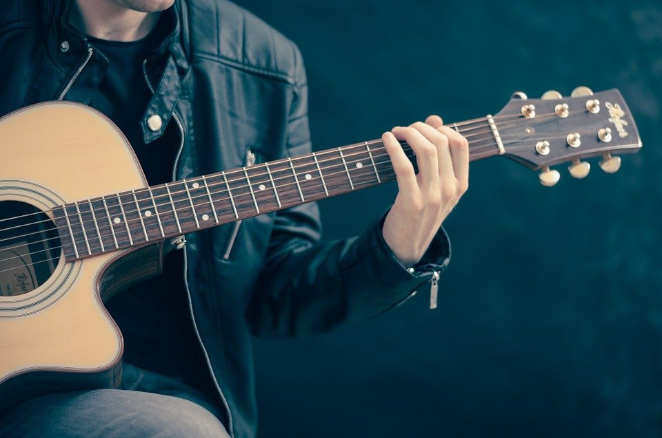
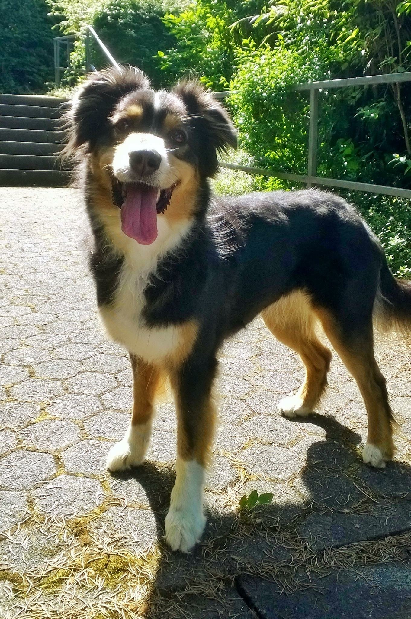
G und H
Gitarre - guitar
Hund - dog
© Pixabay
© Pixabay
© GET Across Borders
7

Slide 8
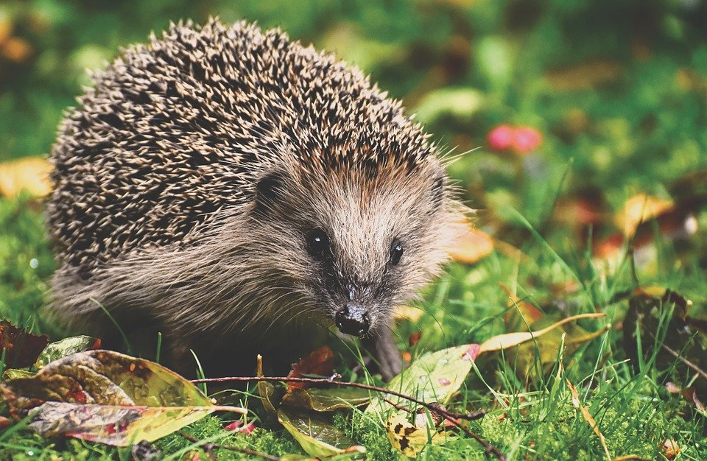
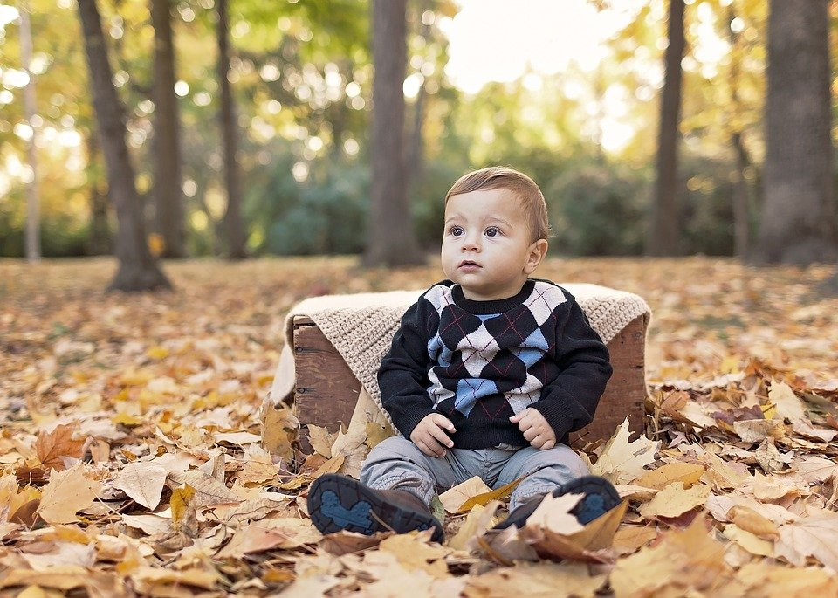
I und J
Igel - hedgehog
Junge - boy
© Pixabay
© Pixabay
© GET Across Borders
8

Slide 9
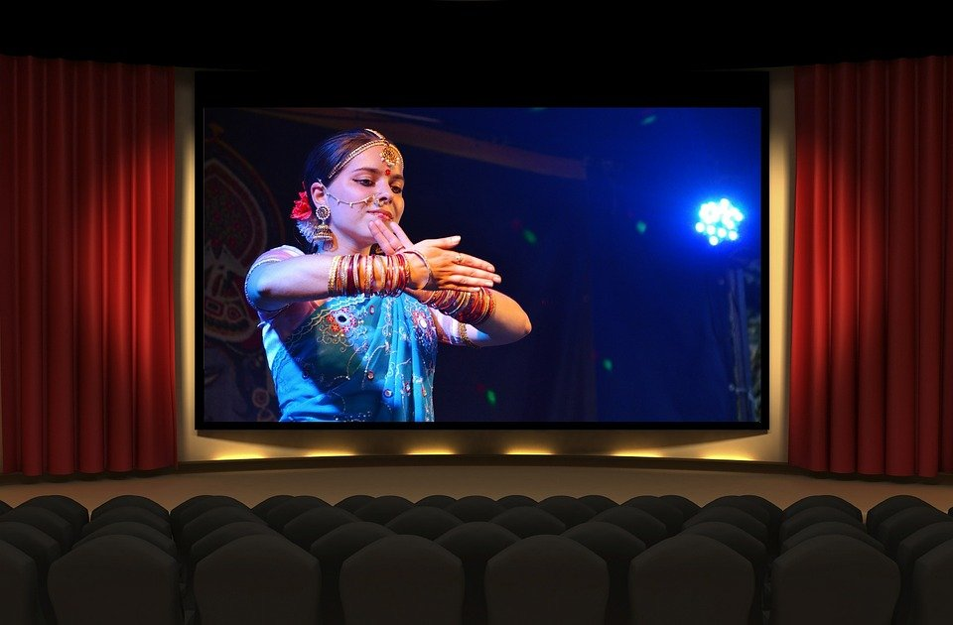
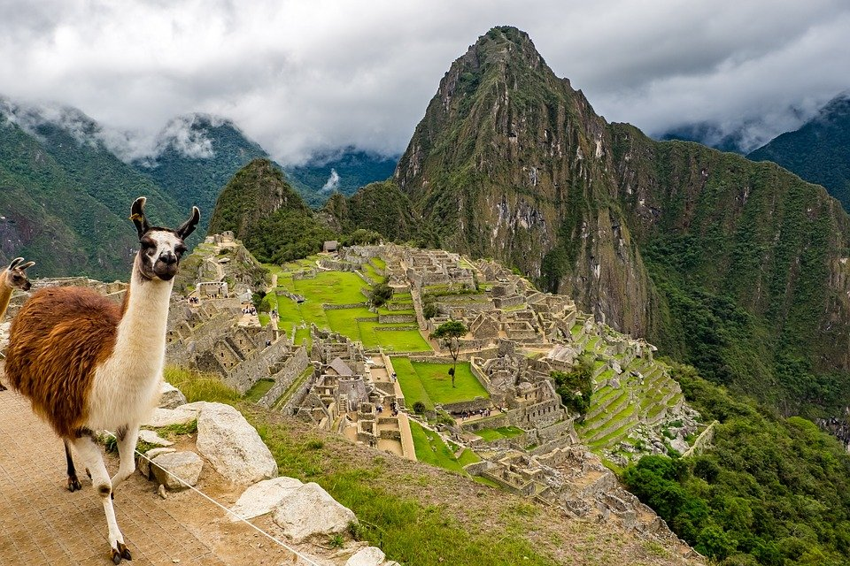
K und L
Kino - cinema
Lama - llama
© Pixabay
© Pixabay
© GET Across Borders
9

Slide 10
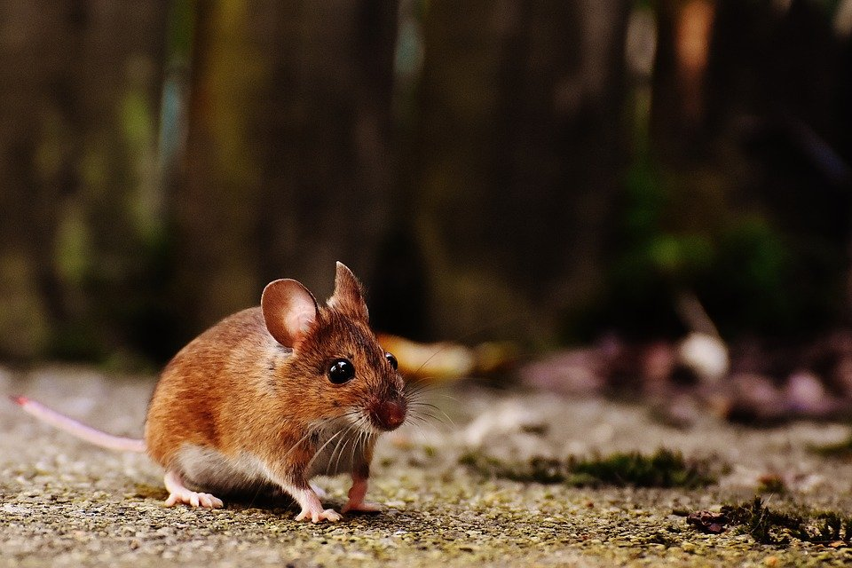
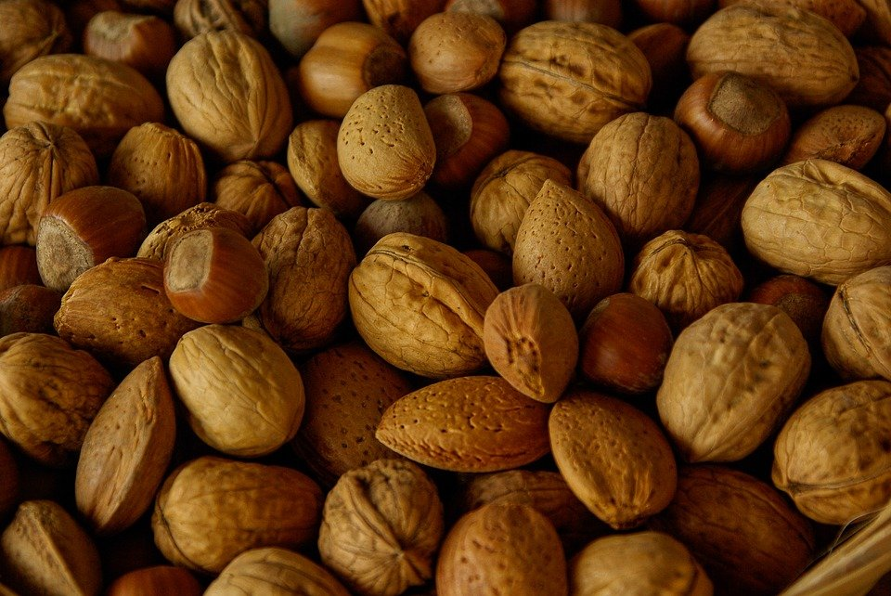
M und N
Maus - mouse
Nuss - nut
© Pixabay
© Pixabay
© GET Across Borders
10

Slide 11
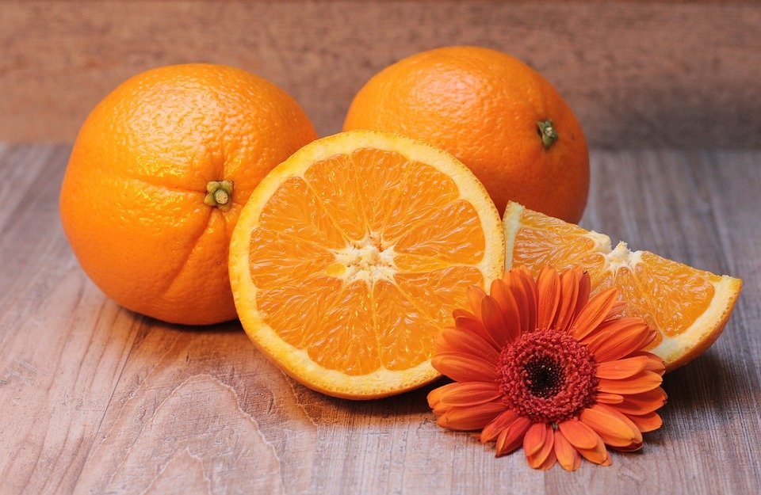
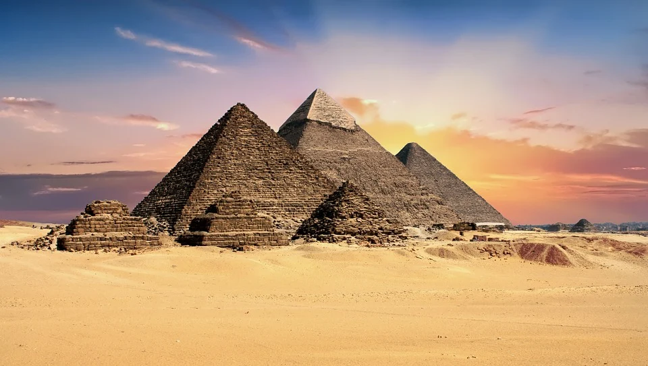
O und P
Orange - orange
Pyramide - pyramid
© Pixabay
© Pixabay
© GET Across Borders
11

Slide 12
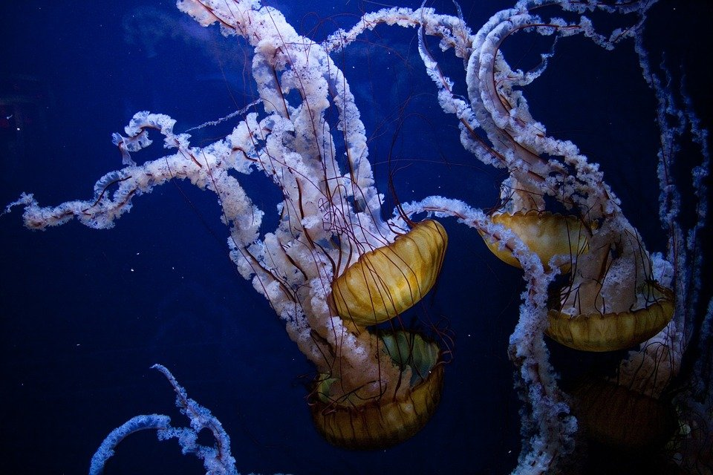
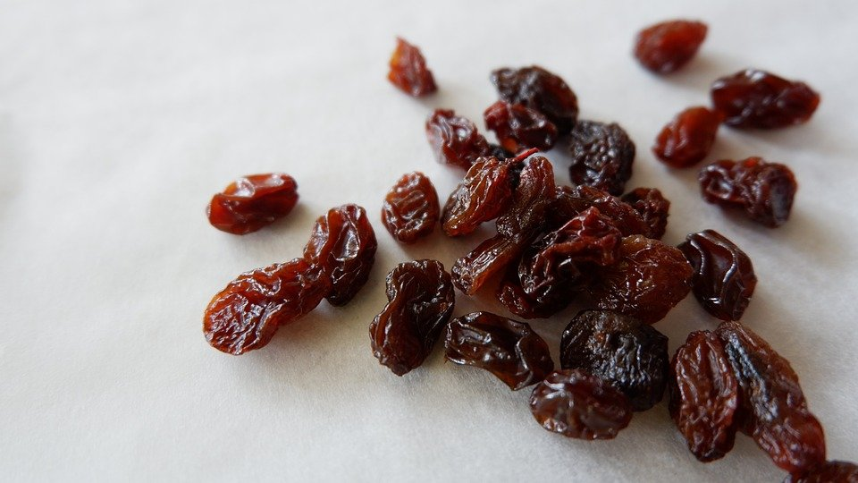
Q und R
Qualle - jellyfish
Rosine - raisin
© Pixabay
© Pixabay
© GET Across Borders
12

Slide 13
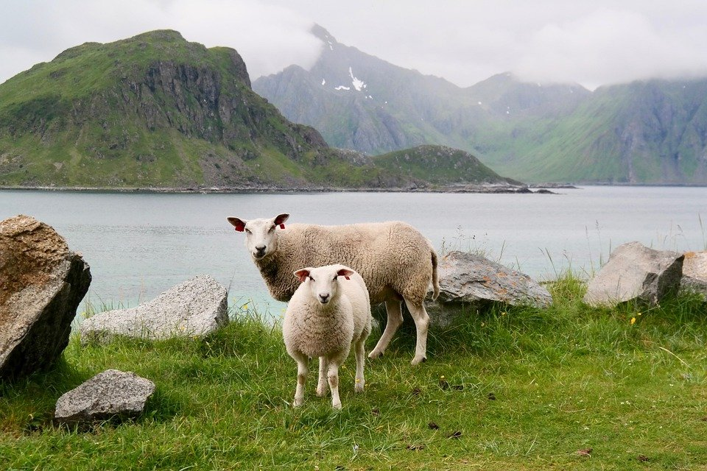
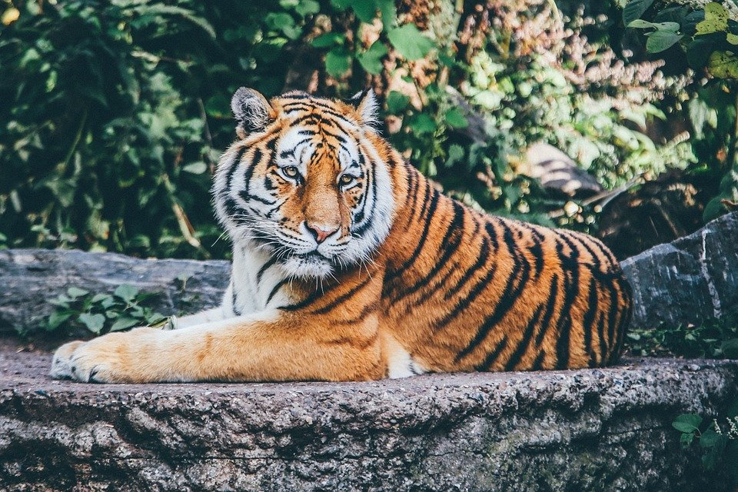
S und T
Schaf - sheep
Tiger - tiger
© Pixabay
© Pixabay
© GET Across Borders
13

Slide 14
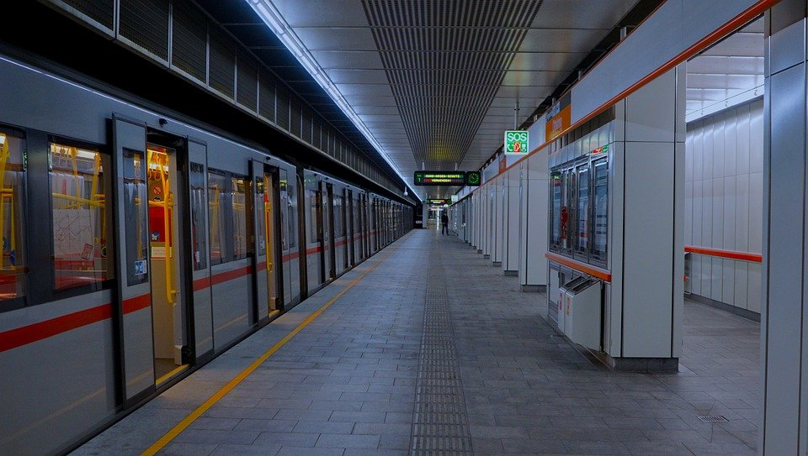
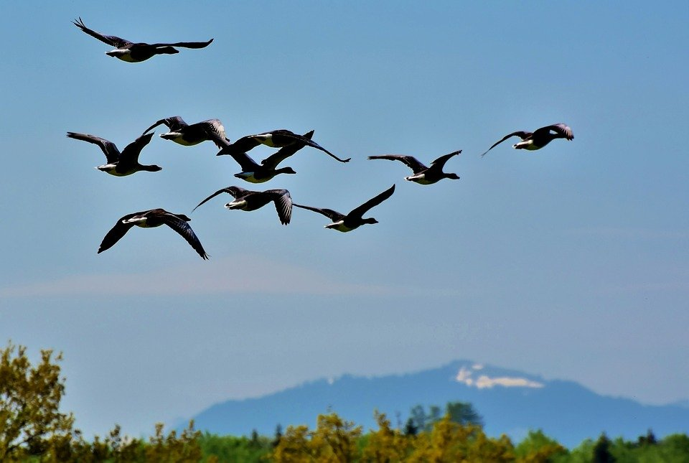
U und V
U-Bahn – underground railway
Vogel - birds
© Pixabay
© Pixabay
© GET Across Borders
14

Slide 15

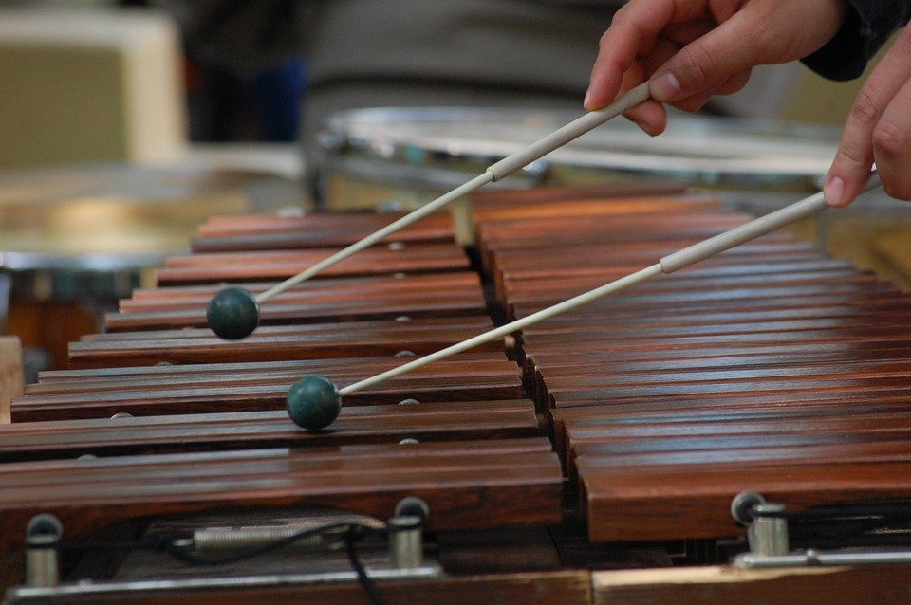
W und X
Wasser - water
Xylophon - xylophone
© Pixabay
© Pixabay
© GET Across Borders
15

Slide 16
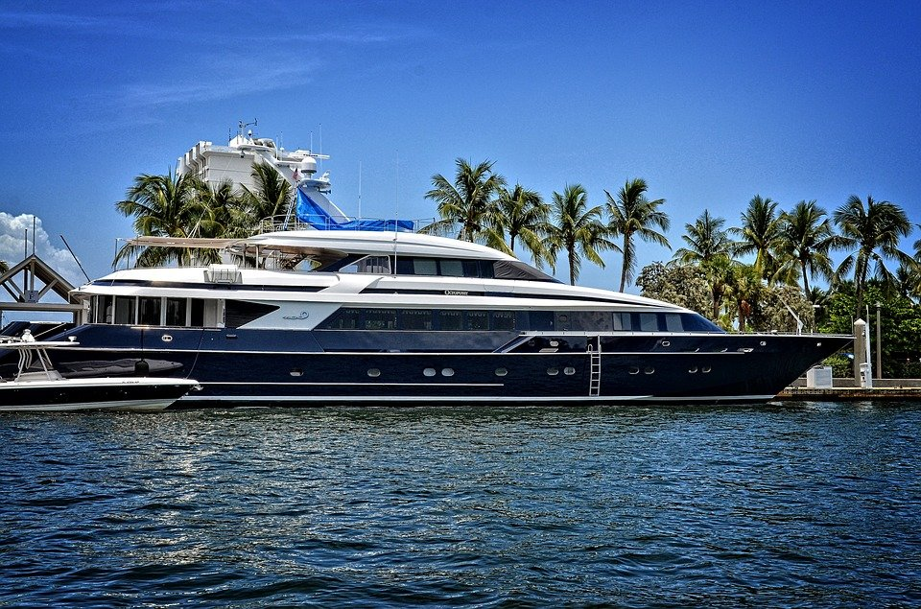
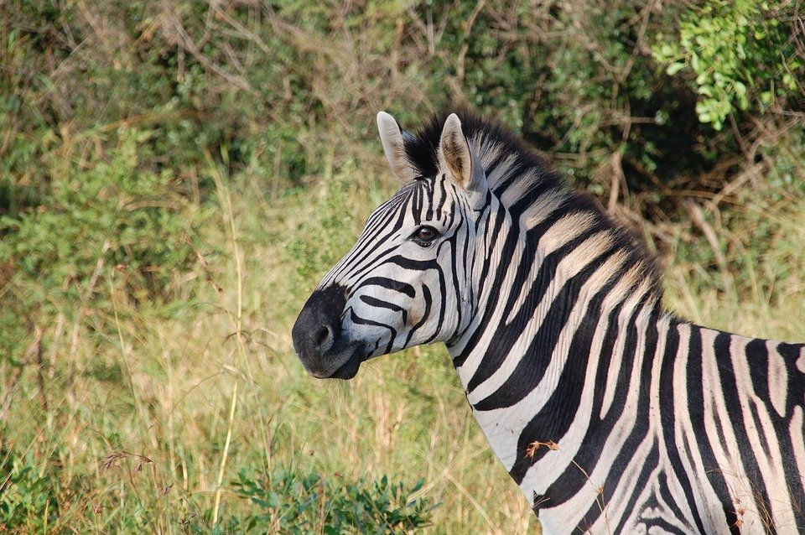
Y und Z
Yacht - yacht
Zebra - zebra
© Pixabay
© Pixabay
© GET Across Borders
16

Slide 17
Alphabet Song
Sing the German alphabet to the melody of “Twinkle, twinkle little star“!
You will find a version below.
© GET Across Borders
17

Slide 18
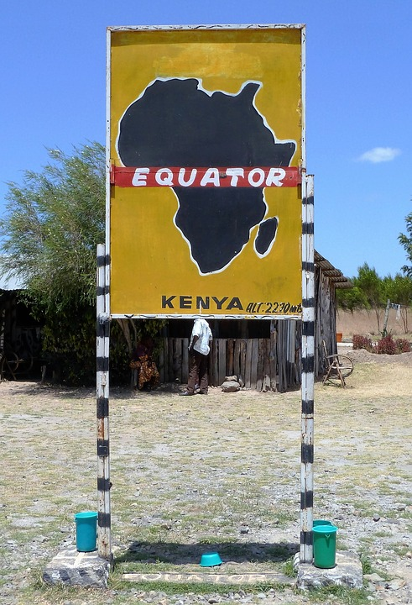
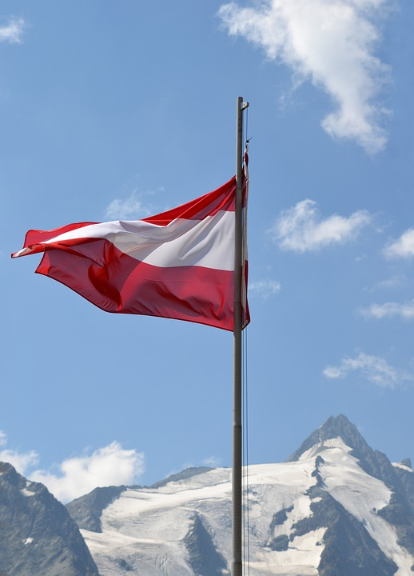
Ä und Ö
Äquator – Equator
Österreich – Austria
© Pixabay
© Pixabay
© GET Across Borders
18

Slide 19
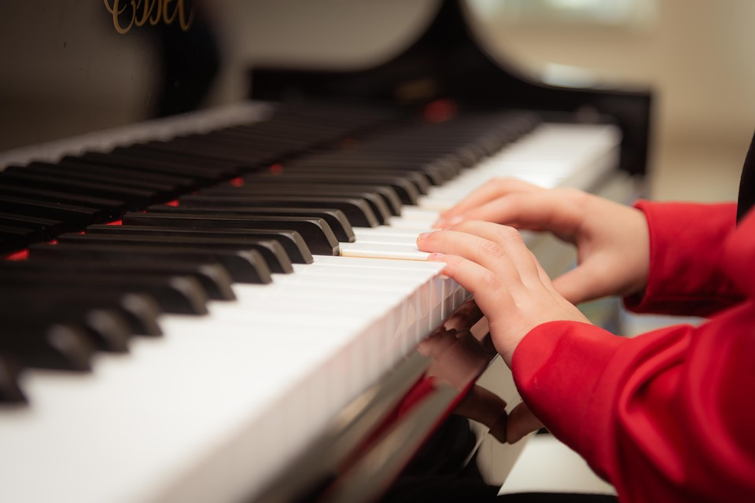
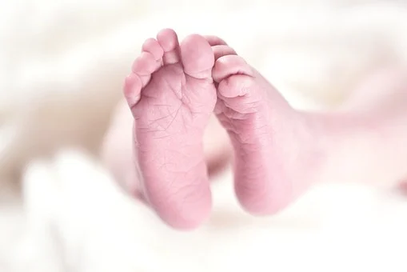
Ü und ß
üben – to practice
Fuß - foot
© Pixabay
© Pixabay
© GET Across Borders
19

Slide 20
Zusammenfassung
The German alphabet consists of the same 26 letters as the English alphabet.
Only the pronunciation is different at times.
The special characters “Ä”, “Ö”, “Ü” and “ß” are not found in the English language.
© GET Across Borders
20

Slide 21
Sources
https://pixabay.com/de/photos/%C3%A4pfel-obst-rot-saftig-reif-634572/
https://pixabay.com/de/photos/bananen-fr%C3%BCchte-lebensmittel-698608/
https://pixabay.com/de/photos/auto-citroen-2cv-rot-klassiker-569269/
https://pixabay.com/de/photos/landschaft-berg-himmel-wolken-3969074/
https://pixabay.com/de/photos/search/esel/
https://pixabay.com/de/photos/kugel-stadion-fu%C3%9Fball-sport-488700/
https://pixabay.com/de/photos/gitarre-konzertgitarre-756326/
https://pixabay.com/de/photos/igel-tier-stacheln-natur-s%C3%A4ugetier-3703244/
https://pixabay.com/de/photos/baby-junge-kinder-kind-bezaubernd-2098881/
https://pixabay.com/de/photos/bollywood-film-kino-indien-theater-1687410/
https://pixabay.com/de/photos/peru-machu-picchu-lama-2774925/
© GET Across Borders
21

Slide 22
Sources
https://pixabay.com/de/photos/maus-nagetier-niedlich-s%C3%A4ugetier-1708347/
https://pixabay.com/de/photos/afrika-%C3%A4quator-zeichen-kenia-1798548/
https://pixabay.com/de/photos/%C3%B6sterreich-fahne-gro%C3%9Fglockner-alpen-1224683/
https://pixabay.com/de/photos/n%C3%BCsse-mandeln-haseln%C3%BCsse-mix-1118233/
https://pixabay.com/de/photos/apfelsine-orange-zitrusfrucht-obst-1995056/
https://pixabay.com/de/images/search/%C3%A4gypten/
https://pixabay.com/de/photos/qualle-unterwasser-ozean-meer-tier-690472/
https://pixabay.com/de/photos/rosine-schwarze-johannisbeere-2772204/
https://pixabay.com/de/photos/schaf-lamm-wasser-berge-meer-gr%C3%BCn-5215213/
https://pixabay.com/de/photos/tier-tiger-gro%C3%9Fe-katze-safari-1868911/
© GET Across Borders
22

Slide 23
Sources
https://pixabay.com/de/photos/vienna-rolltreppe-u-bahn-rolltreppe-5103169/
https://pixabay.com/de/photos/wildg%C3%A4nse-graug%C3%A4nse-gans-v%C3%B6gel-3933488/
https://pixabay.com/de/photos/tropfen-wasser-wasser-wellen-578897/
https://pixabay.com/de/photos/musik-percussion-akku-ton-3534990/
https://pixabay.com/de/photos/yacht-fort-lauderdale-florida-1604478/
https://pixabay.com/de/photos/zebra-tier-safari-pferde-s%C3%A4ugetier-163052/
https://pixabay.com/de/photos/klavier-spielen-lernen-3957650/
https://pixabay.com/de/photos/search/fu%c3%9f/
© GET Across Borders
23

Slide 24
Thank you for learning German with us! ☺
DISCLAIMER: Please note that any resources uploaded to this website are purely for educational purposes only. If any of the items, photos or texts uploaded are in infringement of copyright then please do not hesitate to contact us and we will have them removed.
© 2020 – GET Across Borders and © Leap4Joy

