Slide 1
GET Buddied Up
German with Ali, the Eagle
get-across-borders@uni-mainz.de
© 2020 - GET Across Borders

Slide 2
Deutsch lernen mit Ali, unserem Adler Sigrid Rieuwerts get-across-borders@uni-mainz.de

Slide 3
Willkommen!
What we’re going to learn today …
→ the months of the year
But first we’re going to repeat …
the days of the week
© GET Across Borders
3

Slide 4
Task: Connect the German words with their English form!
Samstag
Donnerstag
Montag
Mittwoch
Freitag
Sonntag
Dienstag
Monday
Tuesday
Wednesday
Thursday
Friday
Saturday
Sunday
© GET Across Borders
4

Slide 5
Task: Put the German days of the week into the correct order!
Dienstag
Freitag
Montag
Samstag
Mittwoch
Donnerstag
Sonntag
Montag
Dienstag
Mittwoch
Donnerstag
Freitag
Samstag
Sonntag
© GET Across Borders
5

Slide 6
The months
die Monate – the months
Januar
Februar
März
April
Mai
Juni
Juli
August
September
Oktober
November
Dezember
© GET Across Borders
6

Slide 7
How to remember them easily?
Januar leave out the -y
Februar leave out the -y
März a →ä, z →ch
April
Mai y → i
Juni e → i
Juli y → i
August
September
Oktober c → k
November
Dezember c → z
…capitalisation!
© GET Across Borders
7

Slide 8
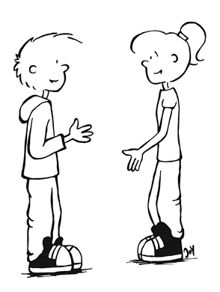
The months
Welchen Monat haben wir?
What month is it?
Wir haben …
It is …
© GET Across Borders
8

Slide 9
Quiz
Look at the following pictures.
Think about which month the picture might show (in German!).
Question:
Welcher Monat ist das? Which month is it?
© GET Across Borders
9

Slide 10
Welcher Monat ist das? November oder Dezember?
Das ist Dezember.
Frohe Weihnachten!
Merry Christmas!
©Pixabay
© GET Across Borders
10

Slide 11
Welcher Monat ist das? Februar oder Oktober?
Das ist Oktober.
Fröhliches Halloween!
Happy Halloween!
©Pixabay
© GET Across Borders
11

Slide 12
Welcher Monat ist das? September oder Mai?
Das ist September.
©Pixabay
© GET Across Borders
12

Slide 13
Welcher Monat ist das? Juni oder April?
Das ist April.
Frohe Ostern!
Happy Easter!
©Pixabay
© GET Across Borders
13

Slide 14
Sources
https://pixabay.com/de/photos/weihnachten-weihnachtsbaum-1869902/
https://pixabay.com/de/photos/halloween-gruselig-jack-o-laterne-2905531/
https://pixabay.com/de/photos/herbst-rot-saison-wald-natur-1072821/
https://pixabay.com/de/photos/ostereier-suche-kinder-m%C3%A4dchen-388364/
Ideas from teaching material developed by former GET Sabrina Koch
© GET Across Borders
14

Slide 15
Thank you for learning German with us! ☺
DISCLAIMER: Please note that any resources uploaded to this website are purely for educational purposes only. If any of the items, photos or texts uploaded are in infringement of copyright then please do not hesitate to contact us and we will have them removed.
© 2020 – GET Across Borders and © Leap4Joy

