Slide 1






GET Buddied Up
German with Ali, the Eagle
get-across-borders@uni-mainz.de
© 2020 - GET Across Borders

Slide 2
Deutsch lernen mit Ali, unserem Adler
Sigrid Rieuwerts get-across-borders@uni-mainz.de

Slide 3
Willkommen!
What we’re going to learn today…
How to talk about which day it is.
© GET Across Borders

Slide 4


Die Wochentage
Donnerstag
Dienstag
Montag
Mittwoch
Samstag
Freitag
Sonntag
Which is the corresponding English day of the week?
Think about it and check with the solutions on the next slide!
© GET Across Borders

Slide 5
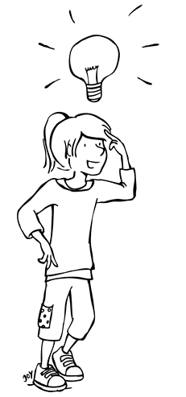
Die Wochentage
Donnerstag = Thursday
Dienstag = Tuesday
Montag = Monday
Mittwoch = Wednesday
Samstag = Saturday
Freitag = Friday
Sonntag = Sunday
Do you know the right order?
Look at the next slide!
© GET Across Borders

Slide 6
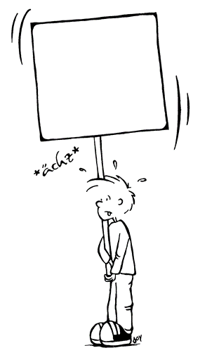

Die Wochentage
Montag
Dienstag
Mittwoch
Donnerstag
Freitag
Samstag
Sonntag
Listen
and
repeat!
© GET Across Borders

Slide 7

Welchen Tag haben wir heute?/
Welcher Tag ist es?
What day is it today?
Heute ist…
Today is…
© GET Across Borders

Slide 8

Task: Welchen Tag haben wir heute?
Think about the days we’re looking for and write them down.
After that, talk to your partner and take turns at telling each other which day it is.
One of you asks “Welchen Tag haben wir heute?” and the other one answers the question.
Begin with “Heute ist” and end with the day you have written down.
Check with the solutions!
© GET Across Borders

Slide 9


Welchen Tag haben wir heute?
Write down the day of the week we‘re looking for!
F_ _ i t _ g
M o _ _ a g
S_ n n t _ _
M _ t t _ o c _
D o _ n e _s t _ _
S a _ s _ a g
D i e _ _ _ a g
© GET Across Borders

Slide 10


Solutions
Heute ist … Freitag.
Heute ist … Montag.
Heute ist … Sonntag.
Heute ist … Mittwoch.
Heute ist … Donnerstag.
Heute ist … Samstag.
Heute ist … Dienstag.
© GET Across Borders

Slide 11

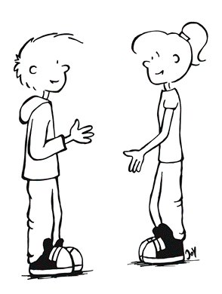
Task: Welchen Tag haben wir heute?
Take turns!
Heute ist…
Welchen Tag haben wir heute?
© GET Across Borders

Slide 12
Thank you for learning German with us! ☺
DISCLAIMER: Please note that any resources uploaded to this website are purely for educational purposes only. If any of the items, photos or texts uploaded are in infringement of copyright then please do not hesitate to contact us and we will have them removed.
© 2020 – GET Across Borders and © Leap4Joy

