Slide 1
GET Buddied Up
German with Ali, the Eagle
get-across-borders@uni-mainz.de
© 2020 - GET Across Borders

Slide 2
Deutsch lernen mit Ali, unserem Adler Sigrid Rieuwerts get-across-borders@uni-mainz.de

Slide 3
Willkommen!
What we’re going to learn today…
How to say the months in German.
© 2020 - GET Across Borders

Slide 4
Die Monate
die Monate – the months
Welcher Monat ist es?
Which month is it?
© GET Across Borders

Slide 5
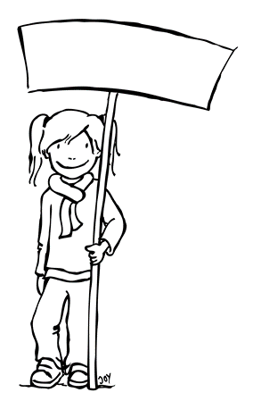
Der Jahresanfang
der Jahresanfang – the beginning of the year
1. Januar
Es ist Januar. - It is January.
2. Februar
Es ist Februar. - It is February.
3. März
Es ist März. - It is March.
4. April
Es ist April. - It is April.
© GET Across Borders

Slide 6
Die Jahresmitte
die Jahresmitte - the middle of the year
5. Mai
Es ist Mai. - It is May.
6. Juni
Es ist Juni. - It is June.
7. Juli
Es ist Juli. - It is July.
8. August
Es ist August. - It is August.
© GET Across Borders

Slide 7
Das Jahresende
das Jahresende – the end of the year
9. September
Es ist September. - It is September.
10. Oktober
Es ist Oktober. - It is October.
11. November
Es ist November. - It is November.
12. Dezember
Es ist Dezember. - It is December.
© GET Across Borders

Slide 8
Aufgabe: Welcher Monat ist es?
Which month is it?
→Try to name the month we are looking for.
Stop the presentation and think about your answer or write it down.
Check your answer with the solution.
© GET Across Borders

Slide 9
Welcher Monat ist es?
Hint 1:
The month starts with a “J“.
Hint 2:
It is the beginning of the year.
Hint 3:
It is very cold during this month.
Solution: Es ist Januar!
© GET Across Borders

Slide 10
Welcher Monat ist es?
Hint 1:
The month starts with an “A“.
Hint 2:
It is the middle of the year.
Hint 3:
It is very sunny and hot during this month.
Solution: Es ist August!
© GET Across Borders

Slide 11
Welcher Monat ist es?
Hint 1:
The month starts with an “O“.
Hint 2:
It is the end of the year.
Hint 3:
The trees are changing their colours during this month.
Solution: Es ist Oktober!
© GET Across Borders

Slide 12
Thank you for learning German with us! ☺
DISCLAIMER: Please note that any resources uploaded to this website are purely for educational purposes only. If any of the items, photos or texts uploaded are in infringement of copyright then please do not hesitate to contact us and we will have them removed.
© 2020 – GET Across Borders and © Leap4Joy

